Slide 1
Plantwide control, energy and orienteering challenge
TexPoint fonts used in EMF.
Read the TexPoint manual before you delete this box.: AAAAAAA

Slide 2
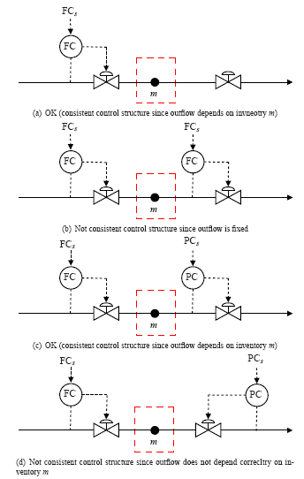
Plantwide control, energy and orienteering challenge
DIPLOMA
WINNER
TexPoint fonts used in EMF.
Read the TexPoint manual before you delete this box.: AAAAAAA

Slide 3
Plantwide control, energy and orienteering challenge
DIPLOMA
LOOSER
TexPoint fonts used in EMF.
Read the TexPoint manual before you delete this box.: AAAAAAA

Slide 4
Plantwide control, energy and orienteering challenge
DIPLOMA
PARTICIPANT
TexPoint fonts used in EMF.
Read the TexPoint manual before you delete this box.: AAAAAAA

Slide 5
5 teams
5 posts in different order + return here (K5)
Solve 6 problems + minimize time
Max 10 points for each problem
Max 20 points for time
  Fastest team to return gets 20 points, slowest 0 points
Other rules
  Must hand in solution before getting next post and problem
  If need help for finding posts or solving problems, call 91371669 (1 min added to time per call)
  Can otherwise use any help (except from PhD students)

Slide 6
Team 1 (no.2, Runner-up; best on time, 59/80)
  Manfred
  Elling
  Audun
  (Federico)
Team 2 (no.5, “Looser”/Loser, last on time, 43/80)
  Ian
  (Morten)
  Marius
  Magnus
Team 3 (no. 4)
  (Heinz)
  Petter
  Deep
  Maryam
Team 4 (no.3)
  Magne
  (Nadi)
  (Truls)
  Stathis
  Esmaeil
Team 5 (no.1, Winner team, 61/80)
  Krister
  Ivar
  Vidar

Slide 7
Posts:
R10 (Vlad)
NTVA (Chriss)
Sem Sælands vei 14 (Adriana)
Cybernetics (Julian)
Main building (Vini)
K5 (return) (Sigurd, Johannes)
Team 1: 1, 2, 3, 4, 5, 6
Team 2: 3, 2, 1, 4, 5, 6
Team 3: 2, 1, 3, 5, 4, 6
Team 4: 4, 5, 1, 2, 3, 6
Team 5: 5, 4, 3, 2, 1, 6

Slide 8
Problem 1. PI tuning
Team: Post: R10
Propose PI-settings (K_{c} and ¿_{I}) for the following process:
g = (-0.25*s+1)/(3*s*(s+1))
Half rule: g=e-0.75s/3s.
SIMC with tauc=theta=0.75:
Kc=3/2*0.75=2, taui=4*2*0.75=6

Slide 10
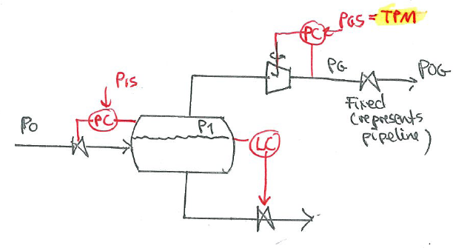
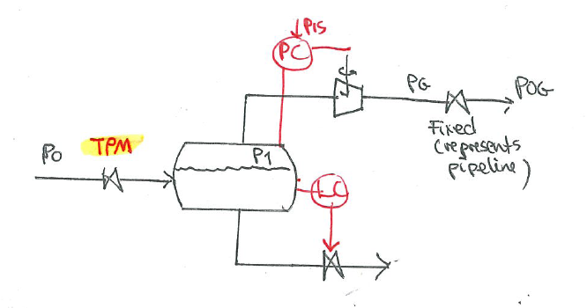

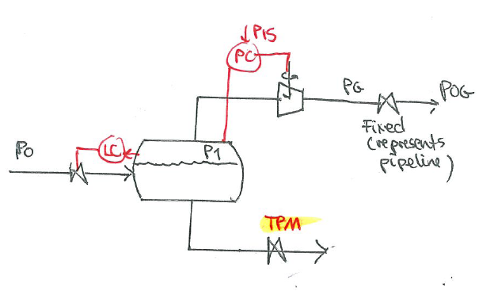
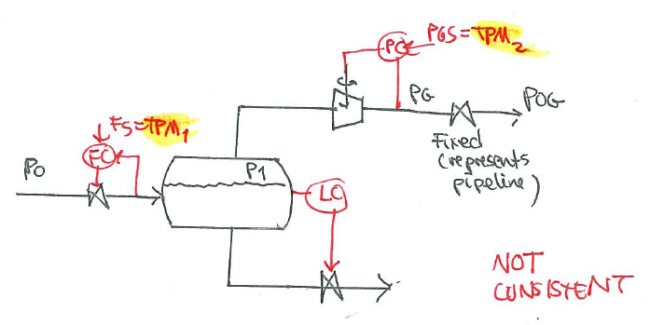

Team: Post: NTVA
Problem 2. Does it work? Yes or No

Slide 12
Team: Post: Sem Sælands vei 14
Problem 3. Distillation
Separation of heavy water from water by distillation is difficult because the difference in boiling point is only 1.4C (relative volatility 1.05). Consider a feed mixture with 1% heavy water and 99% water
(a) What is the minimum* no. of theoretical stages to get a heavy water product of 90% purity and a water product of 99.9% purity?
(b) What if the heavy water should have 99% purity? How large (in %) is the increase in (b1) no. of stages, and (b2) energy usage (Vmin)?
* This is with infinite energy (reflux). In practice, we need about 2-3 times as many stages

Slide 14
Problem 4. RGA
Team: Post: Cybernetics
G =
1.1 2 4 5
-1 0 0 5
2 4 7 9
10 10 0 1
RGA=G.*inv(G)'
5.0000 -9.2727 0.7273 4.5455
-0.1039 0 0 1.1039
-5.1948 x 0.2727 -4.6753
1.2987 -0.3247 0 0.0260
What is x in the RGA?
(b) What pairings would you suggest? (circle pairings on G- or RGA-matrix)
(c) The 1,1-element in G is changed. What value makes G singular?
x = 10.5974
Pairing (for DIC): only one possibility. u1 with y4, u2 qith y3, u3 with y1, u4 with y2
Make G singular: Change 1,1-element to 1.1*(1-1/5)=1*0.8 =0.88

Slide 16
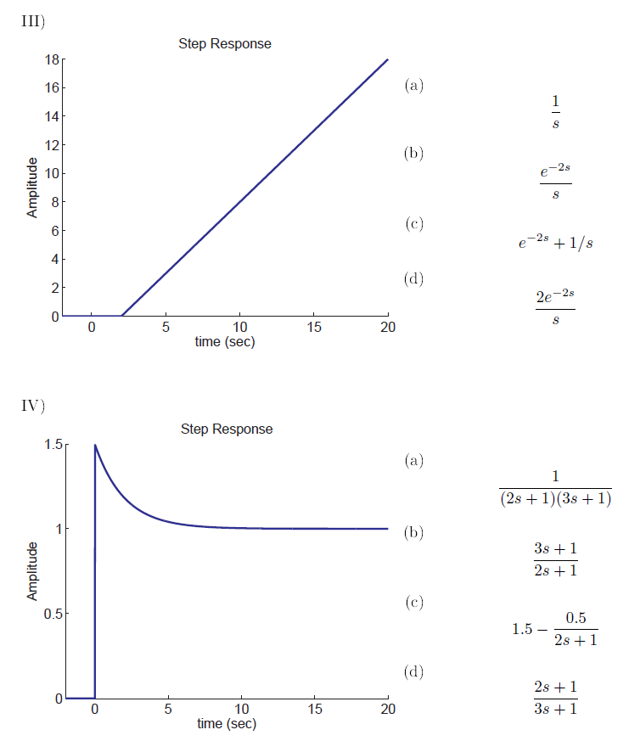
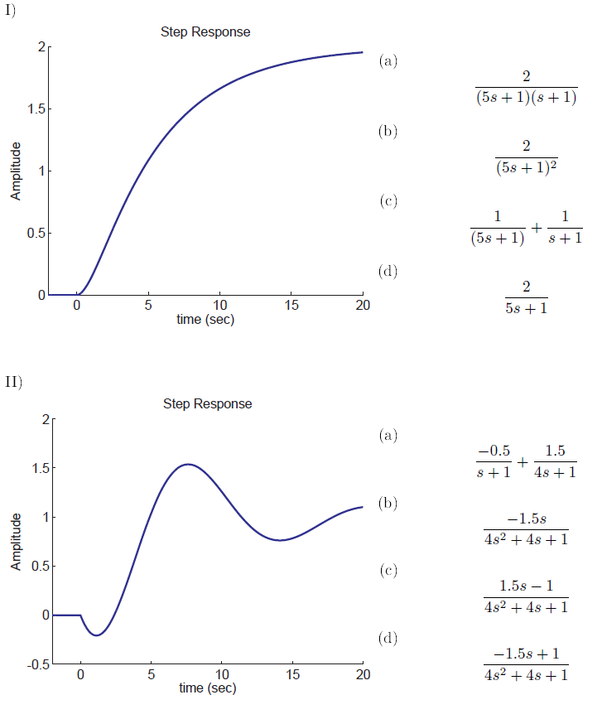
Problem 5. Transfer functions
Team: Post: Main building
Which one is the correct transfer function? Circle the correct alternative.
Note: None of the alternatives or more than one are possible answers
SEE NEXT PAGE!

Slide 17
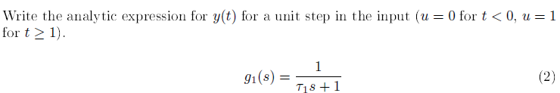
V) y = g₁(s) u

Slide 18
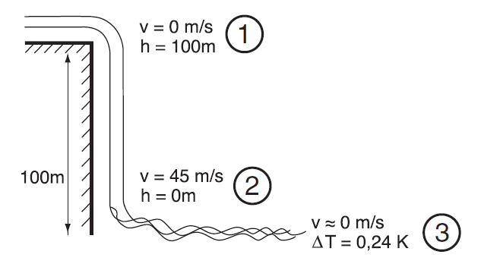
Problem 6. Energy
Team: Post: K5
Waterfall: (1) potential energy -> (2) kinetic energy -> (3) thermal energy
Fill in the two missing numbers
Last post. Please return to K5!

