Slide 1

Sigurd Skogestads
60th celebration day
NTNU, Trondheim
22-08-2015

Slide 2
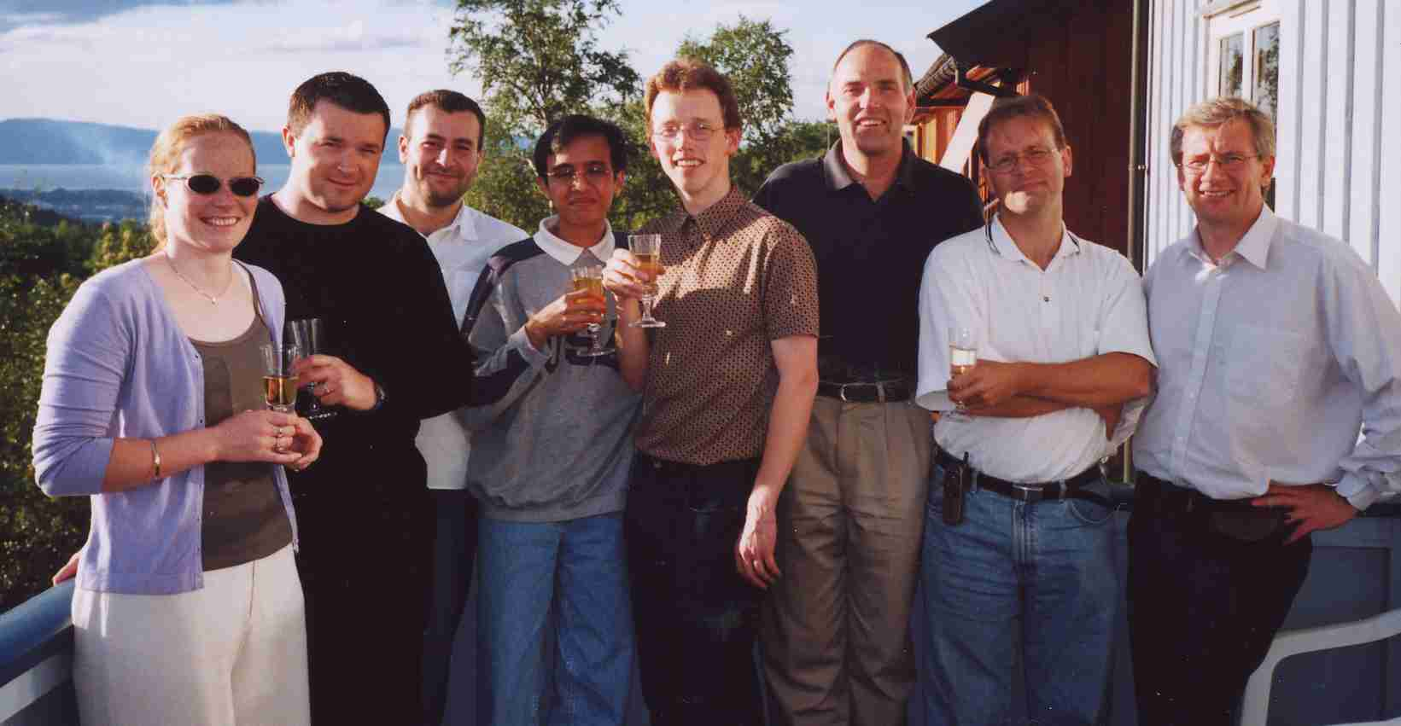
Vidar Alstad
Title: Studies on selection of controlled variables
PhD student number 20
Years: 2000-2005

Slide 3
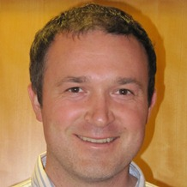
Work bio Vidar Alstad
2005-2007: Norsk Hydro ASA, Oil & Gas, Porsgrunn, Process control engineer
  Process control
  Slug control
2007-2011: Statoil ASA, R&D project manager, Porsgrunn
  Advanced wells
  Model predictive control
2011-2014: Yara International ASA, Porsgrunn, Process control engineer
  Model predictive control
  Control of granulation loops
2014-dd : Yara International ASA, Porsgrunn, R&D Project manager
  Process technology development

Slide 4
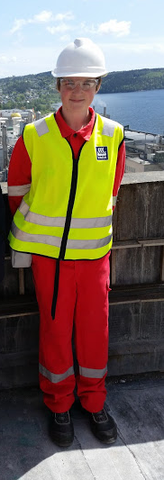
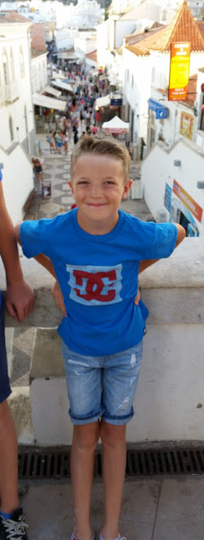

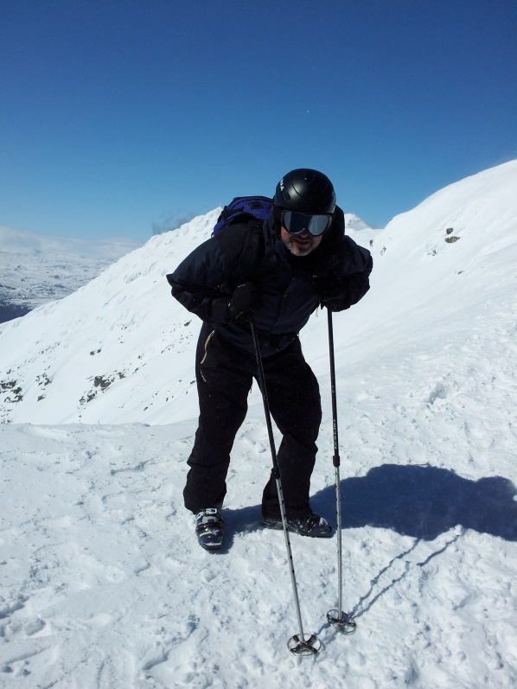
Private bio Vidar Alstad
Married,
Two kids
  Gaute (15)
  Grunde (10)
Interests:
  Kayaking
  Telemark skiing

Slide 5

Control of granulation loops

Slide 6
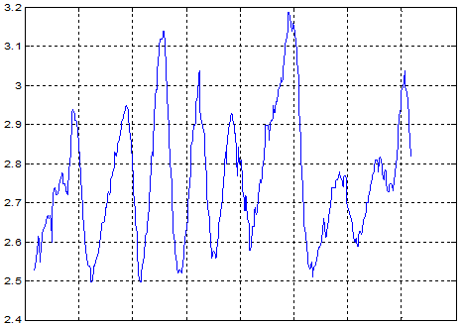
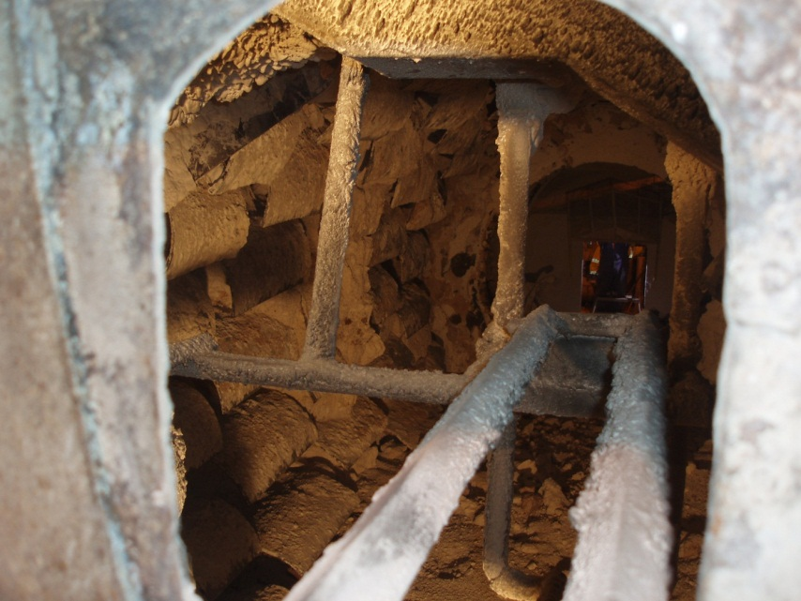
Control of granulation loops
Unsteady limit cycle behavior
Complex chemistry and many disturbances
Not seen as a process control problem

Slide 7
Process control actually can make a difference
Amount of undersize,
oversize and productsize
Particles in recycle stream
Actual production
And previous max
production (red)
140%
120%
100%

