Slide 1
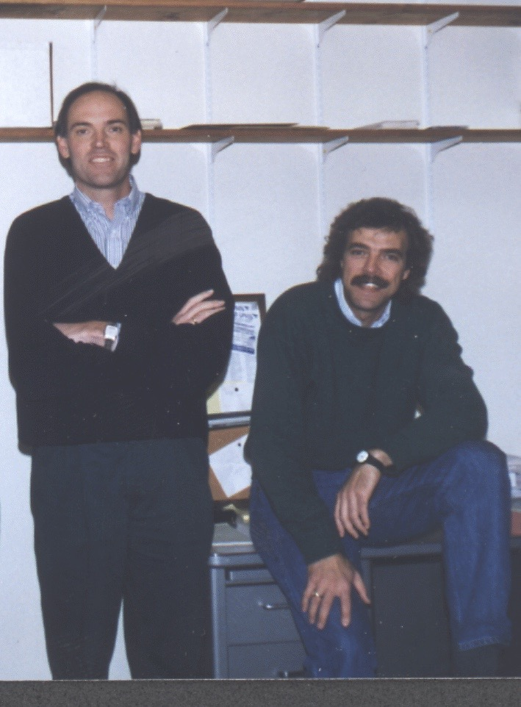
Ian Postlethwaite
PhD Thesis: A complex variable approach to the analysis of linear multivariable feedback systems, 1978.
BSc (Eng), Imperial College
PhD, Cambridge
Research Fellow, Cambridge
Lecturer, Oxford
Professor, Head of Dept, PVC, Leicester
DVC, Northumbria
Director of Corporate Projects, Newcastle

Slide 2
Collaboration with Sigurd
1st ECC, Grenoble 1991, invited to give course on Multivariable Control at next ECC
2nd ECC, Groningen, Robust Multivariable Control: Analysis, Design and Industrial Applications, 1993
Sabbaticals at Berkeley, 1994
Multivariable Feedback Control, 1996
2nd edition 2005

Slide 3
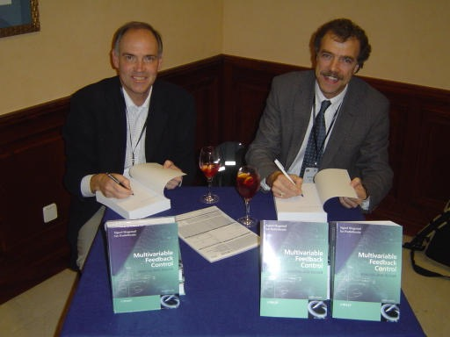
What now? What next?
Now:
Autonomous systems
Singapore campus
Engineering Excellence
Next:
A 3rd edition ?
Hell ?

