Slide 1
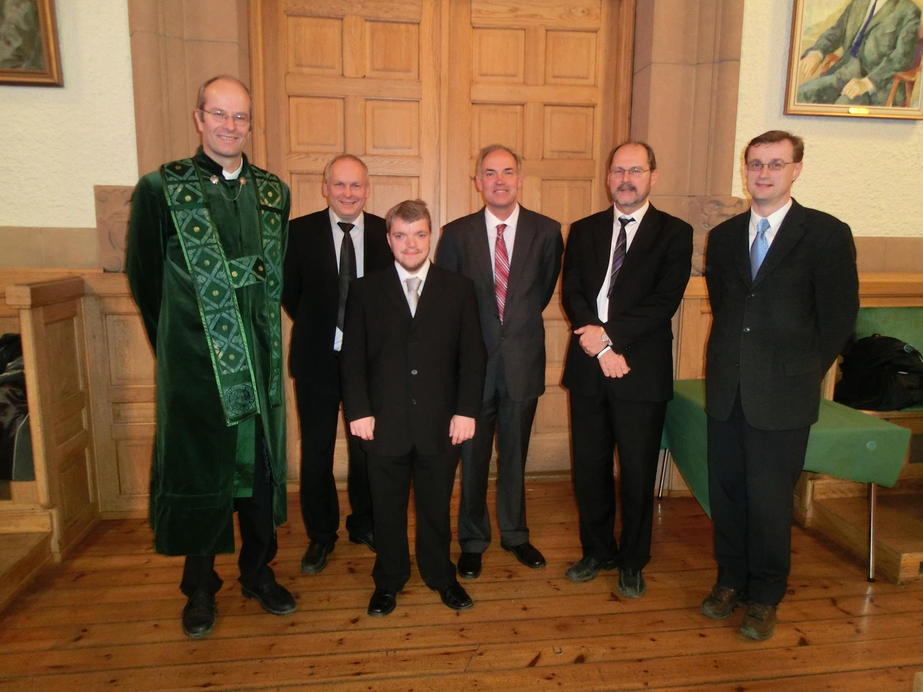
Introduction
Magnus G. Jacobsen
Thesis: «Identifying active constraint regions for optimal operation of process plants» (2011)
Picture from defense. I look quite
small next to prof. Gregersen …

Slide 2
More about me
I like to play guitar and football, and to go mountain hiking.

Slide 4
What do I do now?
Working at Integrated Operations department in ABB, Oslo
Current project: Improving control and performance of water treatment system at Nyhamna (gas plant in Aukra outside Molde)
Former projects:
Process performance monitoring system for the Goliat FPSO project.
Implementing thermodynamics calculations in a computing tool for use in the project
Internal teaching of basic chemical engineering

