Slide 1
Structuring
the Structures
Krister Forsman
2015-08-22

Slide 2
Control structures – an ad-hoc adventure?
Classical control structures:
cascade; at least 3 different versions
feedforward
ratio control; at least 5 different versions
valve position control, a.k.a. mid-ranging, input resetting, habituating control; at least 4 different versions
floating setpoint (VPC on self)
parallel control (2 MVs, 1 CV)
conditional control (1 MV, 2 CVs), a.k.a selector control
split-range
My mission
Document what’s out there
Systematic (algorithmic) procedure for selecting a structure
Pros and cons compared to MPC
Where are there gaps in the theory?

Slide 3
Control structures Jeopardy
In a typical text book, or control course, control structures are presented in the “Jeopardy” way: Here is the answer, you come up with the question.
Unfortunately, this is also the case among many practitioners:
A control solution is suggested before it is even clear what the specifications are

Slide 4
Some history
Apparently this is an area where application came before theory.
The first textbooks dedicated to process control appear in the 50s.
Feedforward used at least since 1925 [2]
Important contributions by Mason, Shinskey, Balchen and many others.
In spite of the wide [...] application of automatic supervision in engineering
the science of the automatic regulation of temperature is at present in the anomalous position
of having erected a vast practical edifice on negligible theoretical foundations. ([3] 1934)
[1] S. Bennet: A history of control engineering 1930-1955. Inst EE. 1993
[2] N.A. Anderson: Instrumentation for Process Measurement and Control. Chilton, 1964.
[3] A. Ivanoff: Theoretical foundations of the automatic regulation of temperature. J. Institute of Fuel, Vol 7, pp. 117-130, 1934

Slide 5
“Classical structures”? Scope
What I mean by “classical structures”
More than one PV and/or more than one MV
Not just variable pairing
Not paradigms where a process model is explicitly present in the controller
For example the SISO controller below is not within the scope of this study
F₁
F₁
u
P
y
r
+
F₂

Slide 6
Borderline case: Floating SP control
The structure below (“VPC on self”) does not fall within the definition of “classical control structures”
r₁
C₁
u₁
P₁
y
r₂
u₂
C₂
y₂
Equivalent:
r₂
r₁
u₁
-
C₂
-
C₁
P₁
y

Slide 7
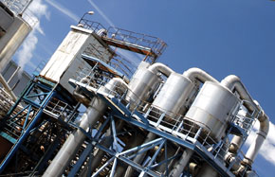
Categories for classification
Most obvious: Number of PVs, CVs and MVs (process variables, controlled vars, manipulated vars)
Reason for using the structure
1: SISO control could be used
Would stabilize the process, but a structure can give improved disturbance rejection
Handle nonlinearity; this can be seen as a sub-category of the previous one
2: SISO control cannot be used
Multivariable problem; extra degrees of freedom
Specifications involve several variables
MPC can be used for all multivariable problems, of course.
Topological properties, using e.g. graph theoretical tools
Graph isomorphism
Fundamental properties
Application based
1: List of processes (evaporator, ....)
2: Topology and nonlinearities of process

Slide 8
Categorization by [PV,CV,MV]
Structure | #PVs | #CVs | #MVs | #Controllers
Cascade control | 2 | 2 | 1 | 2
Feedforward from external signal | 2 | 1 | 1 | 1
Mid-ranging (VPC) | 1 | 2 | 2 | 2
Split-range | 1 | 1 | 2 | 1
Conditional control; Selector control | 2 | 2 | 1 | 2
Parallel control | 1 | 1 | 2 | 2
Ratio control, fixed ratio | 2 | 2 | 2 | 1 or 2
Ratio in cascade | 3 | 3 | 3 | 2 or 3
This represents a bottom-up approach:
Instrumentation given, what is possible?
If two rows have the same list of numbers,
can both structures be used for solving the same problem?

Slide 9
Categorization by rationale
SISO controller could be used
Cascade control
Feedforward
SISO controller cannot be used
Ratio control
VPC
Parallel control
Split range
By “SISO can be used” I mean:
Fixed setpoint
Steady state error =0 after load disturbance

Slide 10
Example: Pressurized liquid system
How do we automatically adjust the flow control valves
so that the share of liquid going to V1 is controlled
PC
V1
High pressure
Atmos pressure
FT
Thruput manipulator
Fixed flow
FC
FT
V2
Atmos pressure
FT

Slide 11
“Split ratio control”
PC
V1
High pressure
Atmos pressure
FT
PV
+
x
FC
OP
SP
FC
FT
Desired
ratio
V2
Atmos pressure
FT

Slide 12
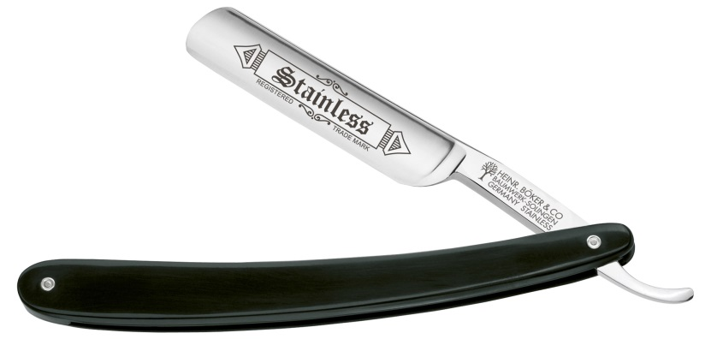
Which is best - MPC or classical structures?
Obviously all classical structures can be captured by MPC in some sense
Are there any reasons for using classical structures?
Advantages of MPC
Directly captures the specifications
One, systematic, procedure for all applications
Disadvantage: If a simple classical structure can solve the problem, the cost for MPC is higher:
manhours for modeling
license fees
maintenance
In some aspects the classical structures may be easier to understand, e.g. robustness: the effect of model errors
There are many applications where it is obvious MPC should be used, because “classical” structure gets too complicated. E.g. when you have many limitations (leading to selector solutions)

