Slide 1

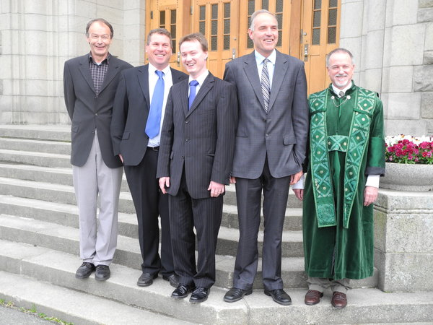
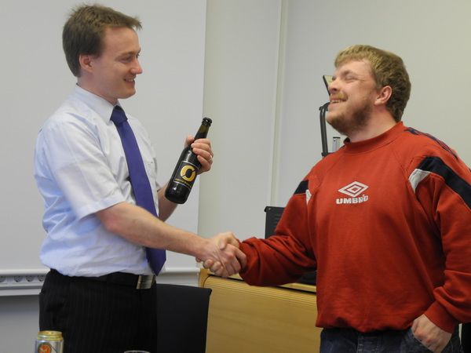
Johannes Jäschke
PhD title: Invariants for optimal operation of process systems, 2011

Slide 2
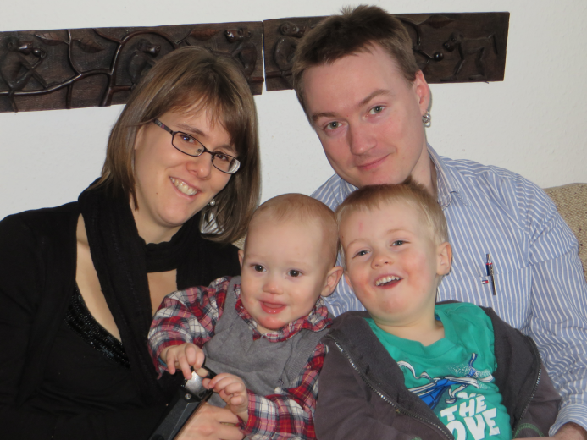



About myself
Born in Germany
Grown up in Tanzania (0-11years)
Married, 2 children
Since 2007 in Norway
Master’s degree Mech. Eng. from RWTH-Aachen University (DE)
PhD Chem. Eng. from NTNU
Postdoc at NTNU
Postdoc at Carnegie Mellon University (Larry Bieglers Group)
Associate professor at NTNU (Subsea oil and gas processing)

Slide 3
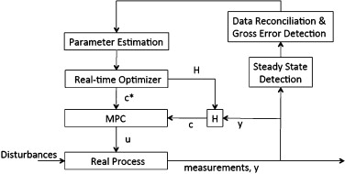
Recent and current control projects
A path-following algorithm for fast economic model predictive control (PD)
Integrating RTO with a self-optimizing control layer using MPC to control SOC variables
Using control degrees of freedom for exending remaining useful life (PhD)
Estimation of unmeasured variables in subsea processing (PhD)
Path of optimal solutions
Corrector step
Predictor step

