Slide 1
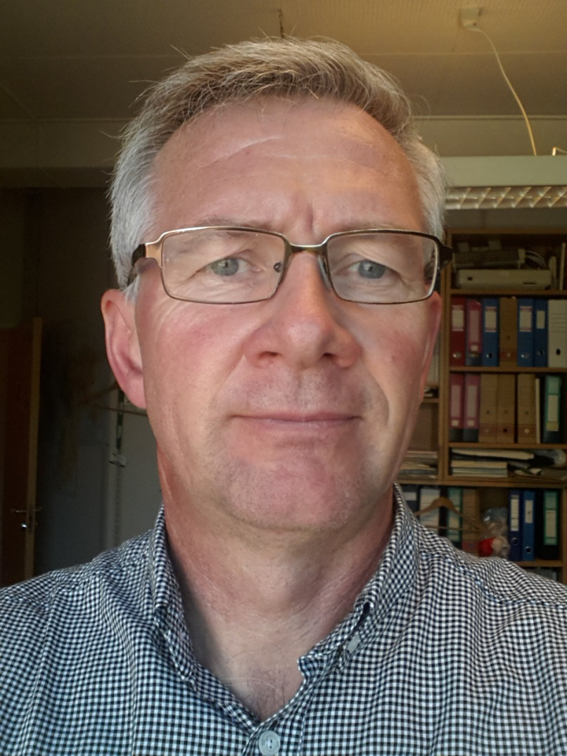
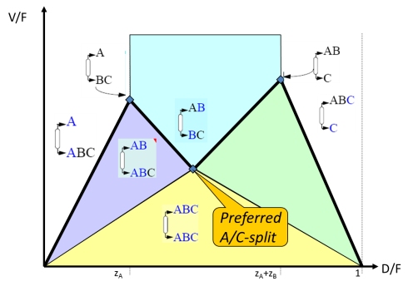
Ivar J. Halvorsen
Phd (May 2001):
Minimum Energy requirements in complex distillation arrangements
Vmin-diagram
Dividing Wall Column

Slide 2
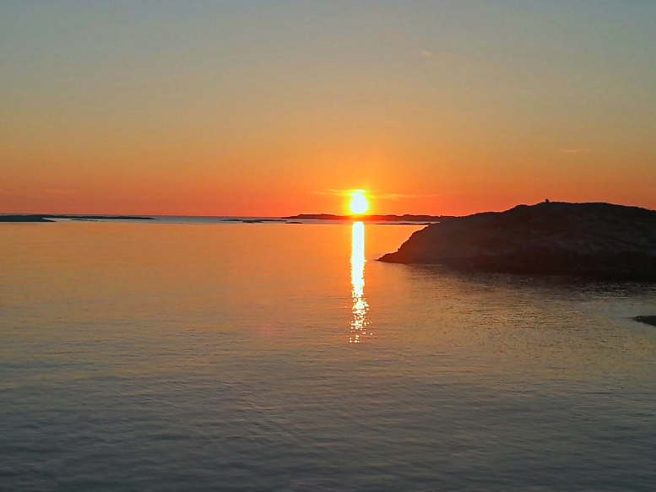
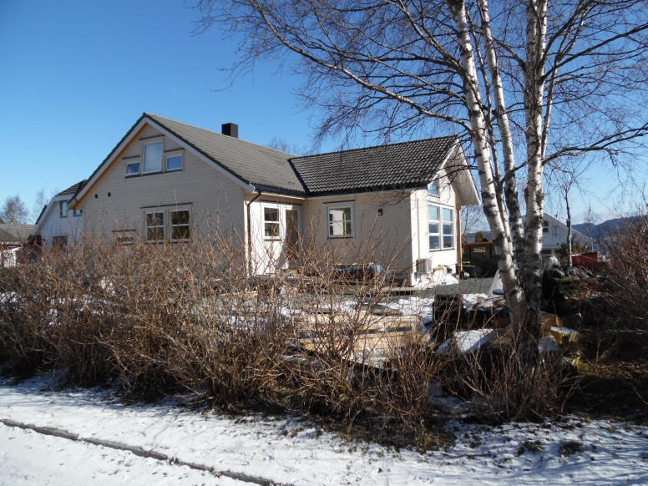
Ivar J. Halvorsen
Born in Øygarden, close to Bergen, 1958.
Married to Toril, 3 children :
Øyvind (26), Berit (24), Maria (20)
Lives at Stavset, Byåsen, Trondheim
MSc: NTH, Dept. of Engineering Cybernetics (ITK) 1982
Kongsberg Våpenfabrikk 1983-1989
SINTEF 1989-1997
Phd in Sigurds group 1997-2001
SINTEF 2001-current:
Senior Scientist at SINTEF ICT, Applied Cybernetics
Various projects related to process control
E.g. BEEDIST 2008-2012 with Sigurd, co-supervisor for Maryam and Deeptanshu

