Slide 1
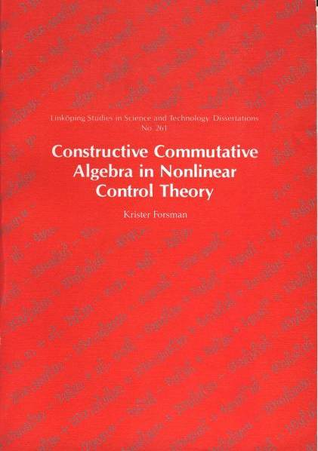
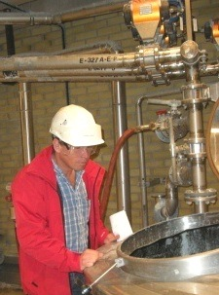
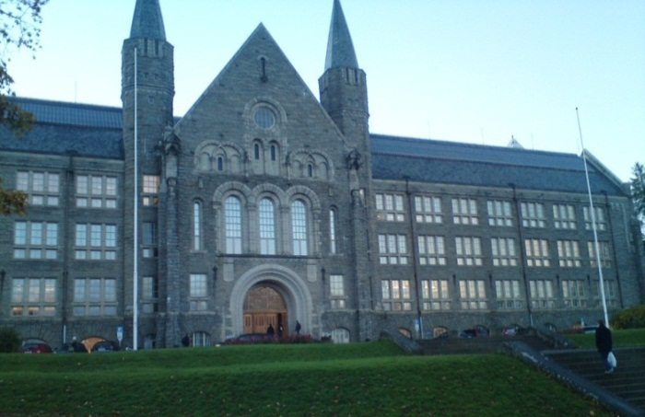
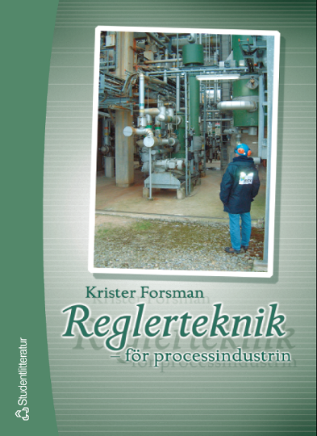
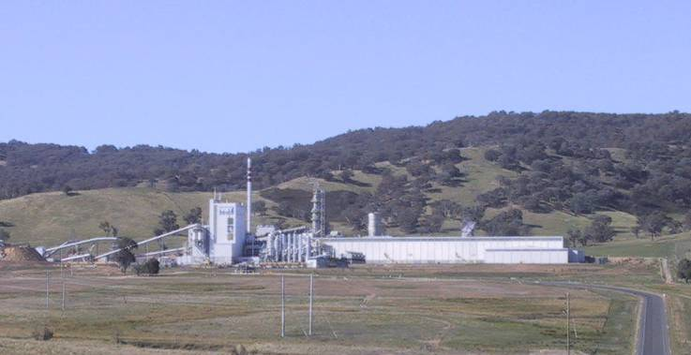
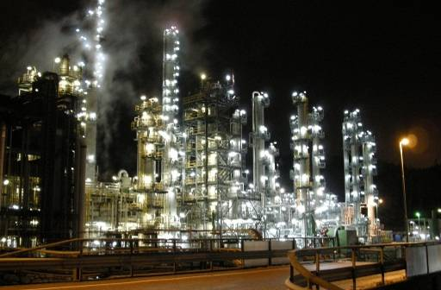
Krister Forsman background
PhD Automatic Control, Linköping University 1991
ABB Corporate Research: 1994-1999
ABB Process Industries: 1999-2003 (ABB Australia 2001-2002)
Self employed consultant: 2003-2005
Perstorp Specialty Chemicals: 2005-
NTNU [part time] Adj Professor: 2012-
Research interests: applications; structures for process control

Slide 2
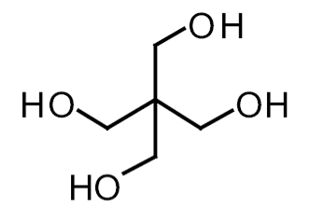
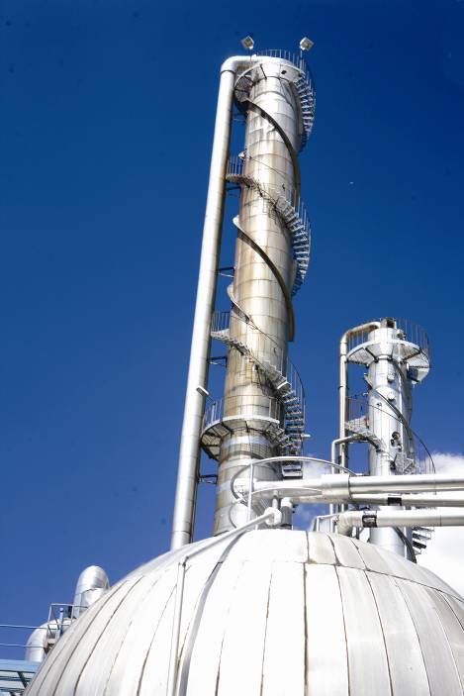
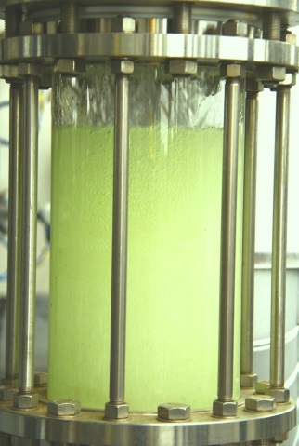
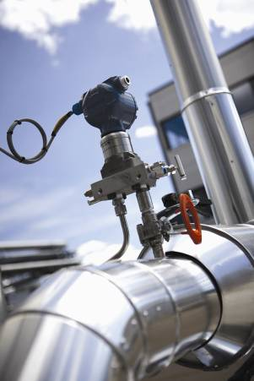
The Perstorp group – short facts
Specialty chemicals company with focus on organic chemistry
Turn-over 2014: >1 GEUR
Owned by PAI Partners – a French equity company.
1500 employees
Products: Mainly additives for other chemical industries
Additives in paints and coatings, plastic-processing and automotive industries: polyols, acids, esters, aldehydes, alcohols, etc
Thermoplastics, plasticizers, food and feed, solvents, bleaching agents, etc
but also end products like feed additives and bio-diesel.
Nine production sites around the world; ~40 plants

Slide 3
