Slide 1
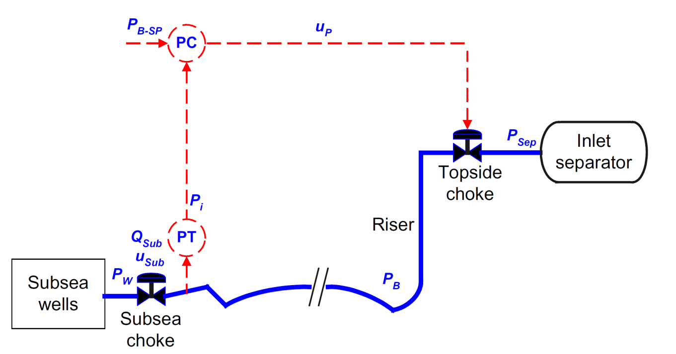
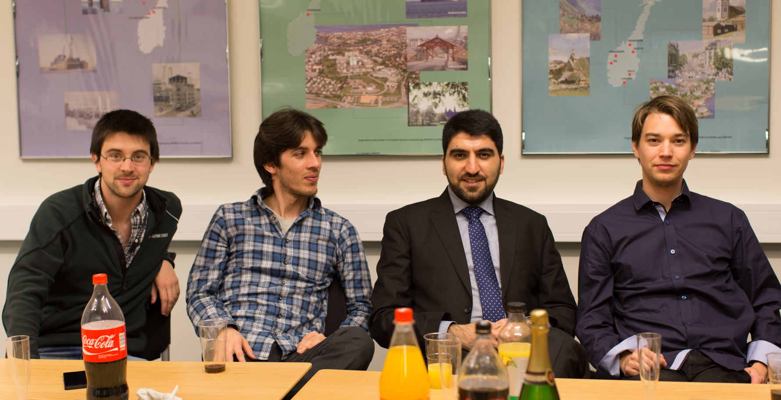
Esmaeil Jahanshahi PhD Thesis: Control Solutions for Multiphase Flow Linear and nonlinear approaches to anti-slug control Defense date: 18.10.2013

Slide 2
Current activities
Siemens (senior development engineer)
PID auto-tuner
Leak detection system
Asset Condition Monitoring (CM)

