Slide 1
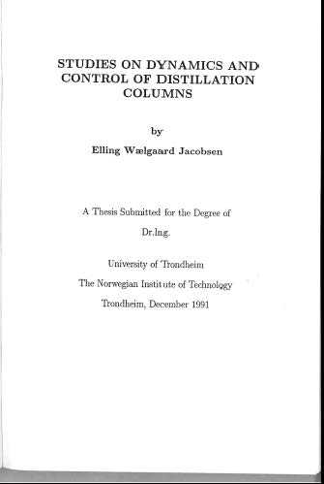
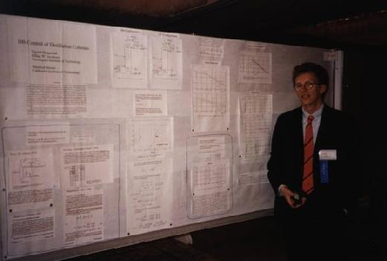
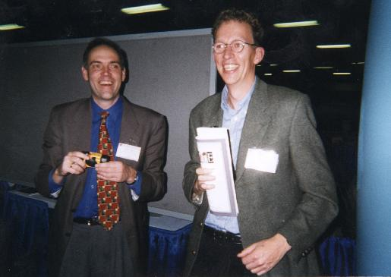
AIChE Annual Meeting 1989
AIChE Annual Meeting 1997

Slide 2
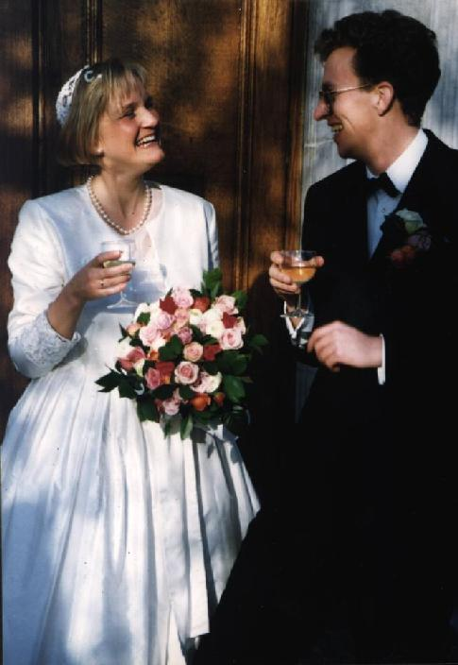
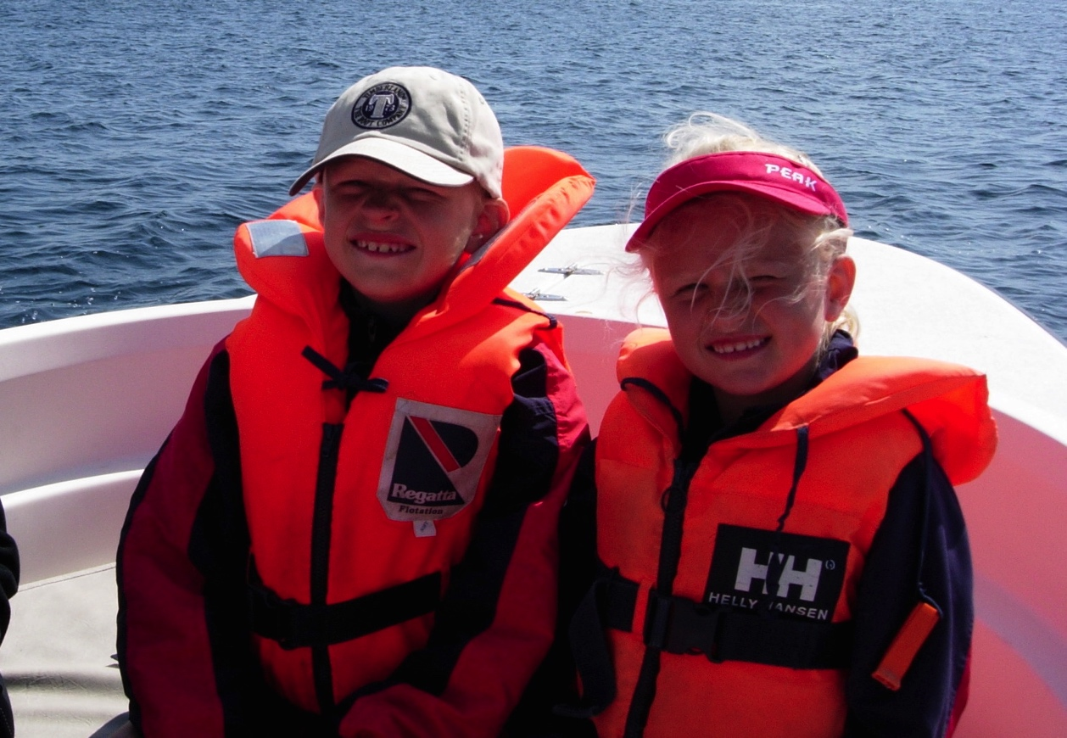
Married to Gry Tingstad, London, 1993
Sten Elling, 1994, Ingrid, 1996
1992-1993: Postdoc, Imperial College, London
1994-: Dep of Automatic Control, KTH, Stockholm

Slide 3
Some Current Research Projects
Systems/Network Biology: inference of intracellular networks with application to e.g., target identification in brain tumors and optimization of mammalian cell growth.
Process control:
model free optimization (extremum seeking control) with application to biofilm reactors
EMPC for grade change in paper machines

