Slide 1
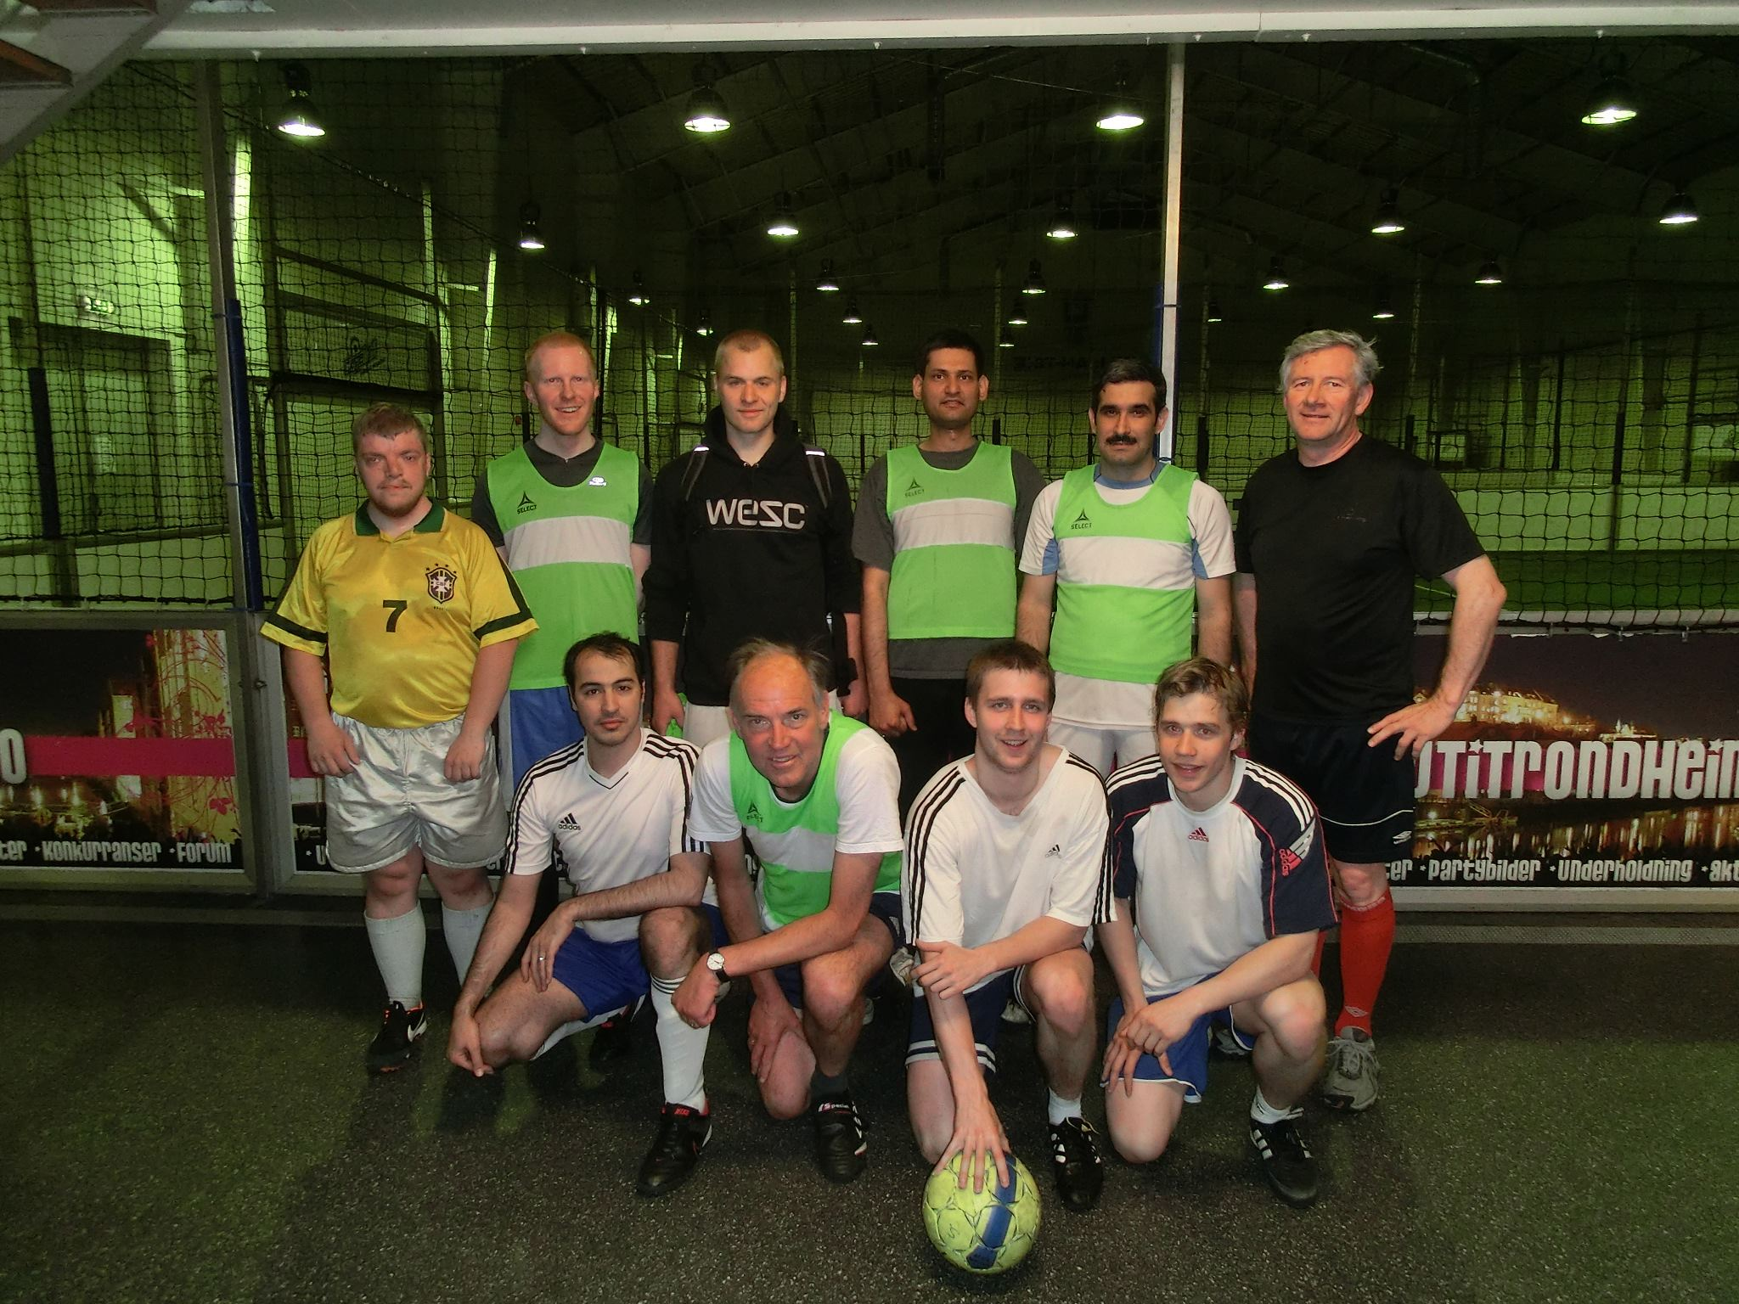
Name: Deeptanshu Dwivedi
Title of PhD: Control and operation of dividing-wall columns with vapor split manipulation, Jan. 2013

Slide 2
Brief overview
Bachelor of Engineering, VTU, Karnataka, India 2001 – 2005
Manager (Process Operations), Reliance Industries Limited, Surat India 2005-2006
Master of Technology, Indian Institute of Tech. Kanpur, India 2006-2008
PhD, NTNU Jan 2009 – May 2012
Safety Engineer, Safetec Nordic AS, Trondheim June 2012- March 2013
Senior Project Engineer, ABB AS, Oslo March 2013 – till date
Process Performance Solutions (Integration Operation)
Process Control
Process Monitoring

Slide 3
Recent Projects
Development of ABB Collaborative Environment, ACE (Goliat, Eni Norway)
a novel web based tool to visualize real time plant data and other applications to assist in monitoring, trouble shooting and collaboration
gathered requirements from customers and assisted in specification of functionalities of ACE
designed dashboards to visualize the KPIs of each system/ equipment in order to support decision related to process optimization, maintenance scheduling/ prioritization etc.
Process monitoring
working on making models for measuring performance degradation of process equipment like heat exchangers, pumps, compressors, heaters, filters, scrubbers etc.
Process Control
Process Control related support to Draugen Platform (Shell Norway)

