Slide 1
Adriana Reyes Lúa
Currently: PhD student
Optimal operation of cooling cycles

Slide 2
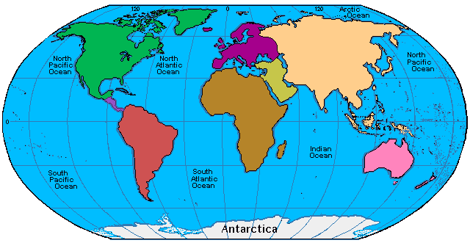
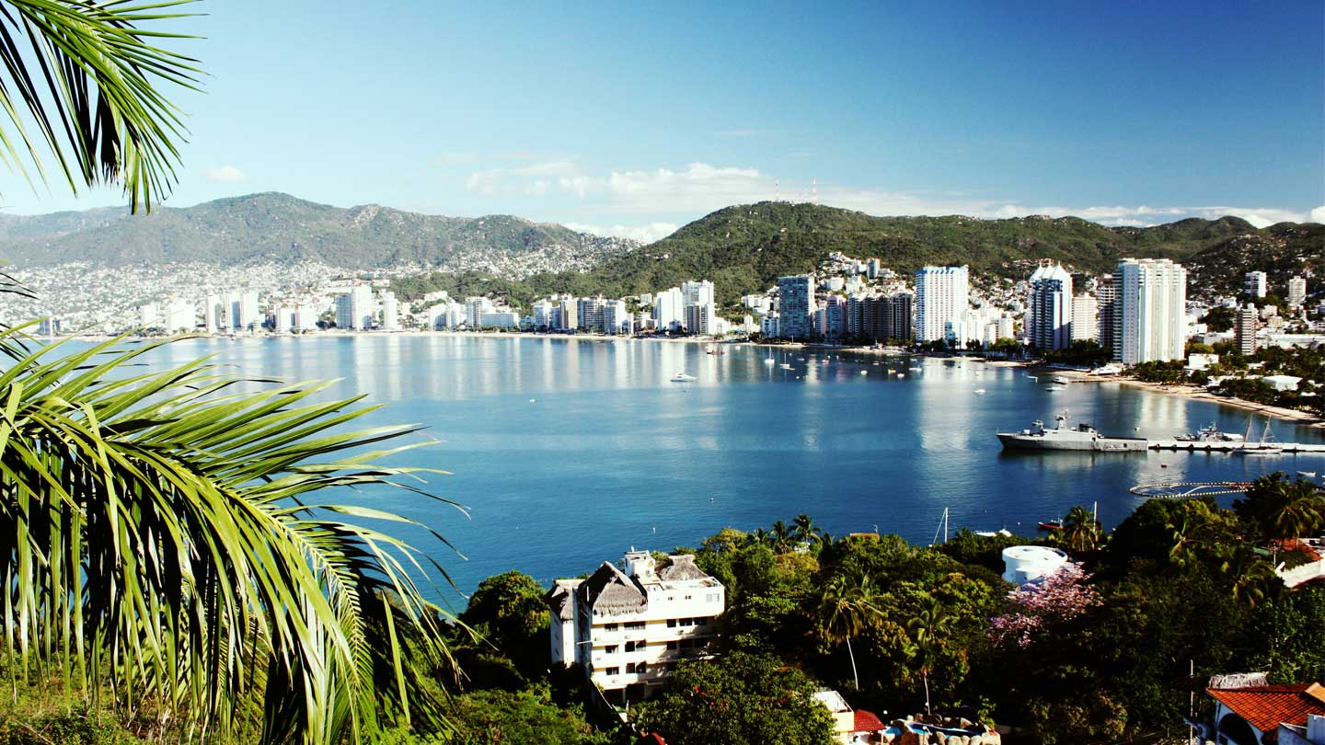
I was born here…

Slide 3
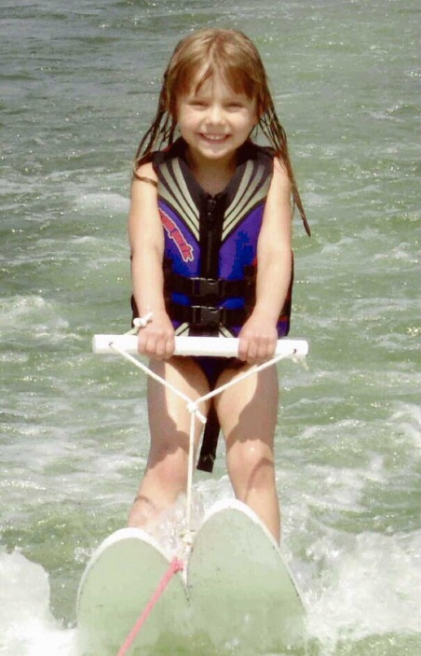
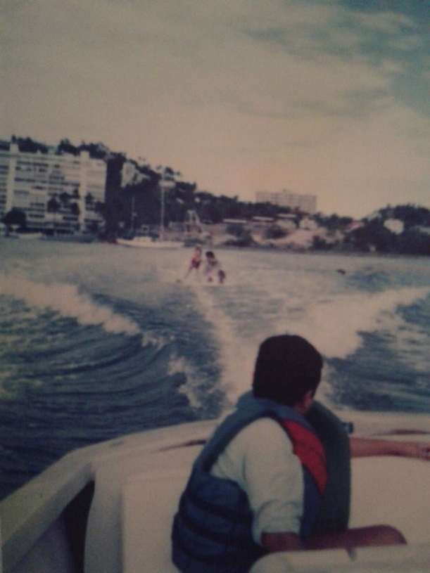
Grew up watching sunsets, wearing shorts, skiing…the other type of skiing

Slide 4
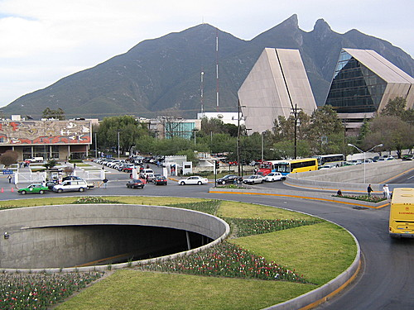
Moved up north to university…

Slide 5
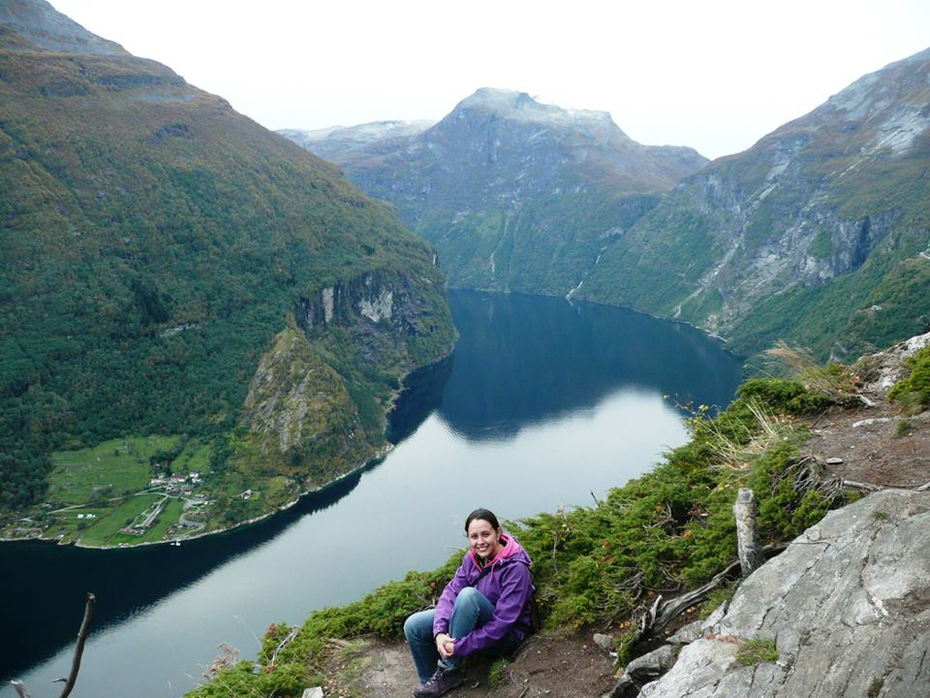
Came to Norway for a master (2012-2014)

Slide 6
In the Process Systems Engineering Group
Master Thesis:
Economic plantwide control
PhD Project:
Optimal operation of cooling cycles
Case study:
Mini-LNG plant for boil-off LNG on carriers.

