Slide 1
Hydraulic consideration in DWC design
Workshop on DWD
October 5-6, 2023, Trondheim
Xigang Yuan
yuanxg@tju.edu.cn
Tianjin University
State Key Laboratory of Chemical Engineering (Tianjin university)

Slide 2
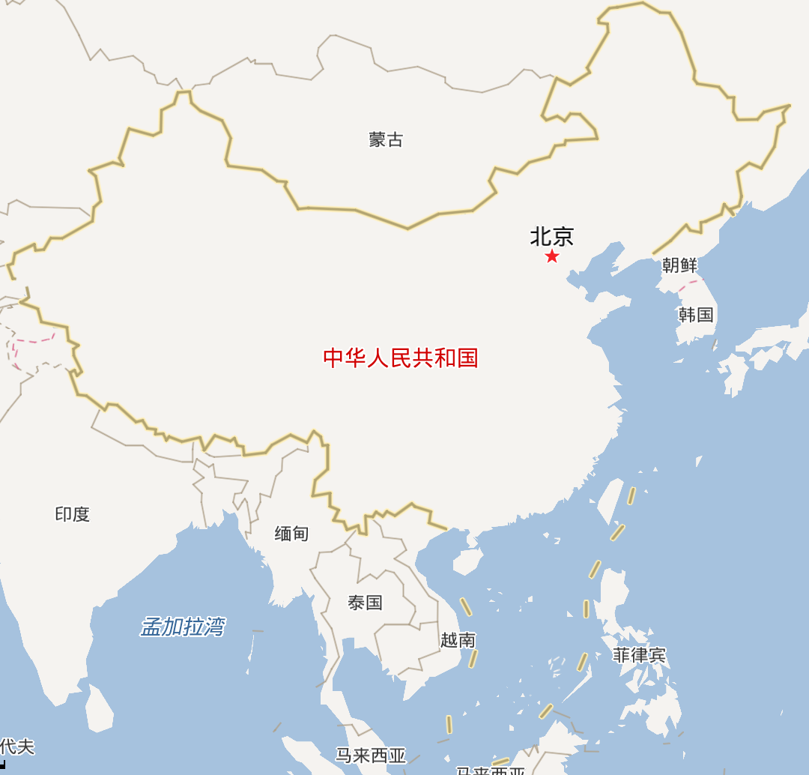
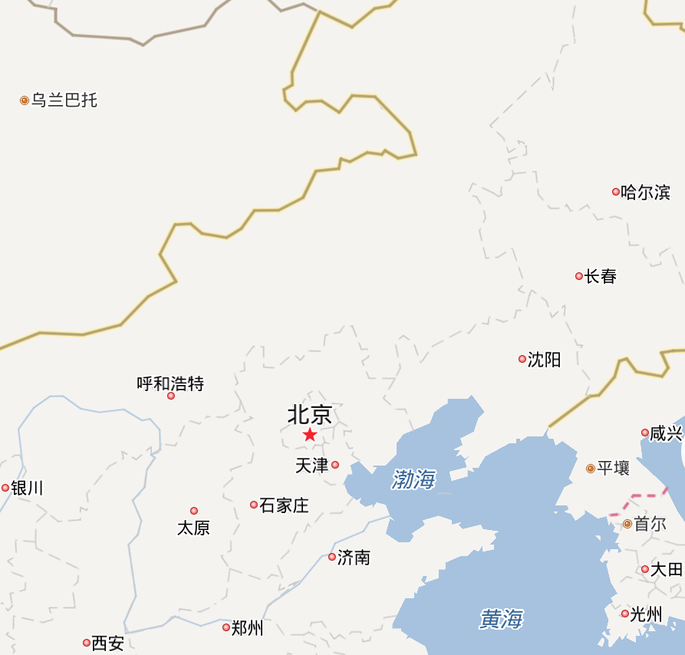
Mongolia
Beijing
China
Tianjin
India

Slide 3
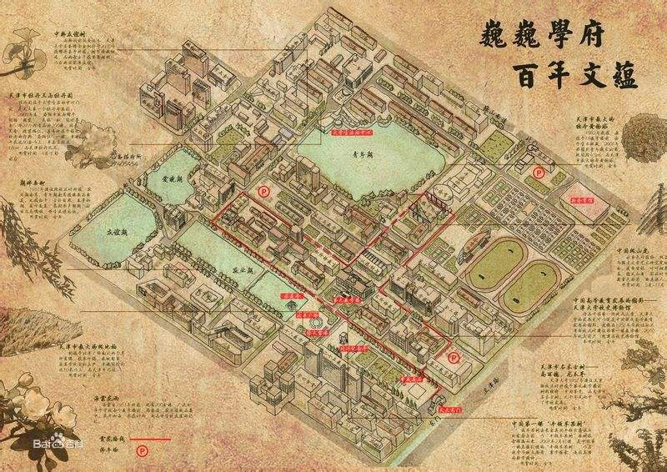
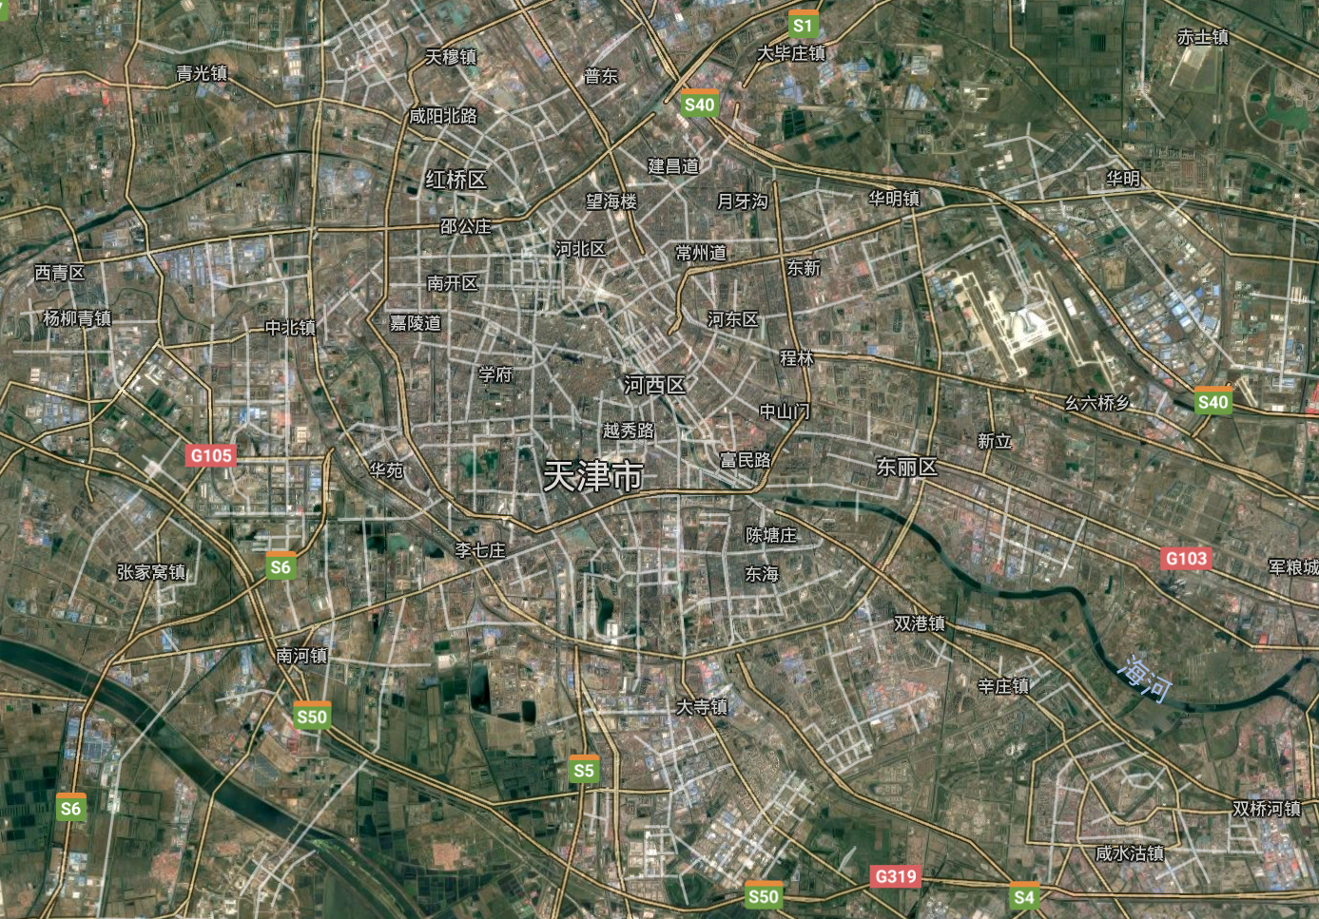
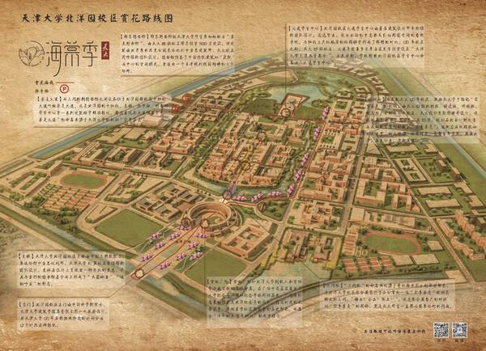
Tianjin University founded in 1895
Weijin campus
Peiyang (new) campus

Slide 4
Hydraulic consideration in DWC design
Xigang Yuan
yuanxg@tju.edu.cn
Tianjin University
State Key Laboratory of Chemical Engineering (Tianjin university)

Slide 5
Outline
Freedom analysis of simple distillation
Design of Dividing Wall Column
Hydraulics consideration
Solution method
Examples
Applications

Slide 6
Freedom analysis of simple distillation
Variables:
number of
variables
or
are given
MESH equations
Material balance
Equilibrium
number of
equations
Summation
Heat balance

Slide 7
Freedom analysis of simple distillation
Number of freedoms
Number of freedoms = number of vars. – number of eqs.
If stage pressures are fixed (modeled), the free variables need to be decided in simulation (design) are usually:
N, N_{F}, R, and D (rating) or
N, N_{F}, x_{LK}, and x_{HK} (design)

Slide 8
Freedom analysis of simple distillation
Pressures
Usually, to close the equation system, a P₁ is chosen and
P_{j+1} = P_{j} + ΔP
where ΔP is a constant
ΔP need to be estimated and checked when choosing column diameters in the design
Then, decision (free) variables for design become:
P₁, N, N_{F}, x_{LK}, and x_{HK}

Slide 9
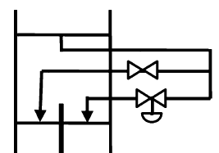
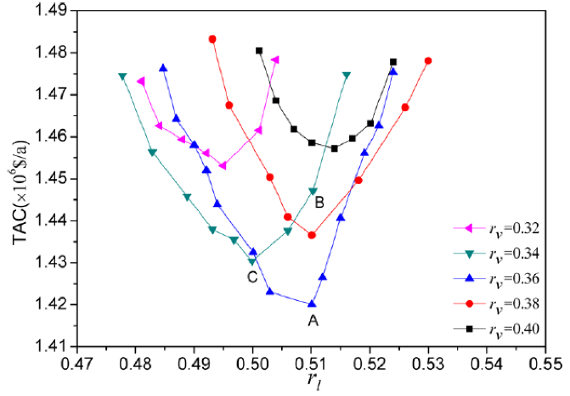
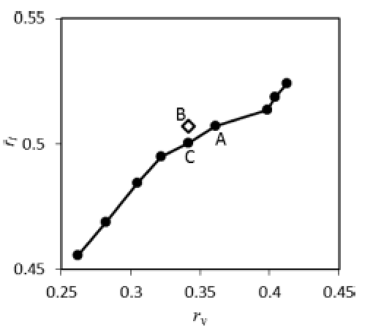
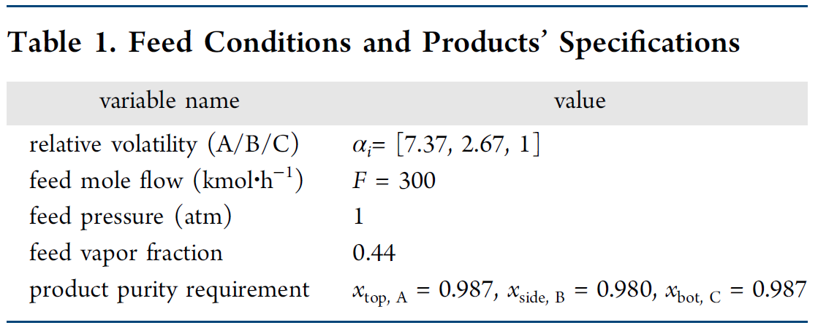
Design of Dividing Wall Column
Liquid split
D
1
R
5
2
6
3
S
F
Vapor
Split
?
4
W
a=0.297
b=0.640
Ge et al., Ind. Eng. Chem. Res. 2014, 53, 13383−13390

Slide 10
Design of Dividing Wall Column
Major challenges for design of DWC:
Pressure drops of the two sides – Hydraulic effect
constant pressure drop – checking – correction approach is difficult to apply
Simultaneous solution for the pressure drops is necessary
Convergence issue

Slide 11
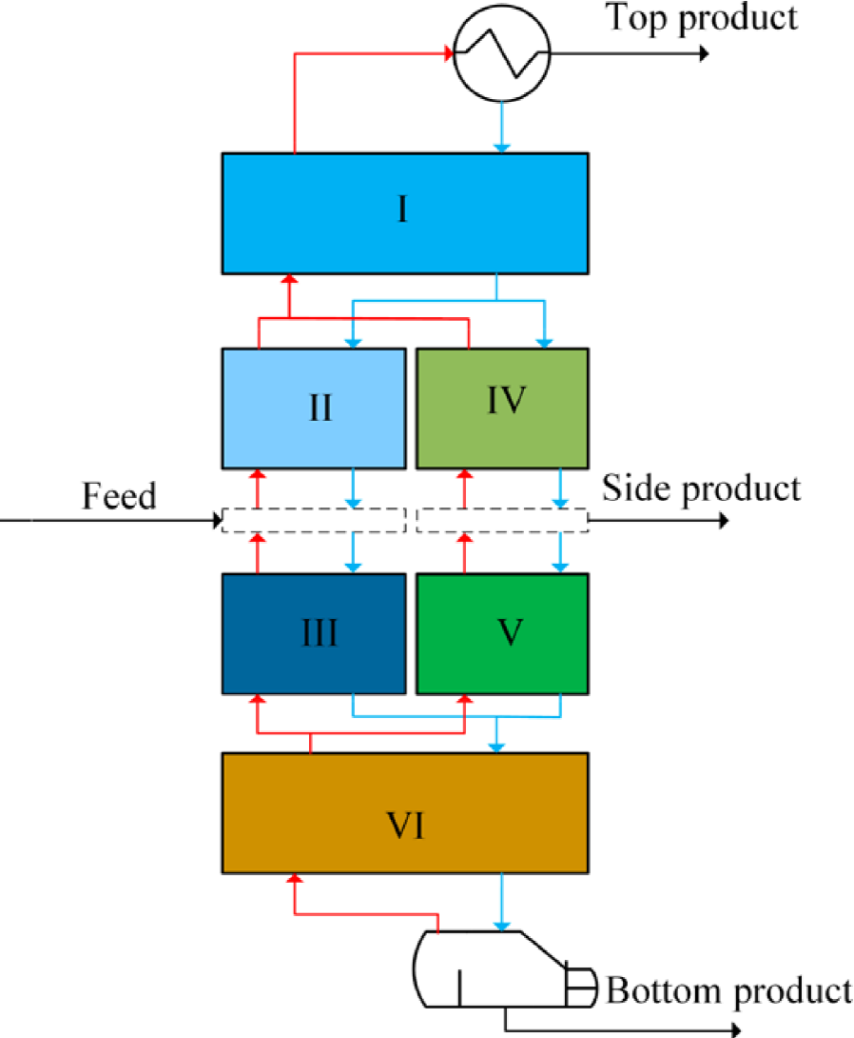
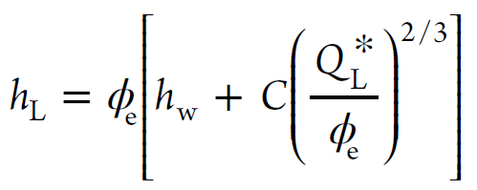
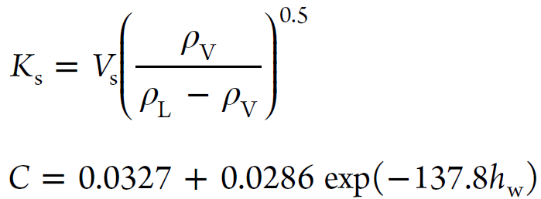
Hydraulics consideration
Pressure drop model for sieve tray by Bennett et al. (AIChE J., 1983, 29(3) , 434)
Pressure drop caused by the liquid inventory on a tray
Pressure drop of dry tray perforations
Pressure drop caused by the formation of vapor bubbles
Constraint for the equality of the pressure drops of the two sides

Slide 12
Hydraulics consideration
Stage pressures are handled as new variables
Pressure model equations need to be added to the MESH system
-- more variables and equations

Slide 13
Solution method
Convergence issue
EO approach
pseudo-transient continuation (PTC) method
Stage number optimization
bypass efficiency (BE) method

Slide 14
Solution method
M:
E:
S:
H:
System of DAE for Pseudo-transient model
M:
E:
S:
H:

Slide 15
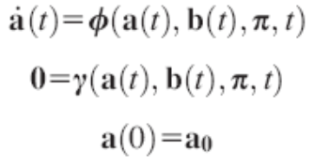
Solution method
Conversion in solving the equation system
initial condition for transient system converging to x*
PTC(x)
x₀
x(t)
x*
N(x)
initial guess for NM converging to x*

Slide 16
Solution method
Conversion in solving the equation system
initial condition for transient system converging to x*
PTC(x)
x₀
x(t)
x*
N(x)
initial guess for NM converging to x*
MESH
DAE
–PT model

Slide 17
Solution method
Optimization
initial condition for transient system converging to x*
z
x
PTC(x)
Algebraic model
x₀
Pseudo-Transient Model
x(t)
x*
Objective/
Constraints/
Gradients
N(x)
z
x
initial guess for NM converging to x*
NLP solver
DAE simulation

Slide 18
Solution method
Optimization of stage numbers
By-pass efficiency model
MESH equations for PTC
M:
Stage j
(1-ε_{j})L_{j-1}
E:
S:
H:
Hold-up:

Slide 19
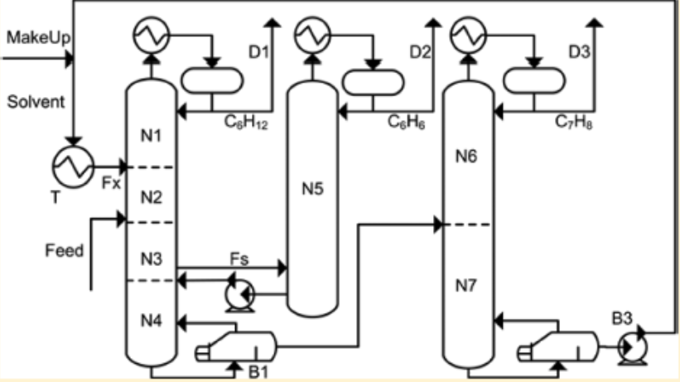
Examples
Partially thermally coupled extractive distillation
Ma, Y. et al., Ind. Eng. Chem. Res., 2017, 56 (21), 6266–6274
The feed flow rate: 100 kmol/h
Components:
mole frac.in fd:
Product demand:
Benzene
Cyclohexane
Toluene
30%
30%
40%
99%
99%
99.4%
Entrainer:
N,N-dimethylformamide (DMF)
Luyben, W. L., Chem. Eng. Res. Des. 2016, 106, 253−262.
Conventional design:
New proposed method:
Five Design Spec/Vary functions to achieve five specific objectives.
Thermally coupled process
Skilled Aspen Plus user needed.
14474 equations, 215 decision variables (distillate/bottom flow rates, reboil/reflux ratios, inter-column vapor flow, entrainer flow/temp., all the bypass efficiencies), and 29 inequality constraints.
skilled user

Slide 20
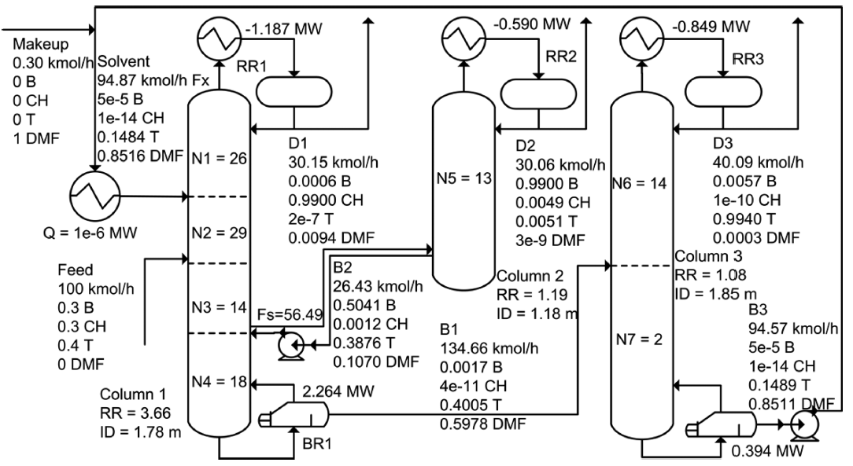
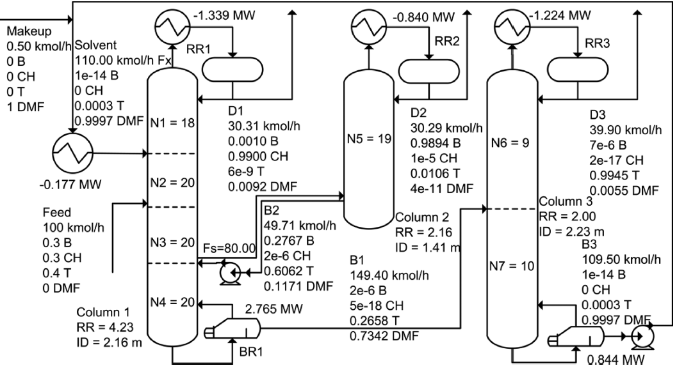
Examples
Partially thermally coupled extractive distillation
Optimized with the proposed method
TAC estimation can be found in:
Ma, Y. et al., Ind. Eng. Chem. Res., 2017, 56 (21), 6266–6274
Luyben’s results
Luyben, W. L., Chem. Eng. Res. Des. 2016, 106, 253−262.

Slide 21
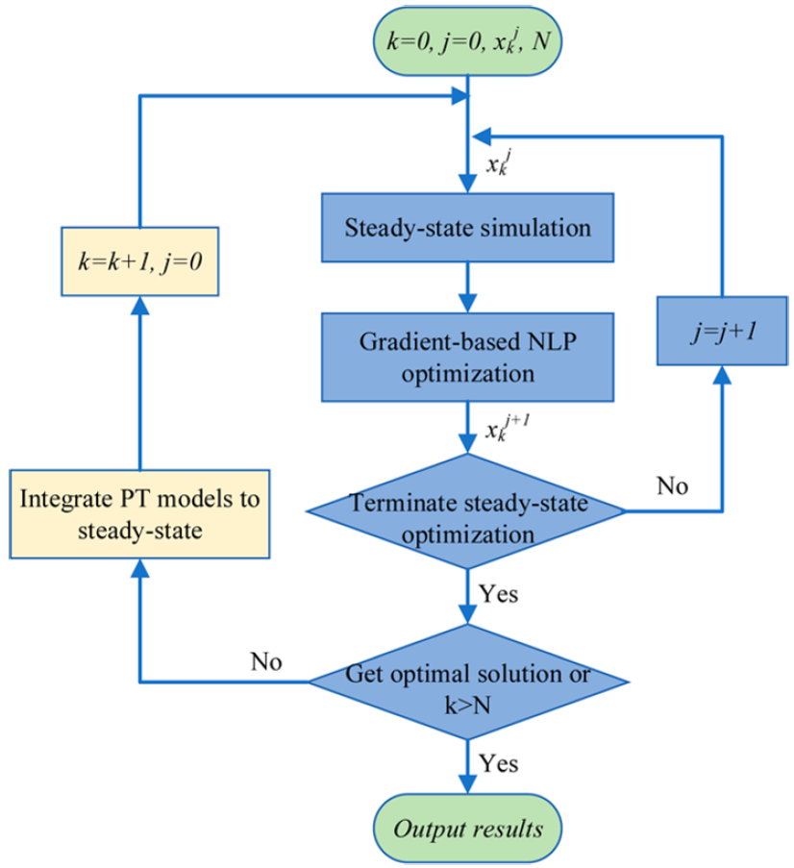
Examples
DWC
To solve
estimated by:
MESH equations
hydraulic model equations
diameter model
s.t.

Slide 22
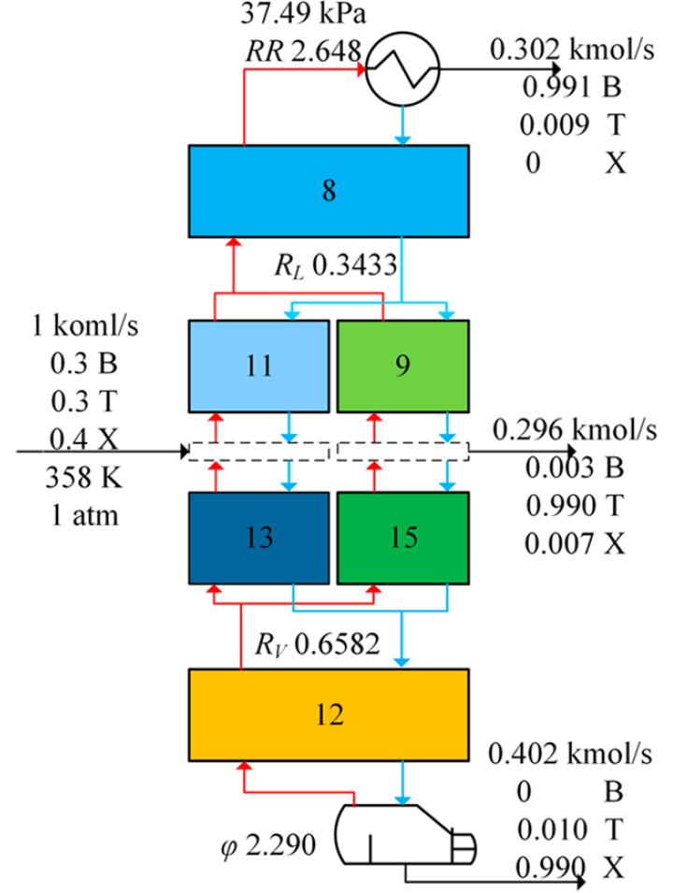
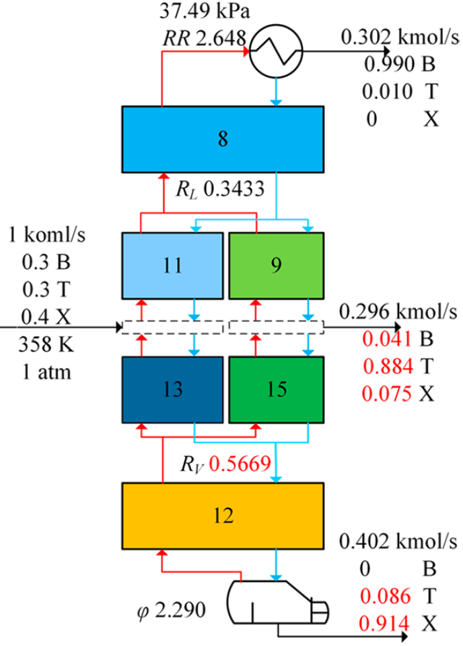
Examples
Example: separation of benzene−toluene−o-xylene (BTX) by Long et al.
(Chem. Eng. Technol. 2016, 39 (6), 1077−1086)
Feed conditions and the decision variables obtained by Long et al.
Feed composition: 30/30/40
Feed temp. and pres.: 358K and 1 Reflux ratio: 2.648
Side draw rate: 0.296 kmol/s
Liquid split: 0.343
Vapor split: 0.658
Boilup ratio: 2.29
Number of stages:
I 8
II 11
III 13
IV 9
V 15
VI 12
✗
products specifications
✗
vapor split ratio = 0.6582

Slide 23
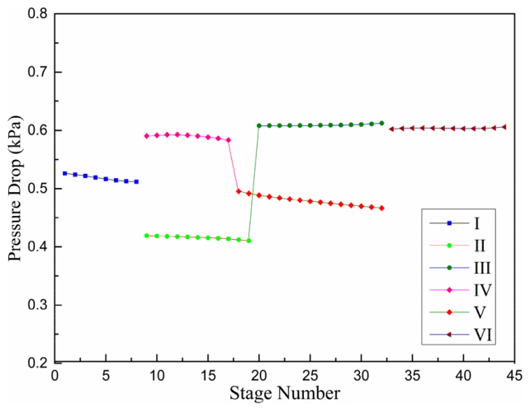
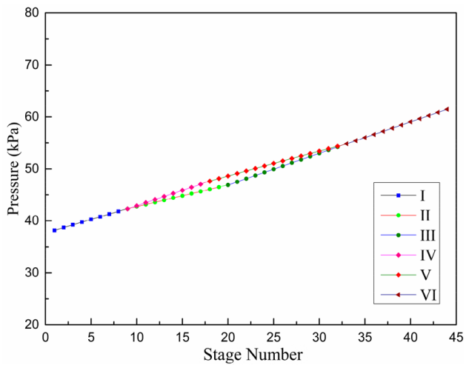
Examples
Example: separation of benzene−toluene−o-xylene (BTX) by Long et al.
(Chem. Eng. Technol. 2016, 39 (6), 1077−1086)
Checked results by simulation with the hydraulic consideration on the DWC optimized by Long et al.

Slide 24
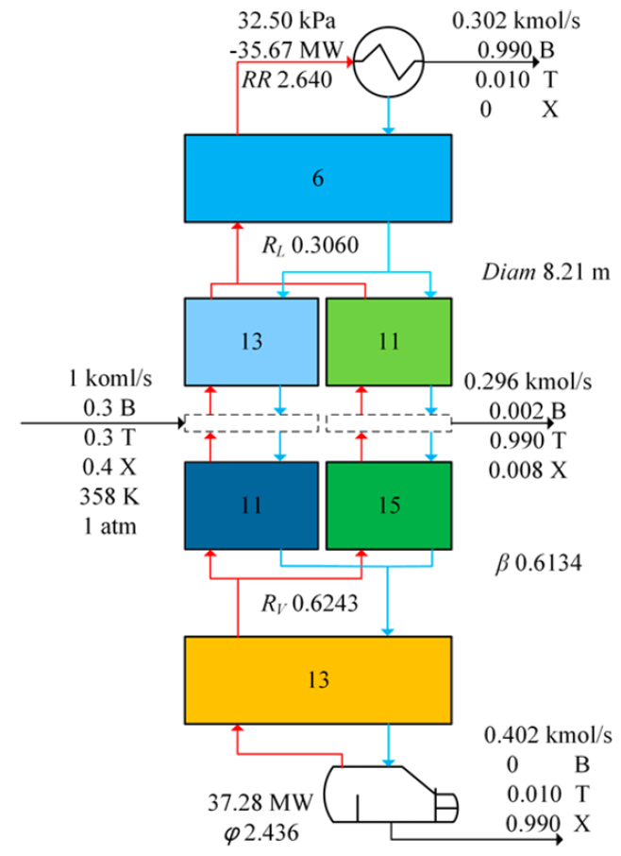
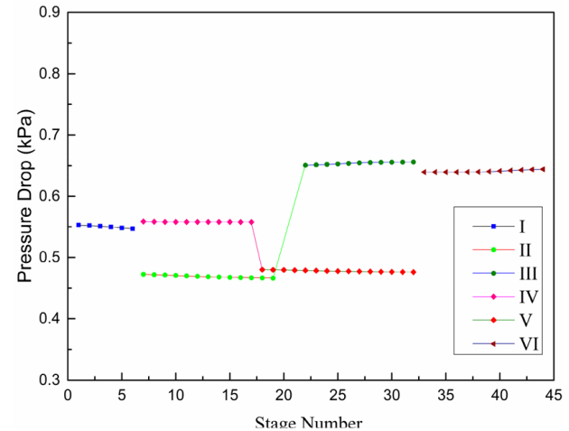
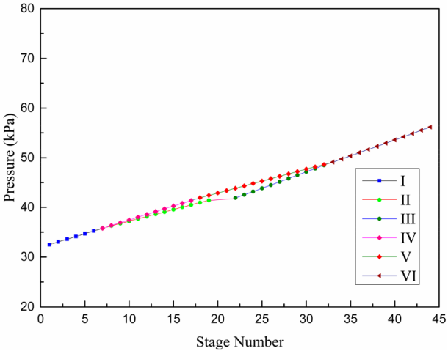
Examples
Example: separation of benzene−toluene−o-xylene (BTX) by Long et al.
(Chem. Eng. Technol. 2016, 39 (6), 1077−1086)
Optimal design result by the proposed method with the hydraulic consideration on the DWC optimized by Long et al.

Slide 25
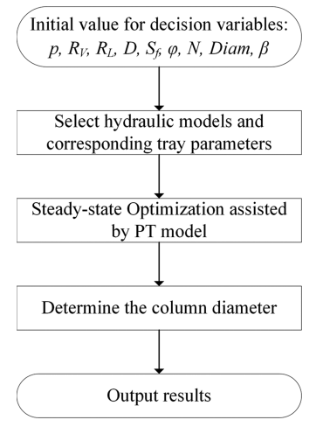
Summary and conclusion
Suggested steps for optimal design of DWC
The proposed approach via bypass efficiency and PTC assisted NLP solution enables rigorous optimization considering hydraulic effect for DWC design

Slide 26
Relevant papers
Ge et al., Ind. Eng. Chem. Res. 2014, 53, 13383−13390
Ma et al. , 2018. Ind. Eng. Chem. Res. 57 (42), 14124–14142 .
Ma et al., Comput. Chem. Eng. 108 (Supplement C), 337–348
Ma et al., Comp. Chem. Eng., 126 (2019), 54–67
Ma et al., Comp. Chem. Eng., 127 (2019) 218–232
Li et al., Ind. Eng. Chem. Res. 2020, 59, 13657−13668

Slide 27
For further information, please contact wangbill@peiyangchem.com

Slide 28
Thank you for your attention !

