Slide 1
Multivessel batch distillation
- With feedback temperature control for indirect level control
Sigurd Skogestad
Department of Chemical Engineering,
NTNU, Trondheim
Notes:
Thank you very much. Let me introduce other contributors. Professor Sigurd Skogestad at the Department of Chemical Engineering at the Norwegian University of Science and Technology & Dr Ivar Halvorsen, Senior Scientist from SINTEF which is a leading R&D organization in Europe and the largest in Scandinavia . I am going to talk on the Control Structure Design for Optimal Operation of 4-product Thermally Coupled Column.

Slide 2
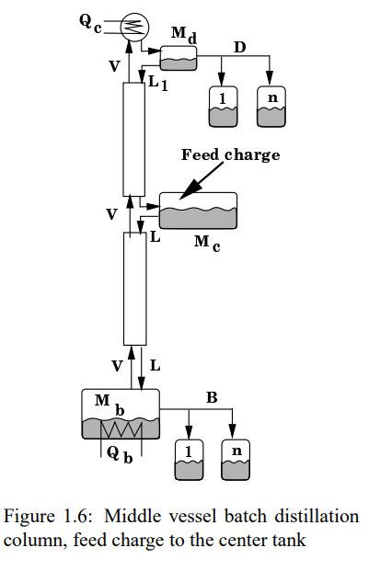
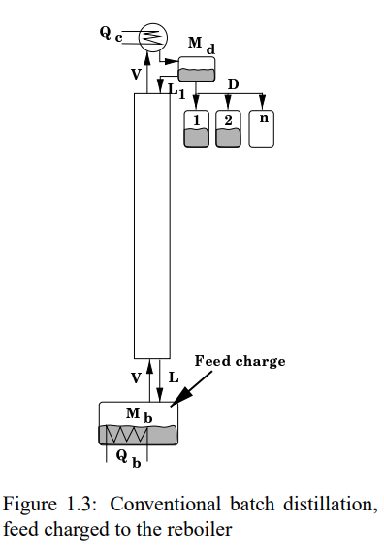

Slide 3
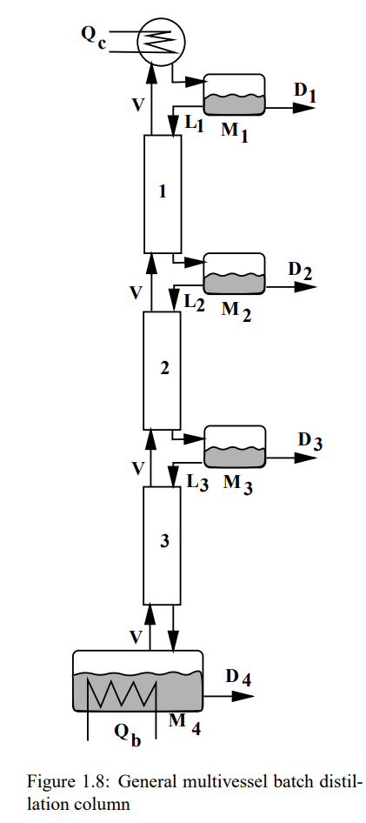


Slide 4

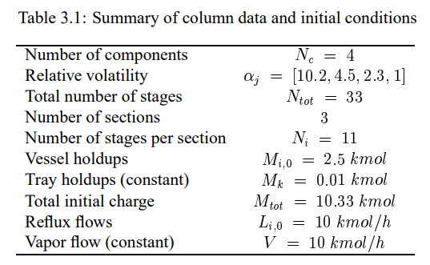
Methanol-ethanol-propanol-butanol

Slide 5
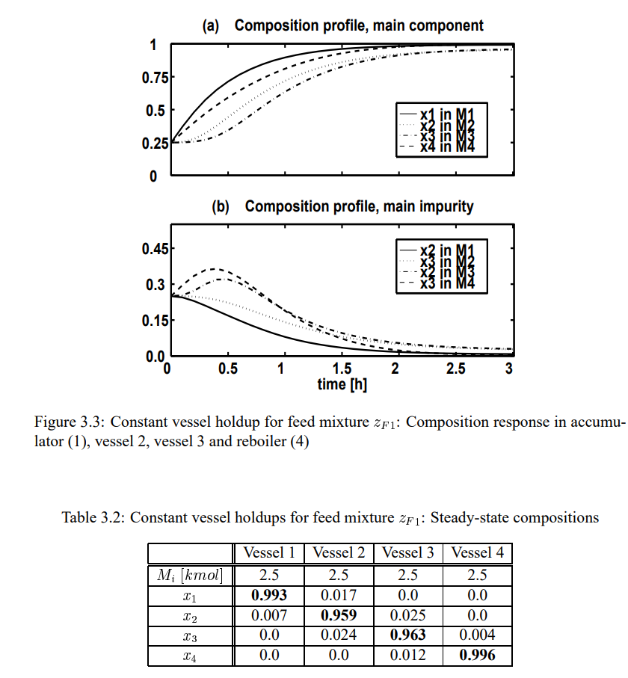

Simulation with constant holdups

Slide 6

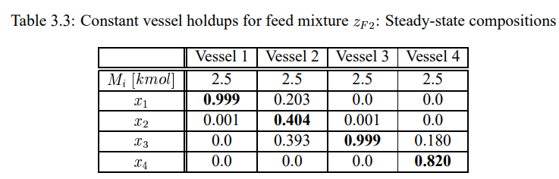
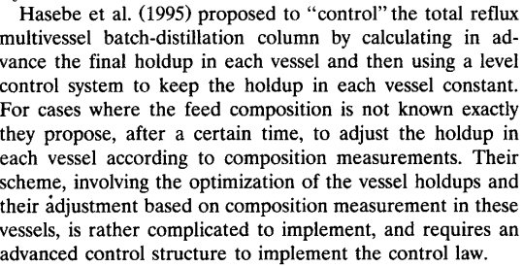
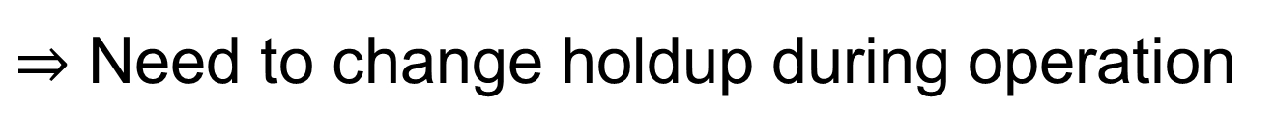
Simulation with constant holdups
Change feed composition:
$⇒$ Need to change holdup during operation

Slide 7
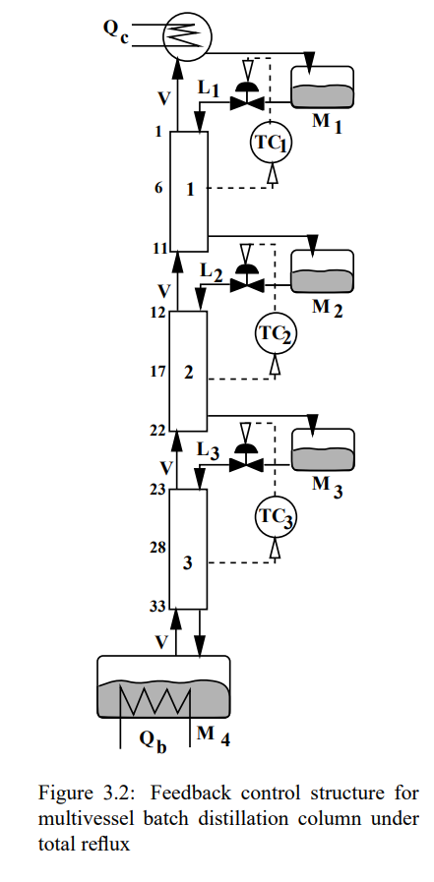

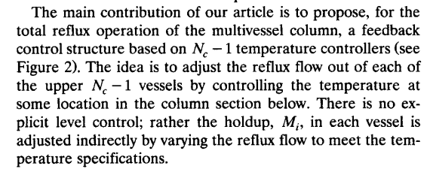
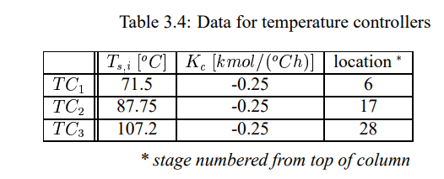
With feedback temperature control for indirect level control

Slide 8
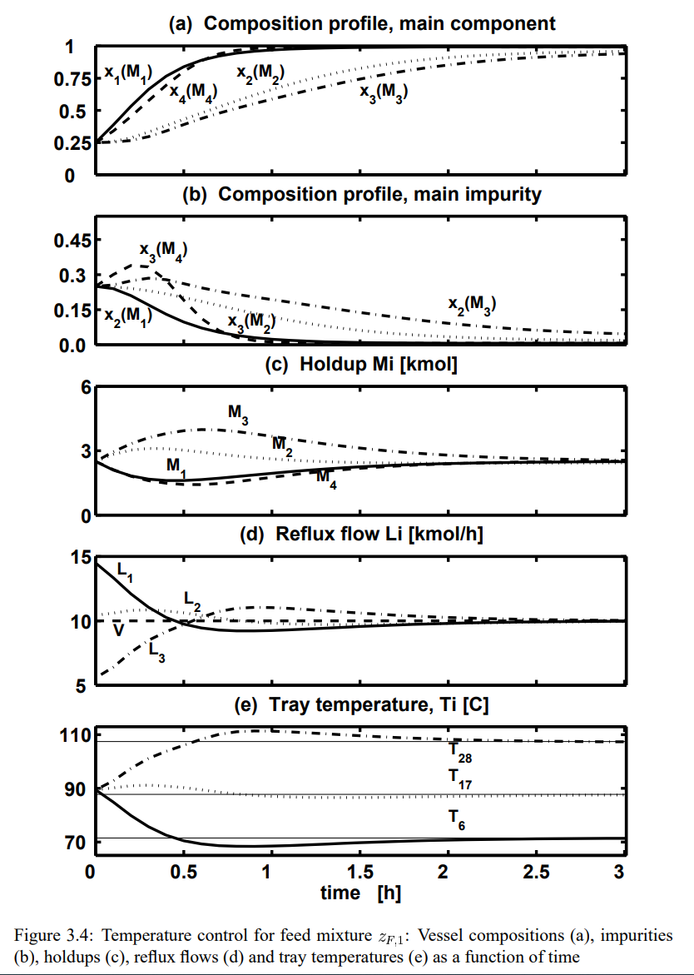

Slide 9
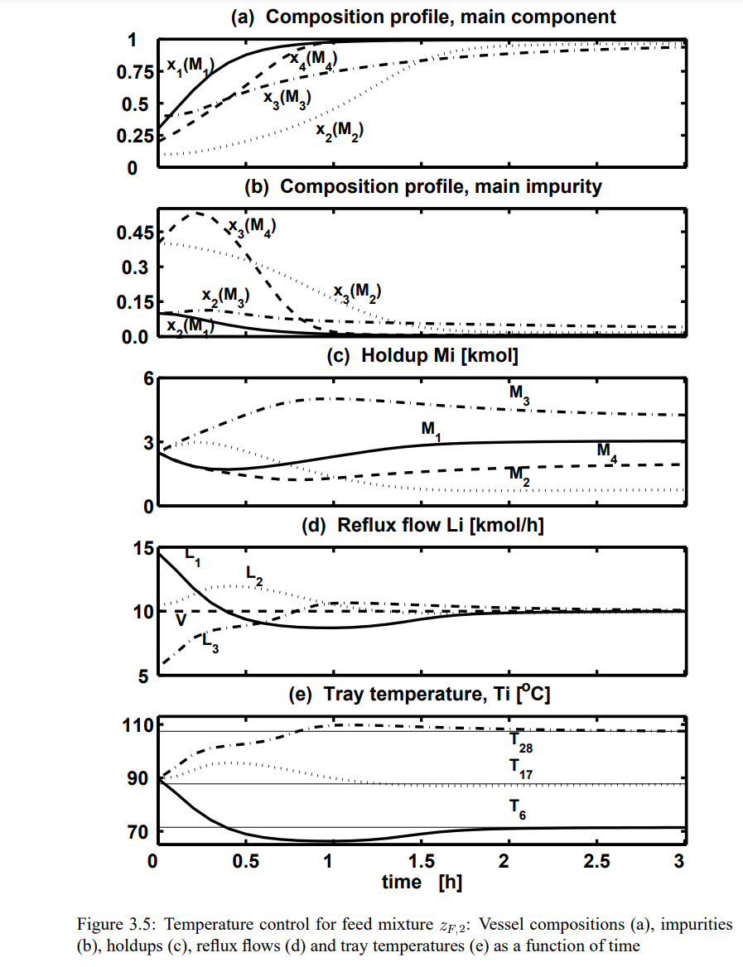

Slide 10
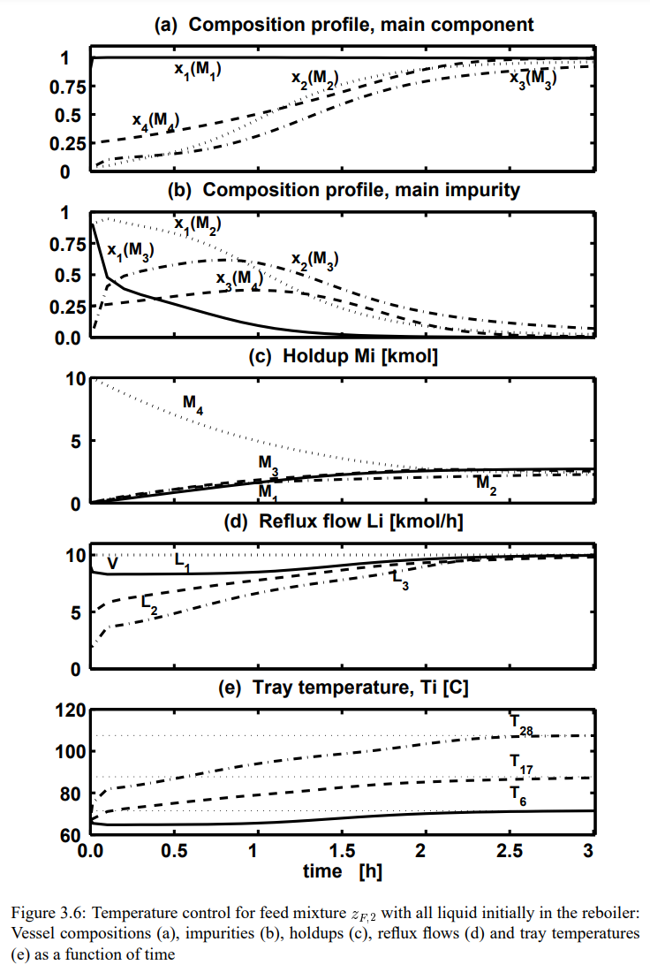

Slide 11
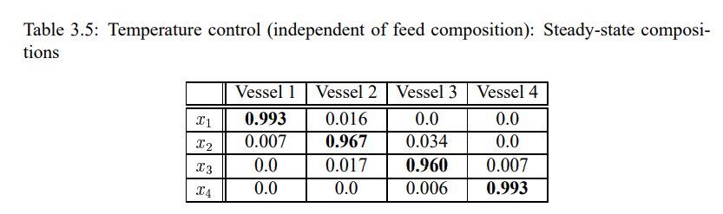
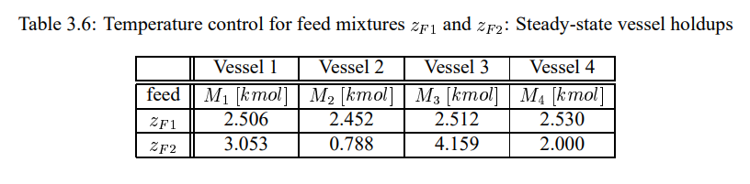

Slide 12
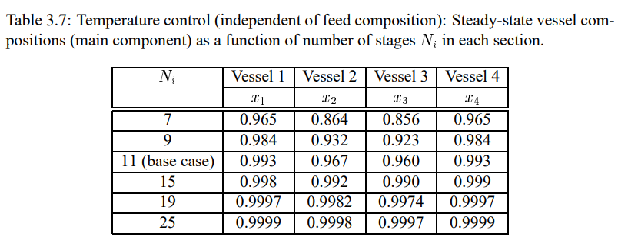

Slide 13
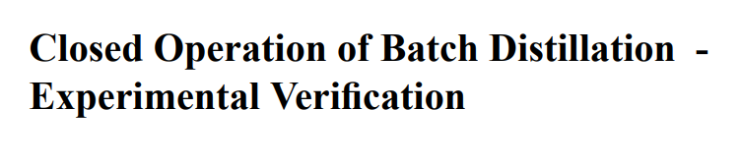
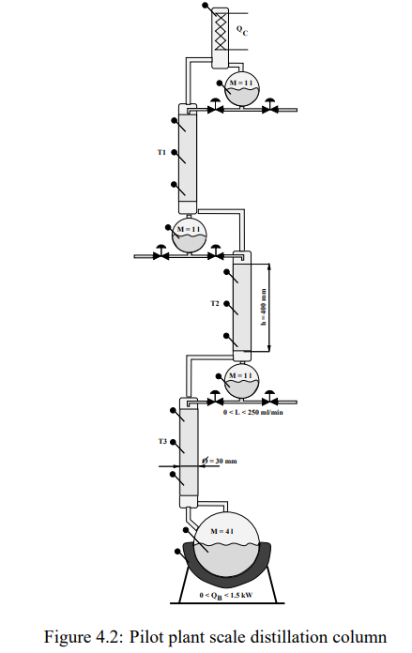
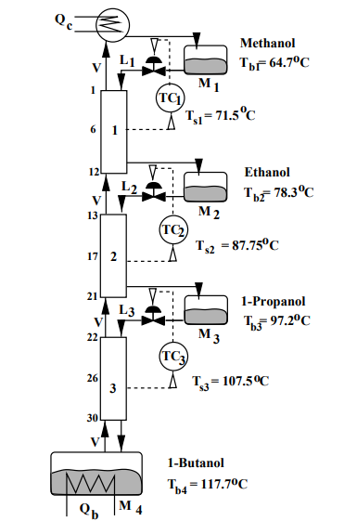


Slide 14
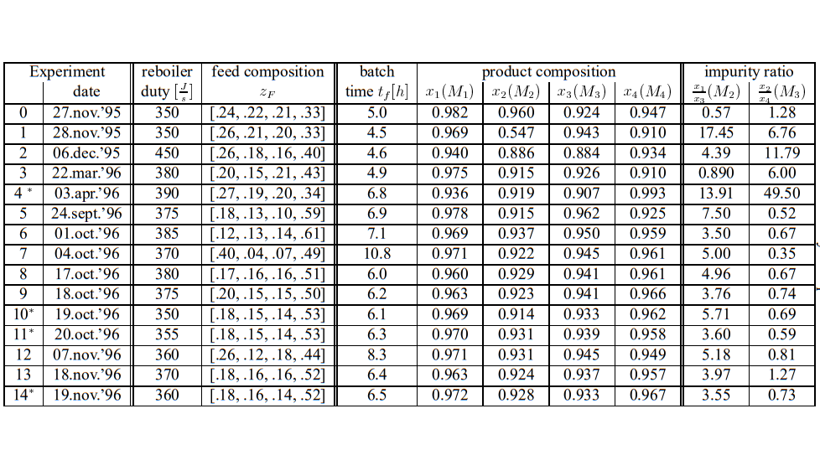


Slide 15

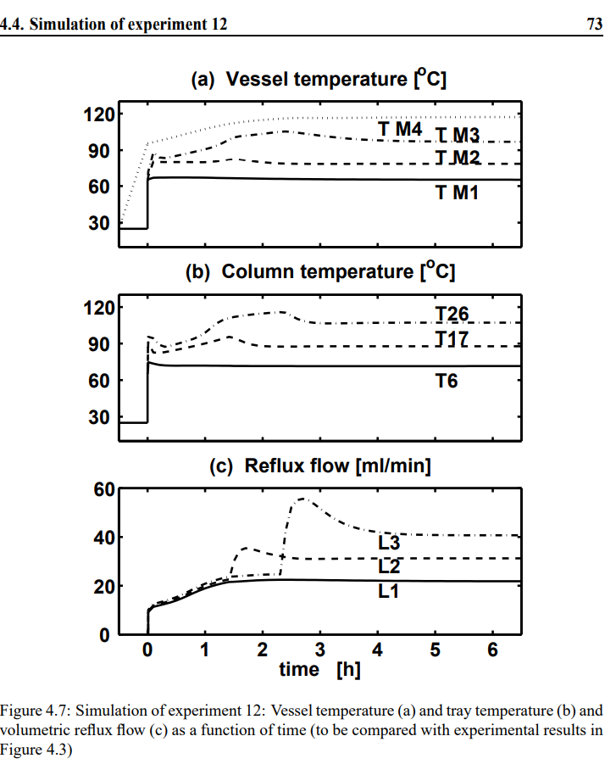
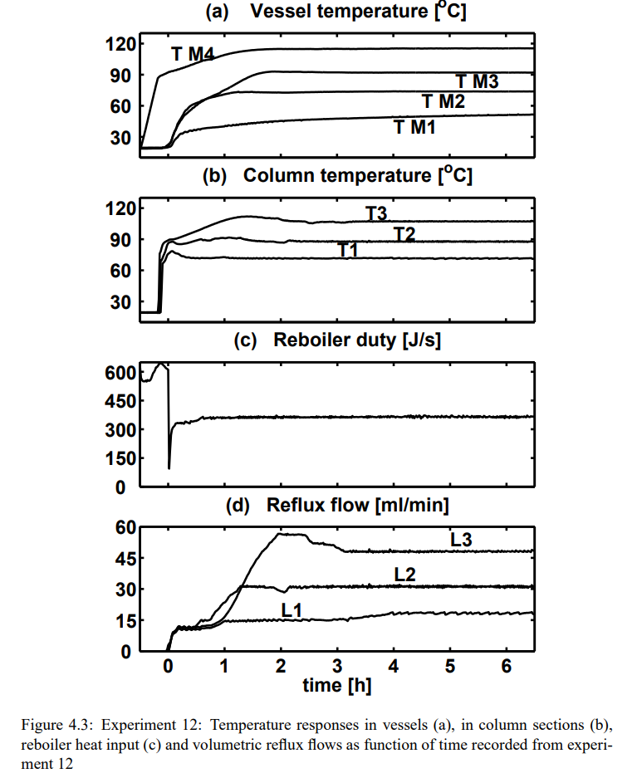

Slide 16
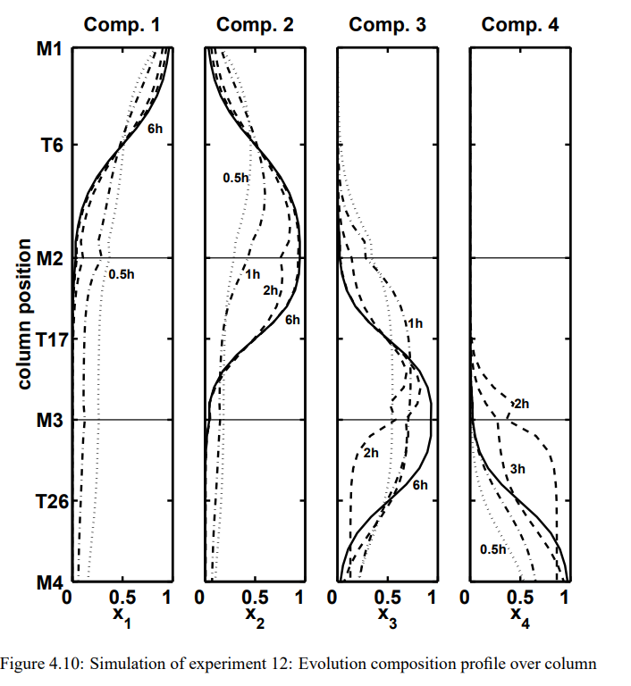
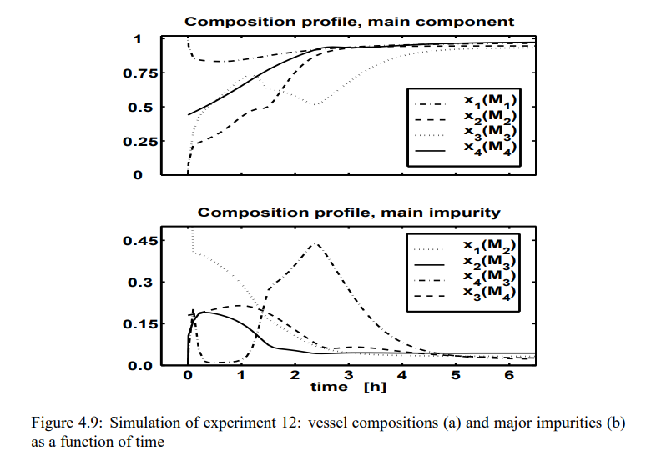

Slide 17
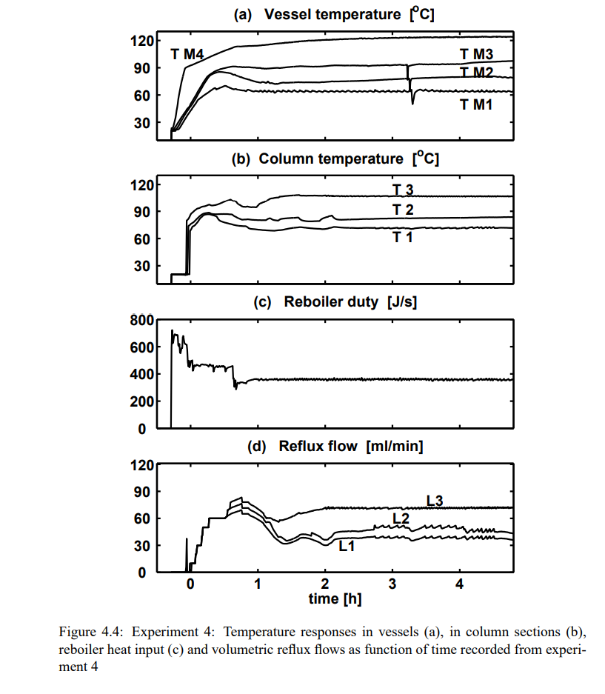


Slide 18
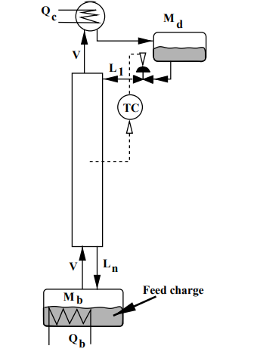
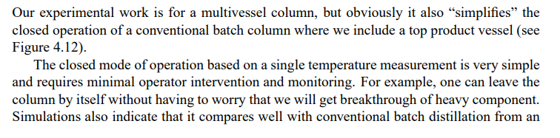
Conventional batch distillation: Closed operation

Slide 19
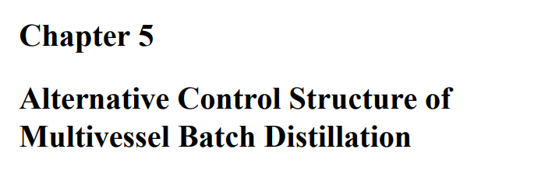
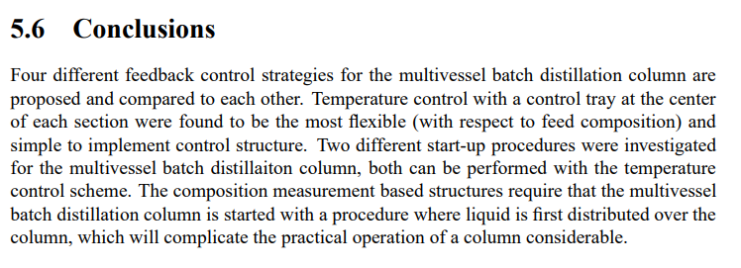
PhD Thesis by Bernd Wittgens (1999)

