Slide 1
New results for divided-wall columns
Deeptanshu Dwivedi (PhD Candidate, NTNU)
Ivar Halvorsen (Senior Scientist, SINTEF)
Sigurd Skogestad * (Professor, Department of Chemical Engineering, NTNU, Trondheim)
EFCE Working Party on Distillation+ Annual Meeting,
Bergen, Norway
May 2012
Notes:
Thank you very much. Let me introduce other contributors. Professor Sigurd Skogestad at the Department of Chemical Engineering at the Norwegian University of Science and Technology & Dr Ivar Halvorsen, Senior Scientist from SINTEF which is a leading R&D organization in Europe and the largest in Scandinavia . I am going to talk on the Control Structure Design for Optimal Operation of 4-product Thermally Coupled Column.

Slide 2
Outline
Introduction: Divided wall columns for 3- and 4-product separations
  Structures
  “V_{min} diagrams”
Experiments: 4- Product Kaibel Column
  Experimental Setup
  Control Structure
  Experimental Runs- Steady state profiles
  Experimental data- model fitting
  Experimental Runs- Vapor Split Experiment
Conclusions

Slide 3
3-product separation: Conventional “direct split”
A/B
A
ABC
B/C
B
BC
C

Slide 4
Improvement: Prefractionator (Easy split first)
A/B
A
A/B
B/C
A
A/C
ABC
AB
A/C
ABC
AB
Simplification 1:
JOIN
B
B
BC
B/C
B
BC
C
C
Simplification 2:
Remove condenser and reboiler in prefractionator
taking vapor and liquid from main column

Slide 5
Simplification: Direct coupling (“Petlyuk”)
+ single shell (divided wall column)
A/B
A
A
AB
AB
A/C
ABC
B
ABC
B
B/C
A/C
BC
BC
C
C
Petlyuk column

Slide 6
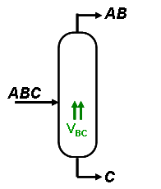
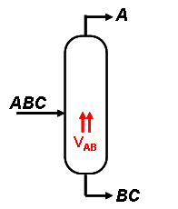
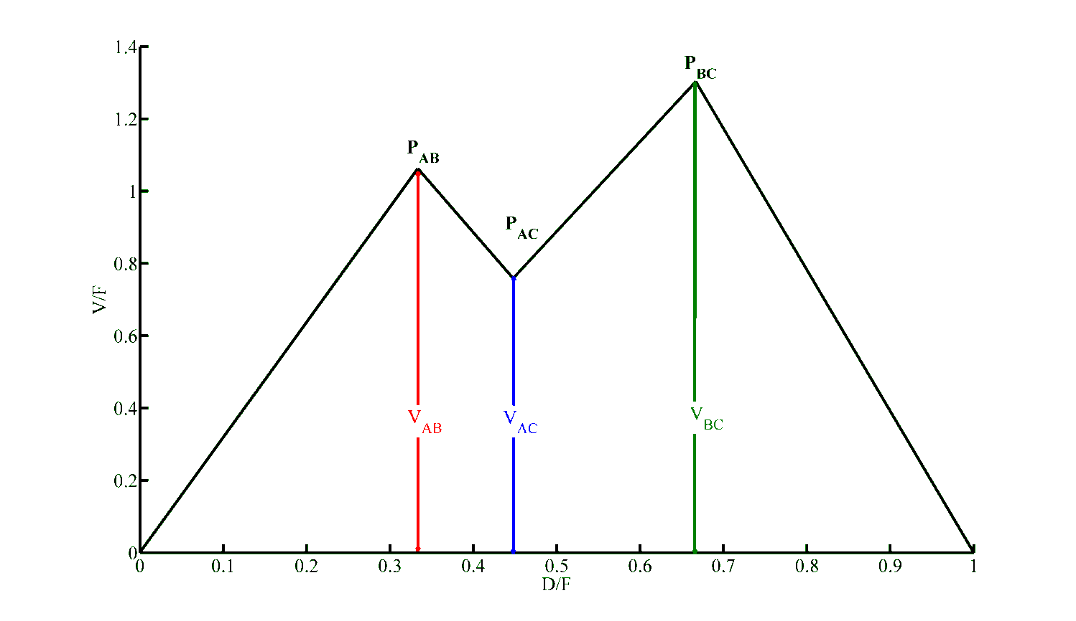
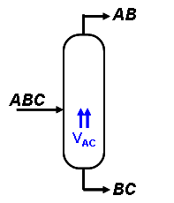
V_{min} diagram for three components
V_{min | Petlyuk} = max (V_{AB}, V_{BC}) = V_{BC}
V_{Prefractionator} = V_{AC}

Slide 7
4-product separation: Extended Petlyuk
A/B
D
AB
A/C
AB
D
ABC
S1
B/C
ABC
A/D
S1
ABCD
BC
ABCD
BC
B/D
S2
S2
BCD
BCD
C/D
CD
CD
B
B
4-product extended Petlyuk column up to ~50 % energy savings

Slide 8
4-product separation: Simplified (“Kaibel column”)
A
A
AB
A/B
AB
B
B
ABCD
ABCD
B/C
B/C
B/C
C
C
CD
C/D
CD
D
D
4-product extended Kaibel column up to ~30 % energy savings
Notes:
This is the Kaibel Arrangement. It consists of the prefractionator where the feed enters and is fractionated with help of the liquid reflux and vapor from the main column. The prefractionator is operated such the there is a sharp B/C split in the prefractionator. And it is possible to get 4 pure products A-B-C-D. This can be all put in a single divided wall column as originally proposed by Kaibel in 1987. Thermodynamically both arrangements are equivalent. The one on the right is more similar to the system we have in the laboratory.

Slide 9
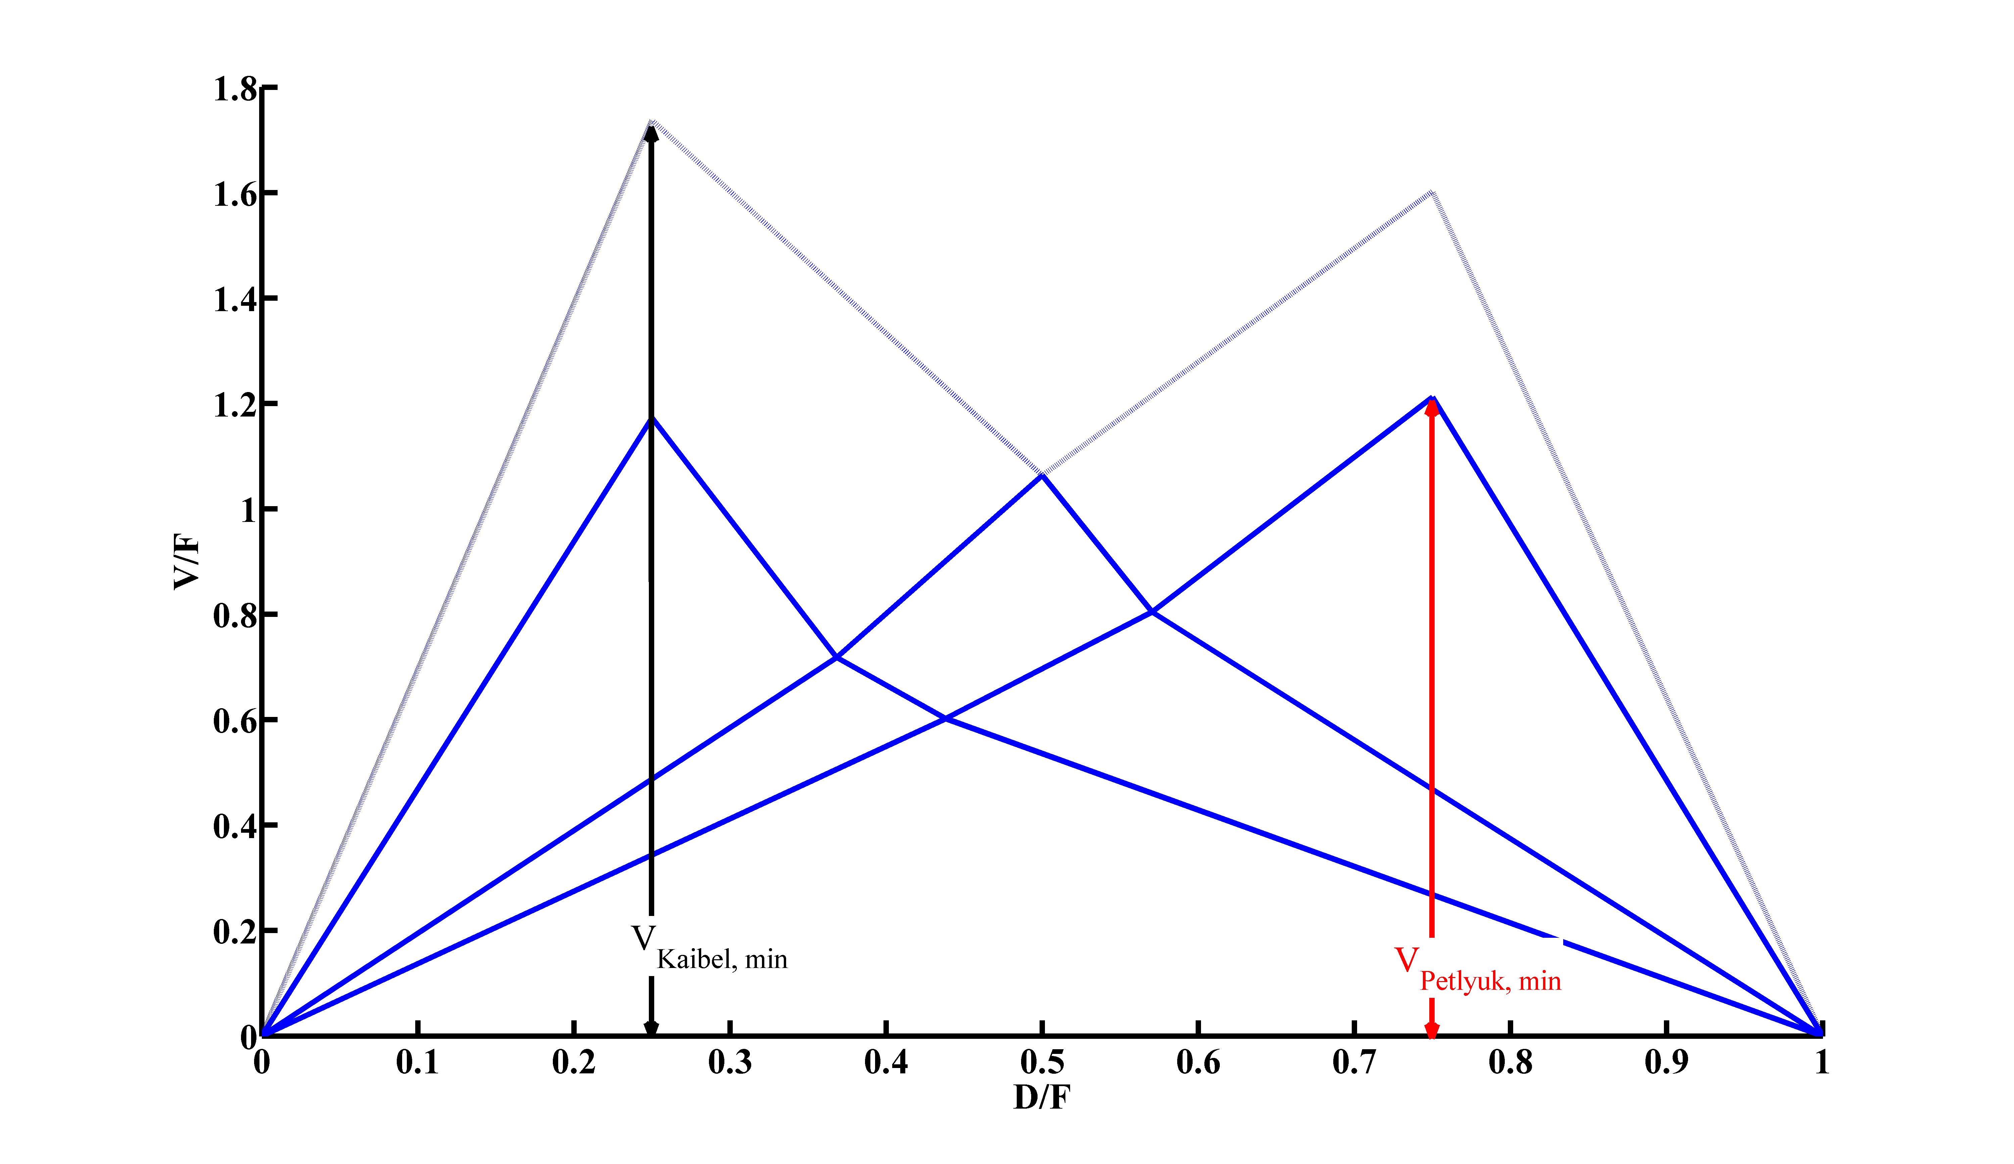
V_{min} diagram for four components

Slide 10
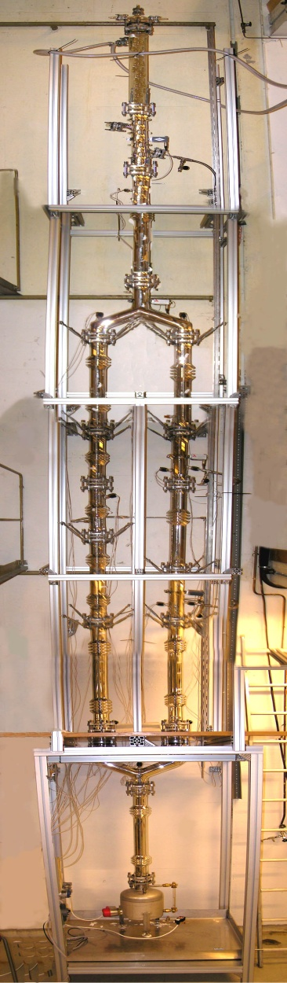
Experimental Set up
4 products
Packed Column
Magnetic funnel-liquid split & Product valves
Number of theoretical stages (experimentally determined):
  Prefractionator: 13
  Main column : 21
8m
A
(Methanol)
B
(Ethanol)
Feed
ABCD
C
(Propanol)
D
(Butanol)
Notes:
We are studying separation of four components namely methanol, ethanol, propanol and butanol. This is the prefractionator and this is the main column. The liquid reflux valve and the product valves are magnetic funnel. The vapor split valve is a rack and pinion arrangement, I will explain this in more detail later. The total number of trays were experimentally determined and they are 17 in the prefractionator and 21 is the main column. We have a labview interface to control it via computer.

Slide 11
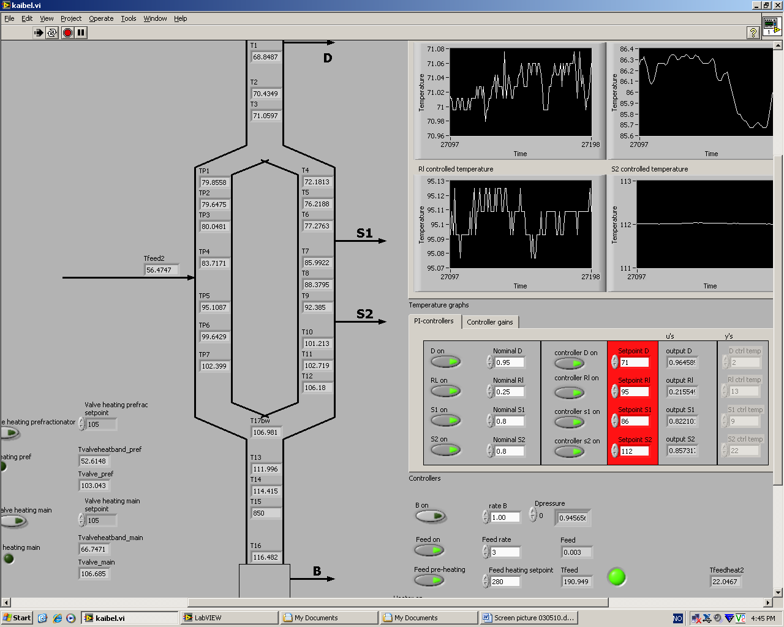
Experimental Set up (Labview Interface)…
Notes:
This is a labview page a view when this column is running. In next few slides I will show the results of some of the experments.

Slide 12
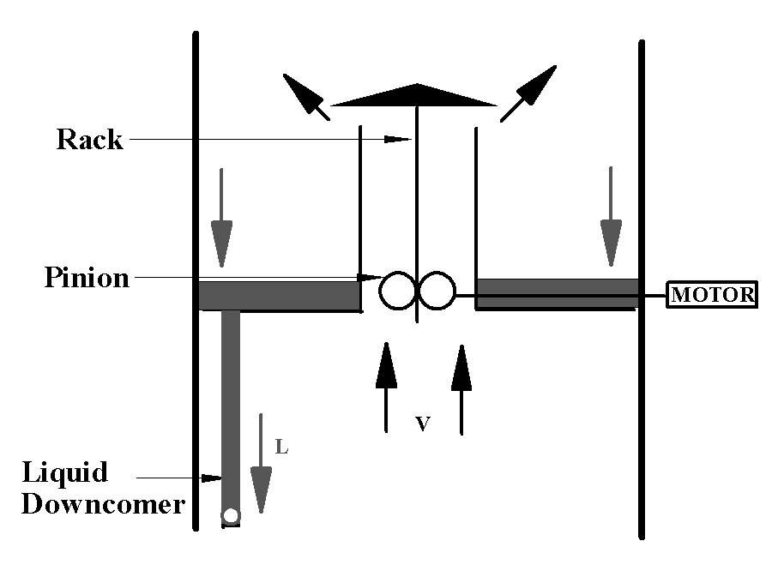
Vapor Split Experiment..
Schematic of the vapor split valve
From top left: Valve in fully open position
Top right: Rack and pinion arrangement
Notes:
Here are some more details of the rack and pinion arrangement of the vapor split valve. This canopy that sits on the valve seat is moved in the vertical direction. Its clear that the resolution of the valve is good in only small opening. But control can however be done with an feedback action,

Slide 13
Vapor Split Experimental run (Total Reflux, two component)
Notes:
This is the control structure used. The vapor split valve here, sets a difference between one temperature in the prefractionator section 2 and the main column 7. These setpoint changes can be done with this arrangement. Also the regulatory response of the same is good, when the reboiler duty is increased by 10%.

Slide 14
Vapor Split Experimental run (Kaibel Column)

Slide 15
Conclusions
Four-Product Kaibel column
  Experimentally demonstrated 4-point temperature control for stabilizing and startup operation
  Experimentally demonstrated active vapor split control
  Experimental data fits well with the model

