Slide 1
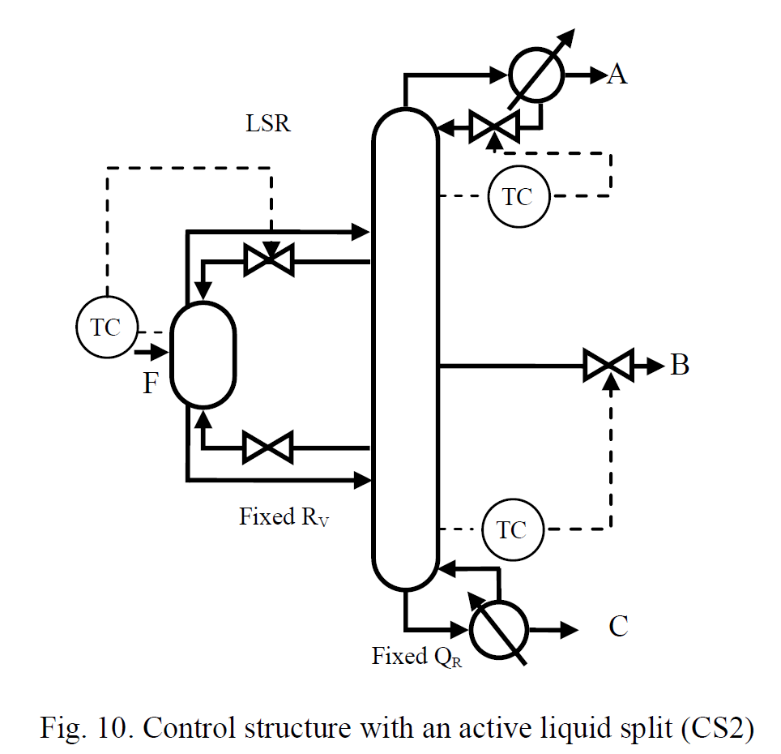
Dividing-wall column workshop
Trondheim
05-06 October 2023

Slide 2
Participants
1. Sigurd Skogestad, NTNU
2. Ivar Halvorsen, NTNU/SINTEF
3. Lena Ränger, Uni-Ulm/NTNU
4. Benedikt Kloss, TU Muchen/NTNU
5. Johannes Jäschke, NTNU
6. Robin Schulz, Julius Montz GmbH / Koch Engineering Solutions
7. Igor Dejanovic, Un. Zagreb
8. Yannick Waibel, Uni-Ulm
9. Chiara Lukas, Uni-Ulm
10. Boelo Schuur, Un. Twente (arrival on 4 October 22:55 and fly back on 6 October 17:00)
11. Meik Franke, Un. Twente,
12. Yuan, Xigang. Tianjin Univ., PR China
13. Mr. Hongtao Yang, CEO of the Peiyang Chemical Co
14. Goran Lukac, Univ. Zagreb
15. Markus Janke, Process Engineer and DWC expert at Montz.
16. Olaf Trygve Berglihn, SINTEF
17. Idelfonso Nogueira, NTNU

Slide 3
Program
Thursday 05 Oct. 2023
08:30 Coffee
09:00 Welcome by Sigurd Skogestad (with vintage 1993 slides on Petlyuk distillation)
09:30 Ivar Halvorsen, NTNU/SINTEF: The Vmin method and the need for vapor split control
10:30 Break
10:45 Lena Rängler, Uni-Ulm: Impact of Stage Number on Operational Flexibility of Vapor and Liquid Split Ratios (from earlier PhD work)
11:30 Ivar Halvorsen, NTNU/SINTEF: Experimental vapor split with application to Kaibel column (based on PhD work of Dwivedi)
12:15 Lunch (Element cafe, Realfagbygget)
13:00 Visit to experimental Kaibel column with on-line vapor split control (Benedikt Kloss, Ivar Halvorsen)
14:00 Robin Schulz¸ Julius Montz GmbH / Koch Engineering Solutions: Industrial implementations of DWC distillation
15:00 Igor Dejanovic, Un. Zagreb: Design and simulation of DWC distillation.
15:50 Break
16:00 Yannick Waibel, Uni Ulm: How to start up multiple dividing wall columns – A theoretical and experimental study
16:30 Meik Feranke, University of Twente: Design of azeotropic and extractive dividing-wall volumns by MINLP methods.
17:00 Igor Dejanovic and Goran Lukac, Univ. Zagreb: 4-product DWC.
17:30 End
19:00 Dinner at Eld Emilie (fish soup, lamb, ice cream).
Friday 06 Oct. 2023
09:00 Ivar Halvorsen, NTNU/SINTEF: New (or at least not well known) results on the Vmin method
09:50 Break
10:00 Sigurd Skogestad, NTNU: Multi-vessel batch distillation (different but similar to DWC)
10:45 Break
11:00 Yuan, Xigang, Tianjin Univ.: Hydraulic consideration in DWC design.
11:30 Lena Rängler, NTNU/Uni-Ulm: Temperature profiles in two-product distillation columns
12:00 Lunch (Element cafe, Realfagbygget)
13:00 End

Slide 4
Introduction by Sigurd Skogestad
0. The Myth
My first Petlyuk presentation (Nov. 1993)
Kaibel column with vapor split (May 2012)
Simple control scheme (May 2016)

Slide 5
Myth about inefficiency of distillation

Slide 6
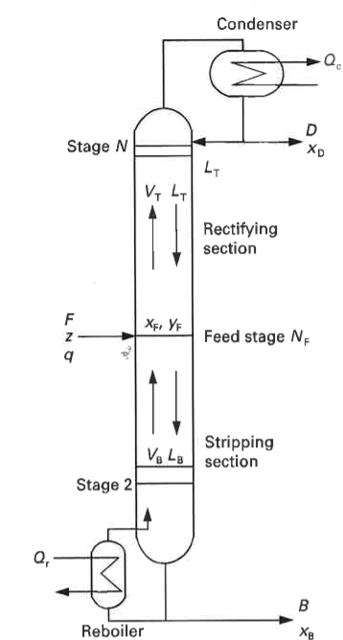
«Distillation is an inefficient process»
This is a myth!
By itself, distillation is an efficient process
  Typically, thermodynamic efficiency >50%
It’s the heat integration that may be inefficient.
  Yes, it can use a lot of energy (Q_{r}=heat), but it provides approximately the same energy as cooling (Q_{c}) at a lower temperature

Slide 7
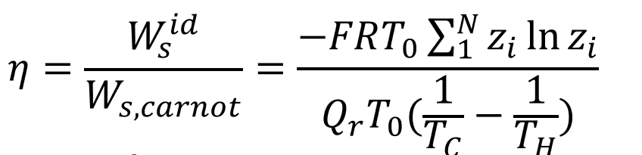



Thermodynamic efficiency of distillation
$$α=10$$
$$α=1$$
$$η$$
Separation into pure components
Plot is for liquid feed, binary mixture
α = relative volatility
z = fraction light component in feed
Plot from I.J. Halvorsen.
Ref: S. Skogestad, Chemical and Energy process engineering, CRC Press, 2009, pp. 224
Ref: C.J. King, Separation processes, McGraw-Hill, 1971, 1980

