Slide 1
Design and Sizing of Packed 4 Product DWCs
Igor Dejanović

Slide 2
SEPARATION PROCESSES ENERGY INTENSITY*
USA: 50 % total energy consumed in the industry
Distillation: 8 % of total energy consumption (2400 TWh per year)
29600 TWh
Two basic approaches to reducing the energy demand, and related CO₂
emissions:
REPLACE – development of new materials for adsorption and membrane based processes.
IMPROVE – increase energy efficiency of the existing processes:
Equipment advances (packings, trays, internals, better control)
Heat integration (heat pumps, background process integration)
Integrated sequences (thermal coupling, DWCs)
*Sholl, D.S., Lively, R.P., Seven chemical separations to change the world, Nature, 532 (2016)

Slide 3
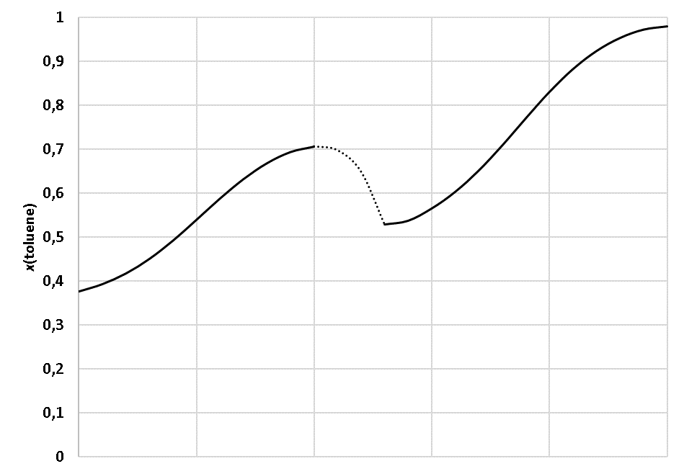
Separation of three products - the direct sequence
Notes:
Nuklearna energija ključna za dekarbonizaciju

Slide 4
Separation of three products - the „Sloppy” sequence
Notes:
Nuklearna energija ključna za dekarbonizaciju

Slide 5
Separation of three products - the Petlyuk and the DWC
Petlyuk sequence
DWC
Notes:
Nuklearna energija ključna za dekarbonizaciju

Slide 6
STATE OF THE ART
Established: 3-product DWCs
More than 200 in operation worldwide.
Packed and tray columns.
Know-how pioneers: BASF SE and Julius MONTZ GmbH.
Proven in practice: about 30 % savings in energy, capital and plot area
Next step: 4-product DWCs
Potential gains could increase to 50% compared to conventional, three-column sequences
Complex internal configurations: design and operation concerns increase.
Subject of academic studies: providing basic and technically sound know-how
SINTEF/NTNU
I. Halvorsen,
S. Skogestad
Univ. of Zagreb
I. Dejanović,
Lj. Matijašević
TU Delft
Ž. Olujić
J. Montz GmbH
H. Jansen, B. Kaibel

Slide 7
Separation of four products
Direct sequence
Petlyuk sequence

Slide 8
Notes:
Nuklearna energija ključna za dekarbonizaciju

Slide 9
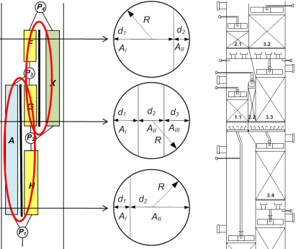
Conceptual design tools
SHORT-CUT DESIGN
Vmin diagram method (I.J. Halvorsen:
Identification of feasible internal configurations.
Initial values for detailed simulations.
DETAILED STAGE NUMBER AND REFLUX CALCULATION
Use of commercial process simulators.
Thermodynamically equivalent conventional column sequences.
Minimizing N(R+1)
HYDRAULIC DESIGN
Packed DWC dimensioning considerations and methods
Main design and operation concern: vapor splits

Slide 10
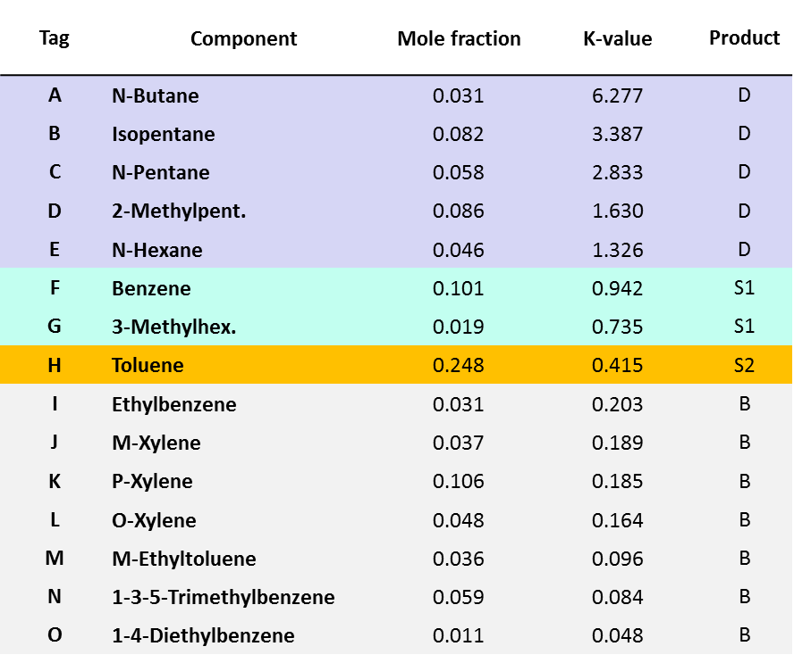
DESIGN CASE: 15 component hydrocarbon feed ⟶ 4 products
Base case configuration
Product specs:
C5-C6 fraction < 1.3 mass % benzene
BRC > 67 mass % benzene
Toluene purity > 97 mass %
BRC = benzene rich cut
Notes:
Product of the catalytic reforming process – split into light gasoline, BRC and aromatics.

Slide 11
DESIGN CASE: 15 component feed ⟶ 4 products
Product specs:
C5-C6 fraction < 1.3 mass % benzene
BRC > 67 mass % benzene
Toluene purity > 97 mass %
Base case configuration
 | C1 | C2 | C3
Top pressure (bar) | 1.7 | 2.7 | 1.013
Shell diameter (m) | 2.0 | 2.0 | 1.8
Shell height (m) | 40.5 | 39.5 | 39.5
Stages (-) | 40 | 38 | 38
Sieve trays (#) | 61 | 59 | 59
Reboiler duty (MW) | 3.76 | 3.12 | 3.15
Total reboiler duty (MW) | 10.03 MW
BRC = benzene rich cut

Slide 12
SHORT-CUT DESIGN
Vmin diagram for a 4-P ("2-3-4" configuration)
Highest peak – sets overall Petlyuk/DWC Vmin
Vmin diagram contains all internal DWC rates at min reflux

Slide 13
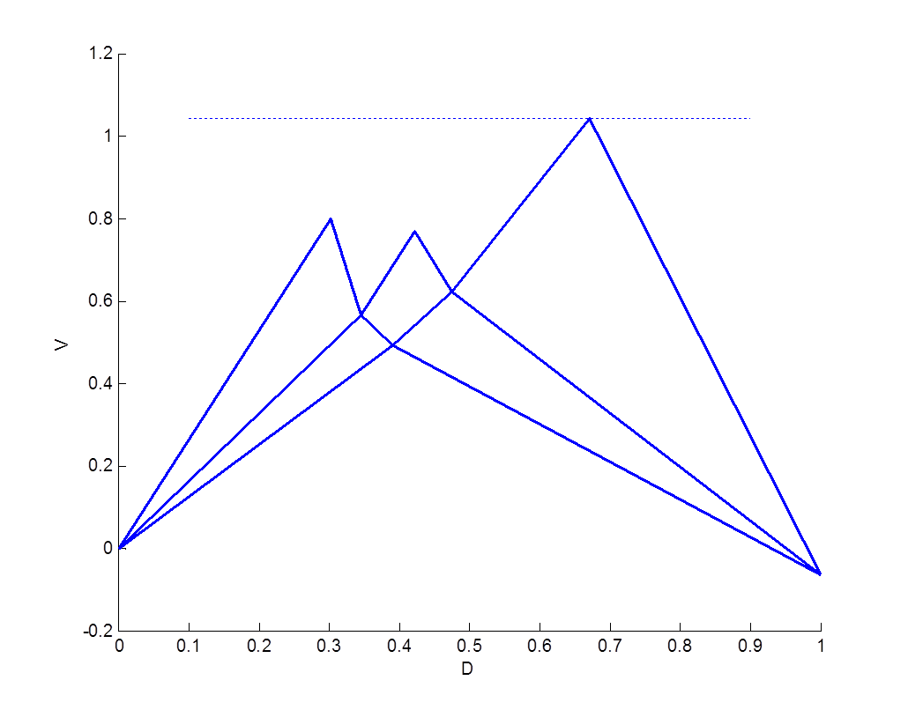
CONCEPTUAL DESIGN USING Vmin
Differences in peak heights give operational/design flexibility
One vapor split eliminated with no energy penalty.

Slide 14
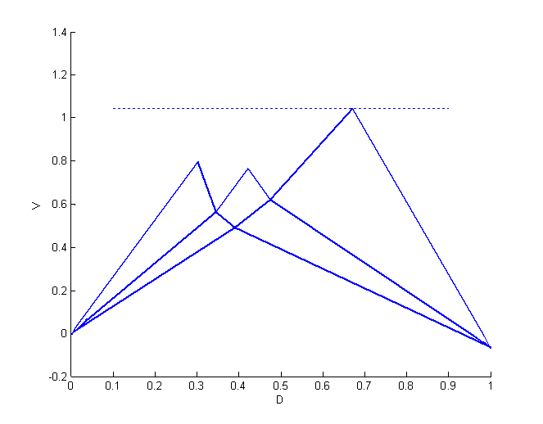
CONCEPTUAL DESIGN USING Vmin
2-3-4

Slide 15
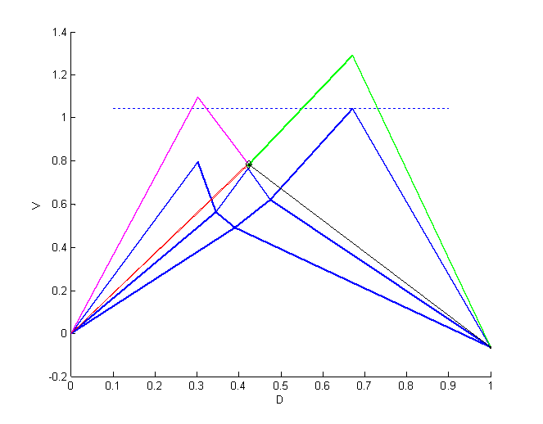
CONCEPTUAL DESIGN USING Vmin
2-4
Kaibel column is not a Vmin configuration, but energy efficiency is traded-off for simpler structure.

Slide 16
CONCEPTUAL DESIGN USING Vmin
2-3-4

Slide 17
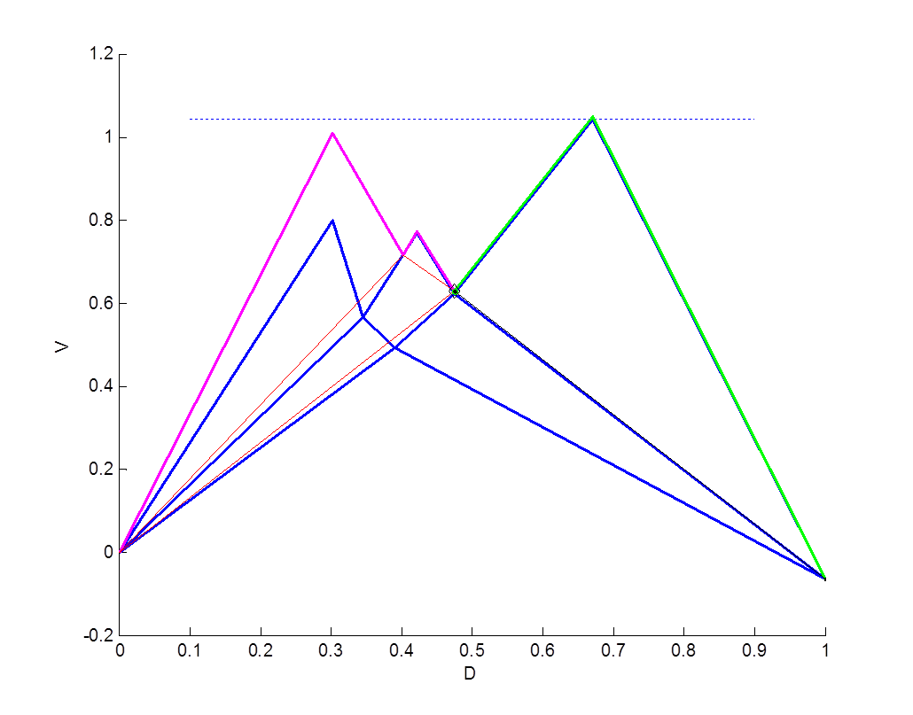
CONCEPTUAL DESIGN USING Vmin
2-2-4
Same energy efficiency, simpler structure.

Slide 18
CONCEPTUAL DESIGN USING Vmin
2-3-4

Slide 19
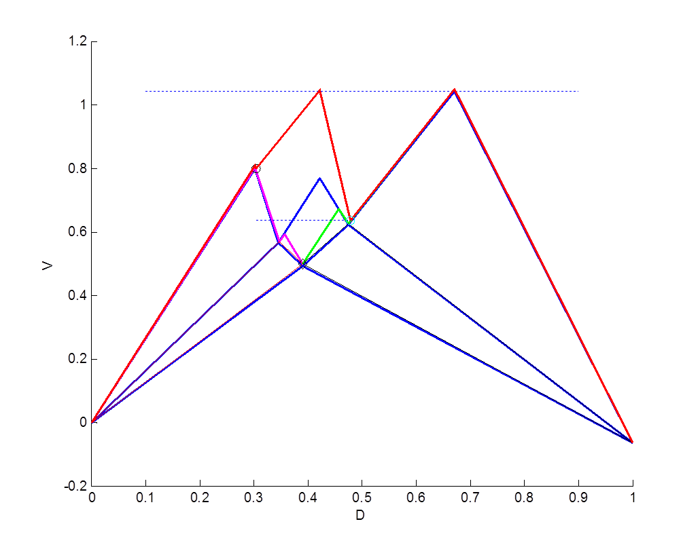
CONCEPTUAL DESIGN USING Vmin
2-3-3
Same energy efficiency, possible manipulation of a vapor split via throttling vapor lines of two condensers.

Slide 20
4-product DWCs
Feasible internal configurations identified by Vmin diagram method
Halvorsen, Dejanović, Skogestad, Olujić, Chem. Eng. Res. Des. 91 (2013) 1954-1965
Dejanović, Halvorsen, Skogstad, Jansen, Olujić, Chem. Eng. Process. 84 (2014) 71–81

Slide 21
4-product DWCs design variables
Configuration | 3P KRS | 2-4 | 2-3-4
Design variables | 11 | 13 | 22
Notes:
Nuklearna energija ključna za dekarbonizaciju

Slide 22
DETAILED DESIGN
Based on the thermodinamically equivalent sequences in a process simulator;
Some possible equivalent sequences of a 3P DWC:
1 column
2 column
4 column

Slide 23
DETAILED DESIGN
Examples of possible equivalent sequences of Vmin 4P DWCs
2-2-4
2-3-3
2-3-4

Slide 24
DETAILED DESIGN
Based on the thermodinamically equivalent sequences in a process simulator;
Initialization heuristics:
Initial mass balance can be derived from the Vmin diagram (vapor and liquid splits);
Initial composition of thermal couplings can be set based on key component recoveries;
Liquid streams set to V/F=0 at the governing pressure;
Vapor streams set to V/F=1 at the governing pressure;
Initial number sof theoretical stages of sub-columns are set to (at least) 4N_{min} as calculated by Fenske equation;
Optimization strategy:
stepwise reduction of the number of theoretical stages (profiles help!);
internal step: optimize vapor and liquid splits minimizing N(R+1);

Slide 25
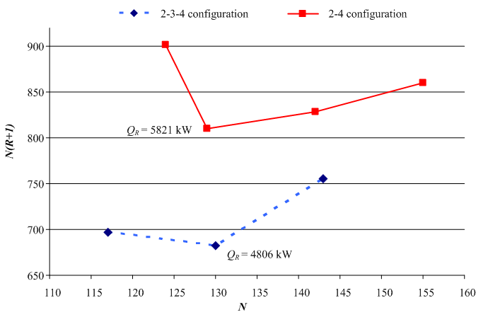
DETAILED DESIGN (once „infinite” number of stages model is set up)
DETAILED STAGE NUMBER AND REFLUX CALCULATION

Slide 26
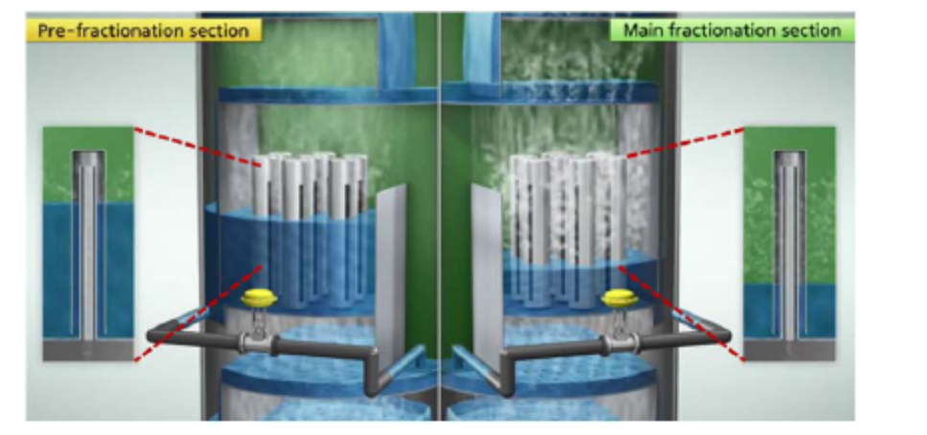
HYDRAULIC DESIGN
Equipment choice / modelling considerations
Liquid splits can be controlled
Vapor splits need to be designed (for now)
Dejanović, Matijašević, Jansen, Olujić, Ind. Eng. Chem. Res. 50 (2011) 5680 – 5692

Slide 27
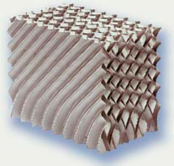
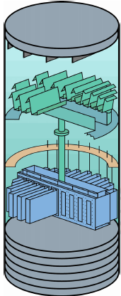
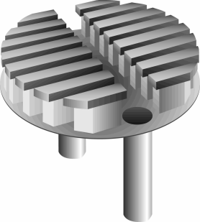

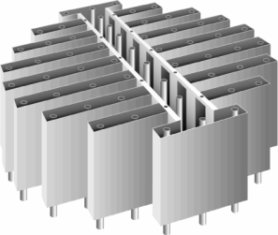
HYDRAULIC DESIGN
Equipment choice / modelling considerations
Various packing types and sizes to maximize flexibility: B1-250, B1-250MN, B1-350, and B1-350MN
B1-250M
Design rules:
Up to 20 equilibrium stages in a single bed;
Δp < 3 mbar/m;
Liquid collectors:
CT for side stream draw-off
CT for liquid loads > 20 m³/m²h
CC for lower liquid loads
Predictive models:
Delft Model for structured packings
Rix & Olujić model for internals
Chimney tray collector (CT)
Chevron collector (CC)
Narrow trough distributor (NT)
Dejanović, Matijašević, Jansen, Olujić, Ind. Eng. Chem. Res. 50 (2011) 5680 – 5692

Slide 28
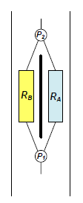
DIMENSIONING PROCEDURE: NEW DESIGN
No
No
No
No
Yes
Yes
Dejanović, Matijašević, Jansen, Olujić, Ind. Eng. Chem. Res., 50 (2011) 5680 – 5692

Slide 29
2-3-3 Vmin configuration
Internal layout
Equivalent sequence
Calculated results

Slide 30
2-3-3 Vmin configuration
Pressure drop balancing in partitioned part
Simplifications:
Parallel chanells modelled as circular columns of equal cross-section area.
Effects of heat transfer neglected.
2.1b 3.1a
For p5=p6:
Δp_{I} + Δp_{H} = Δp_{Y}
Δp_{H} + Δp_{G} = Δp_{A}
Δp_{G} + Δp_{F} = Δp_{X}
1.1 2.2 3.1b
1.2 2.2 3.1b
Fine-tuning by adjusting free area of collectors
Range: 5 – 30%
If insufficient: additional flow resistance can be introduced to generate the required Δp.
2.4 3.3

Slide 31
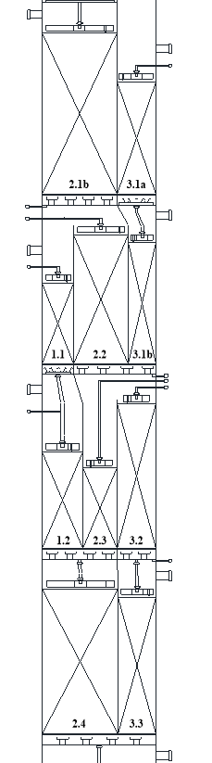
Hydraulic Design using EXCEL Solver
Packed column internals
Rix, Olujić, Chem. Eng. Process. 47 (2008) 1520-1529.
Structured packings: Delft Model
(all working equations can be found in:)
Dejanović et al., Ind. Eng. Chem. Res. 50 (2011) 5080-5092.

Slide 32
2-2-4 Vmin configuration
 | DWC
Top pressure (bar) | 2.7
Shell diameter (m) | 2.0
Shell height (m) | 69.0
Stage requirement (-) | 172 (130)
Sieve trays (#) | -
Reboiler duty (MW) | 4.80
Energy saving (%) | 52
Olujić, Dejanović, Kaibel, Jansen, Chem.Eng.Technol. 8 (2012) 1392–1404

Slide 33
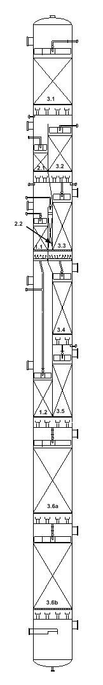
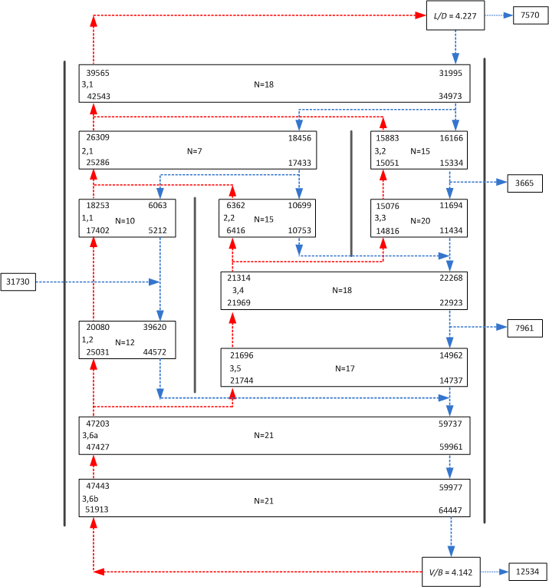
2-2-4 Vmin configuration

Slide 34
DIMENSIONING PROCEDURE – RETROFIT
Fixed value
No
No
No
No
Yes
Yes

Slide 35
2-2-4 as a retrofit
Jansen, Dejanović, Kaibel, Olujić, Chem. Engineering (August 2014) 40–48

Slide 37
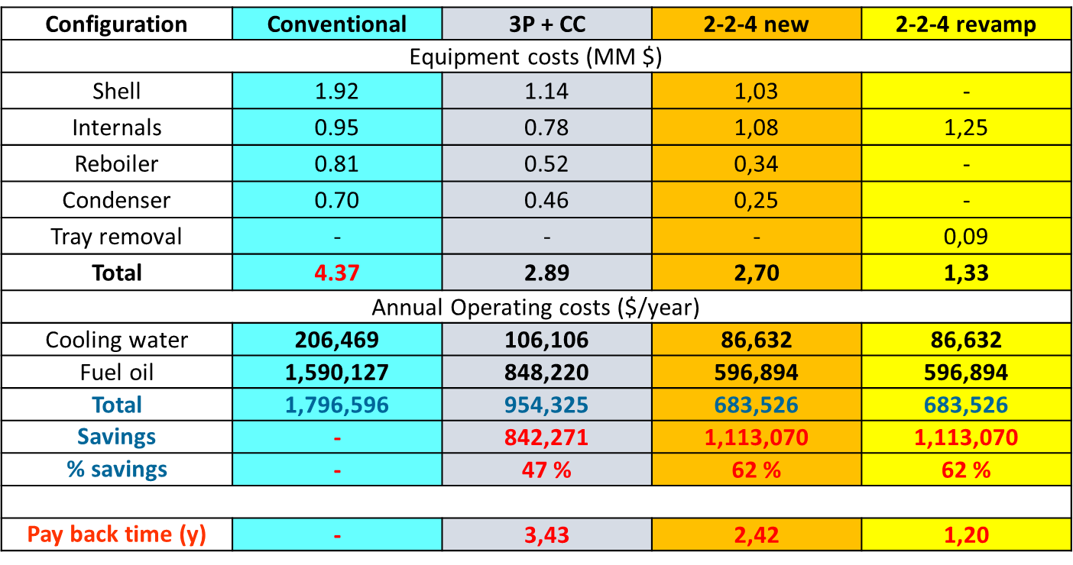
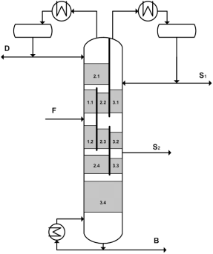
Cost comparison
Configuration | Conventional | 2-4 | s2-3-4 | 2-2-4 | 2-2-4 r | 2-3-3
Equipped with | Sieve trays | Struct. packings | Struct. packings | Struct. packings | Struct. packings | Struct.packings
Investment cost (MM $)
Shell | 1,82 | 1,08 | 0,98 | 0,98 | - | 0,95
Internals | 0,95 | 1,40 | 1,32 | 1,1 | 1,1 + 0,09 for tray removal | 1,27
Condenser | 0,66 | 0,23 | 0,22 | 0,22 | - | 0,25
Reboiler | 0,77 | 0,38 | 0,33 | 0,33 | - | 0,33
Total | 4,20 | 3,10 | 2,84 | 2,60 | 1,19 | 2,80
Operating cost (MM $)
Cooling water | 0,21 | 0,11 | 0,09 | 0,09 | 0,09 | 0,09
Fuel oil | 1,59 | 0,73 | 0,60 | 0,60 | 0,60 | 0,60
Total | 1,80 | 0,84 | 0,68 | 0,69 | 0,69 | 0,69
Savings | - | 53 % | 62 % | 62 % | 62 % | 62 %
TAC ($/year) | 2,22 | 1,15 | 1,00 | 1,00 | 0,81 | 1,00
Savings | - | 48 % | 56 % | 57 % | 63 % | 57 %

Slide 38
Conclusions
DWC is a proven technology, but each new application is a challenge.
Retrofiting existing 4 or more products sequences to save energy a promissing application field with high growing potential.
Complex configurations include multiple vapor-splits, which need to arranged with enough flexibility by design (retrofit in this case can be more flexible due to external vapor lines that can be throttled).
DWC as retrofit option can significantly improve profitability of aromatics processing plants
4P case revamp:
Two columns in series
61 % reduction in operating costs
Two columns in series: less complex internal configuration
Possibility of vapour split control
Payback period 1,2 years

