Slide 1
Modeling of once-through steam generators
William Davidsen
Supervisor: Sigurd Skogestad, IKP
Co-supervisor: Lucas F. Bernardino, SINTEF
Source: https://www.sintef.no/en/projects/2024/demo-cotsg/

Slide 2
Introduction
Reduce GHG emissions from NCS
Main contributor: Gas turbines
Improve turbine efficiency by introducing a steam cycle (utilize flue gas energy)
Weight and space limitations on offshore installations

Slide 3
System description
Add bottoming cycle to increase efficiency
Main focus on the once through steam generator (OTSG)

Slide 4
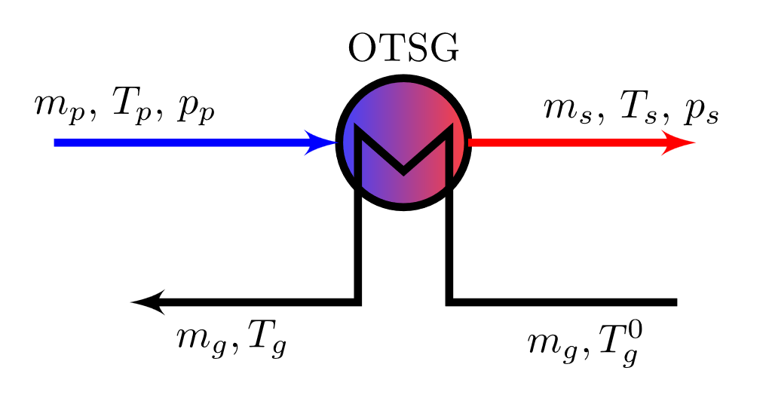
Method
Discretization
Mathematical formulation
$$\dot{y}=f\left(t,x,y\right)$$
$$0=g(t,x,y)$$
Model implementation

Slide 5
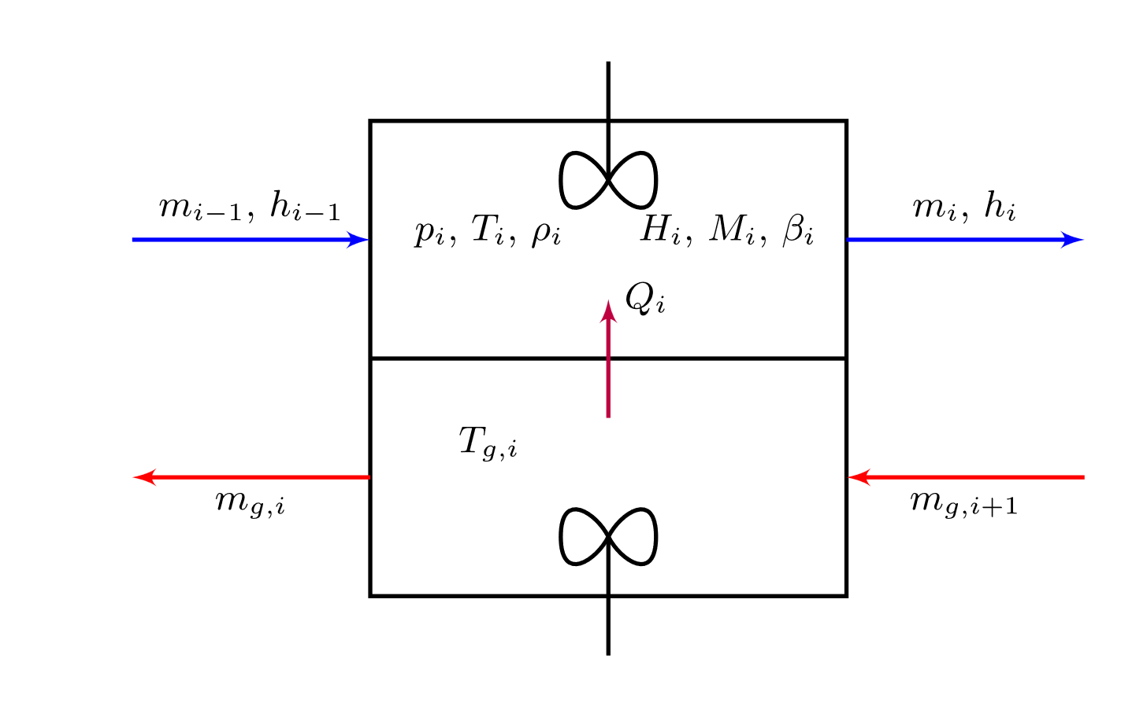
General procedure
Discretization
Volume and area equally distributed
Assumptions
perfect mixing
No heat loss
No thermal resistance
Discretization
Mathematical formulation
$$\dot{y}=f\left(t,x,y\right)$$
$$0=g(t,x,y)$$
Model implementation

Slide 6
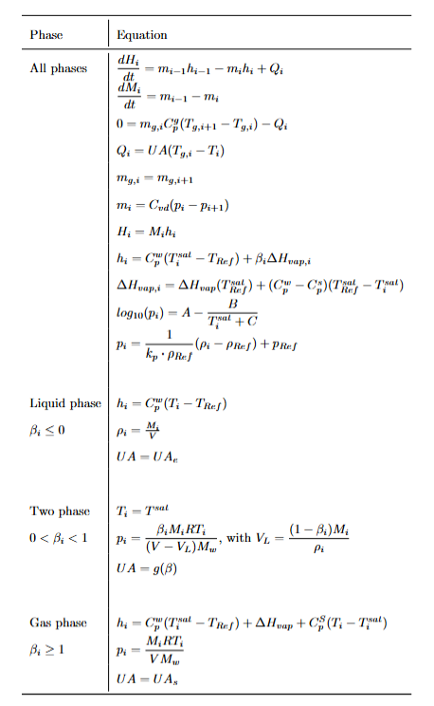
Mathematical formulation
Mass and energy balances
Different equations for each phase
Simplifying assumptions
Ideal gas
Constant Cp
Constant UA
Homogenous flow
Discretization
Mathematical formulation
$$\dot{y}=f\left(t,x,y\right)$$
$$0=g(t,x,y)$$
Model implementation

Slide 7
Model implementation
Discretization
Implementation: Matlab/Casadi
Solver: Idas/Sundials
Main c$hallange→$ Switching of equations
Two switching points: Dew and bubble point
Can use vapor quality $β$ to detect switching points
$$h=C_{p}^{w}\left(T−T_{Ref}\right)+βΔH_{vap}(T)$$
Casadi built in if-else to evaluate symbolic variables
Mathematical formulation
$$\dot{y}=f\left(t,x,y\right)$$
$$0=g(t,x,y)$$
Model implementation

Slide 8
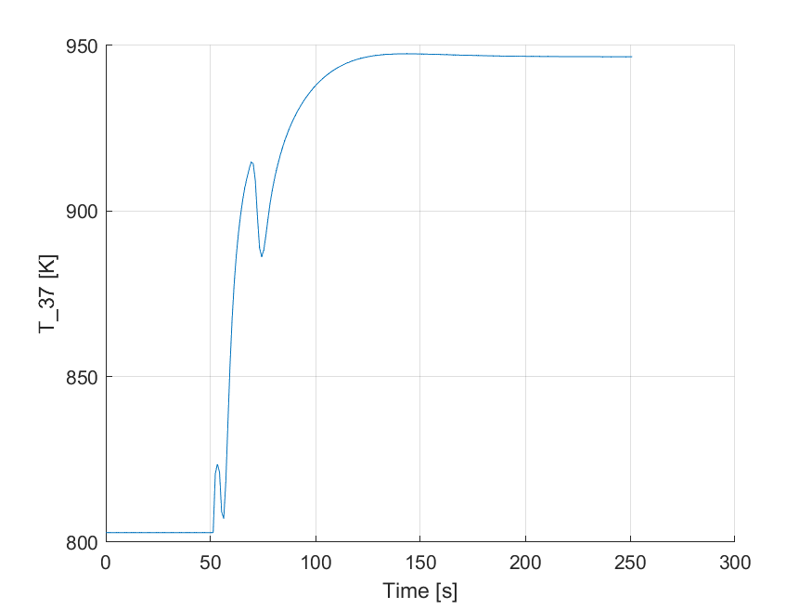
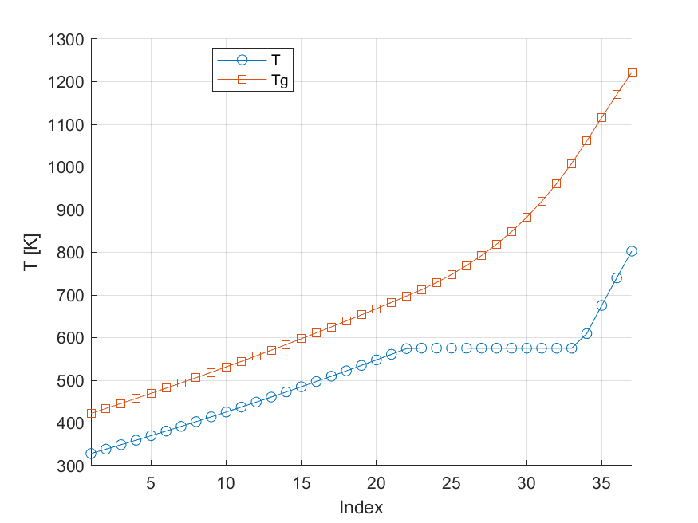
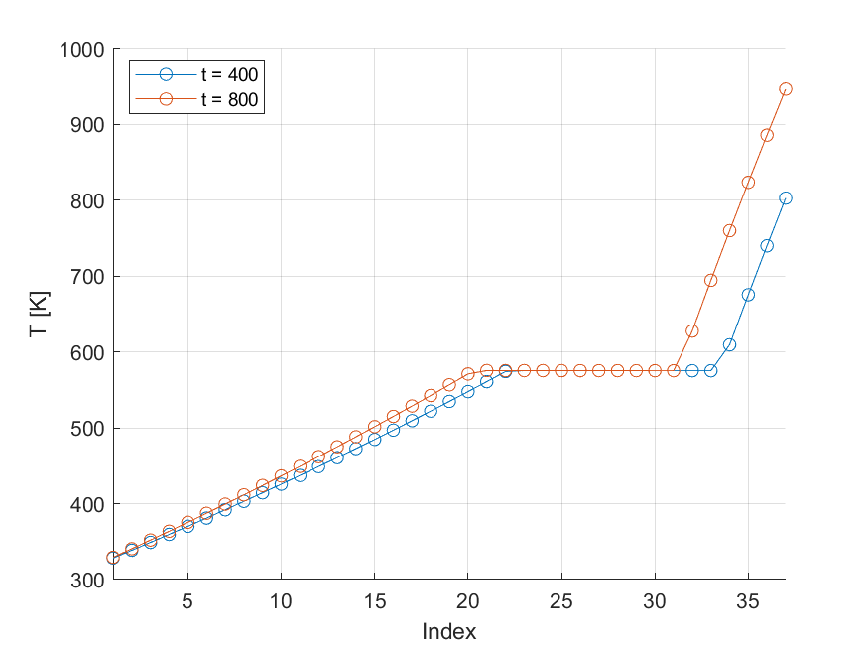
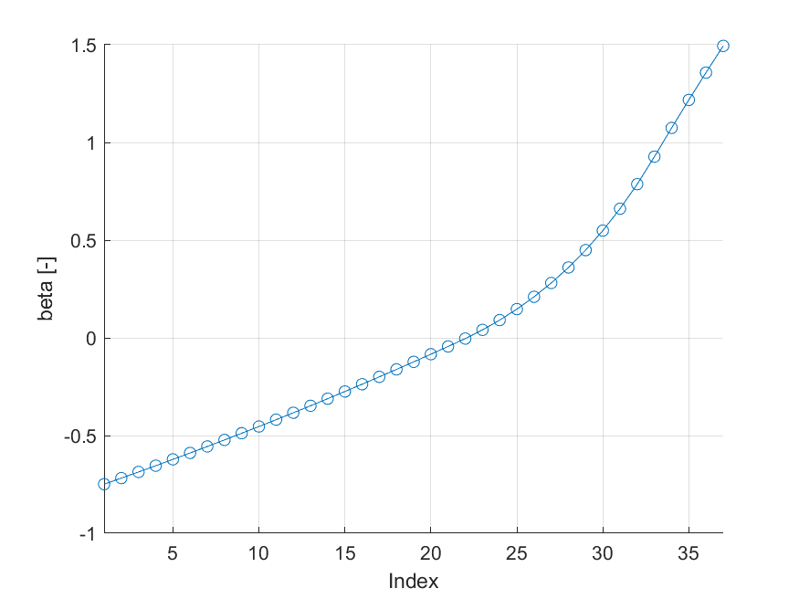
Simulations
Constants and inlet conditions based on Zotică (2020)[1]
Steady state simulations
Nominal operating point
Dynamic simulations
Steps in relevant disturbances
Shows switching of equations
Step in $T_{g}^{0}$
[1} Cristina Zotică, Lars O. Nord, Jenö Kovács and Sigurd Skogestad. Optimal operation and control of heat to power cycles: A new perspective from a systematic plantwide control approach. URL: https://www.sciencedirect.com/science/article/pii/S0098135419311342

Slide 9
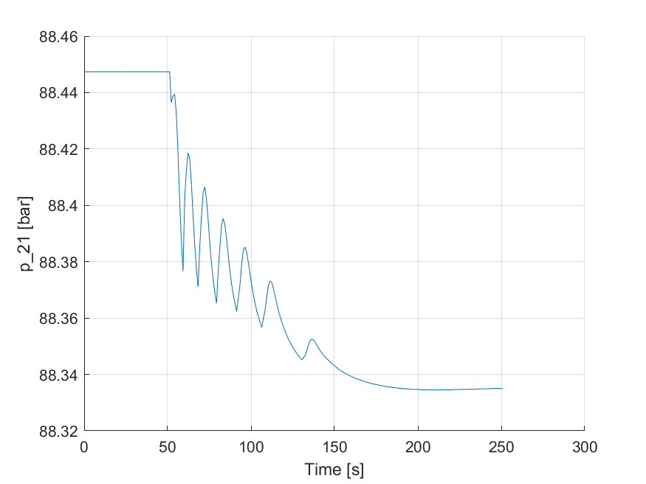
Challenges & future work
Initialization issues
Noise in m and p
Heat transfer issues
Set desired geometry
Implement steam turbine and other units
Add control elements

