Slide 1

Dynamic modelling of a Hex with phase change
Cristina Zotică
15.12.2016

Slide 2
Outline
Project objectives
HEX model
  assumptions
  illustration
  states, inputs, outputs
  equations
  analysis
Simulation & Results
Future work

Slide 3
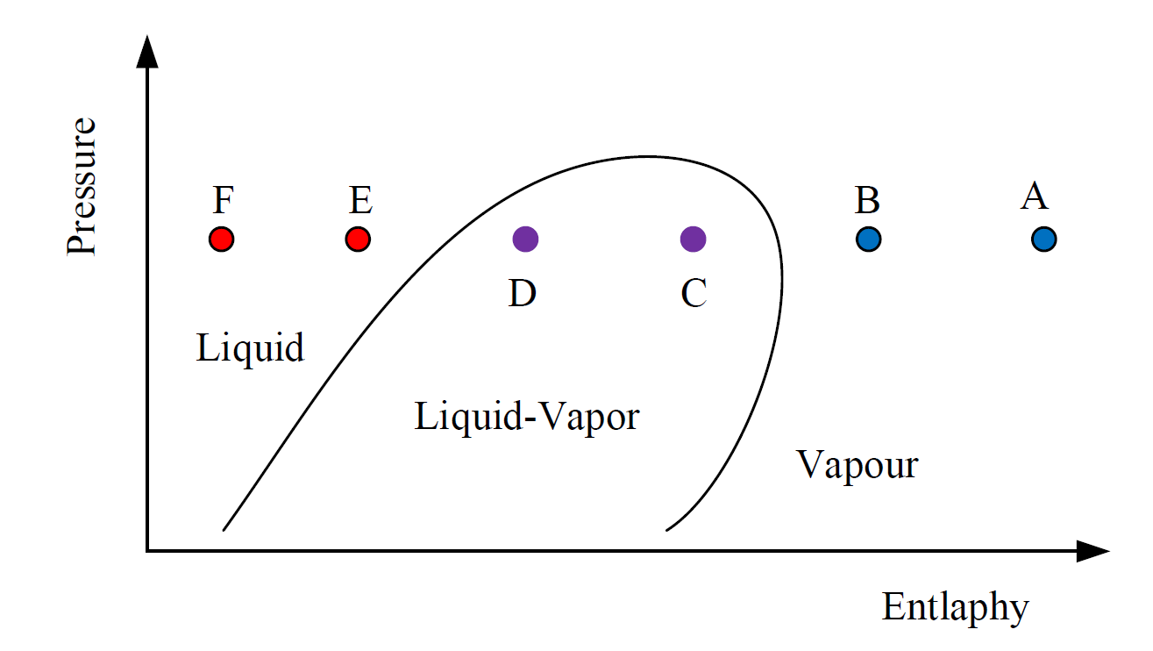
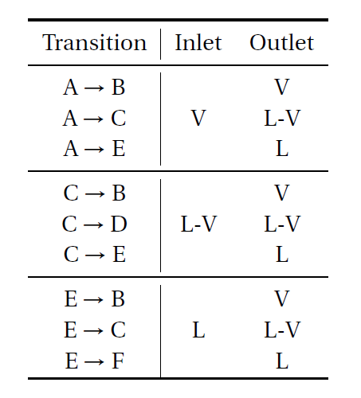
Project Objectives
Dynamic HEX model
Incorporate SRK EOS
main application:
  a small LNG refrigeration cycle

Slide 4
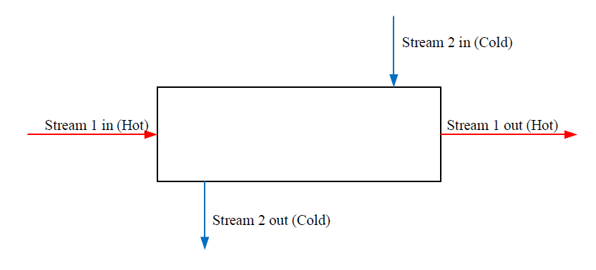
HEX Model - Assumptions
counter current
N cells (lumps) with equal & constant volume (Finite control volume method)
flash calculation in each cell
perfect mixing in each cell mixtures properties given by molar weighting rules
no slip gas and liquid has the same superficial velocity
small pressure drop
stream 1 (with phase change) a series of lumps
stream 2 (no phase change)
given exchanged heat inlet/outlet, flow, constant capacity for stream 2
specified value
equal per cell
no heat loss
the wall capacitance is neglected

Slide 5
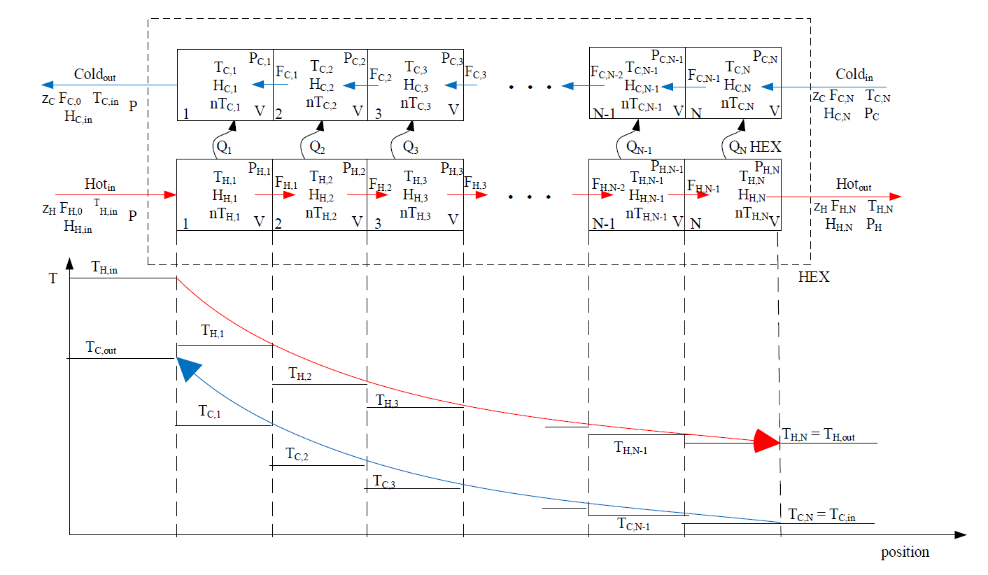
HEX Model - Illustration
General representation of the model

Slide 6
HEX Model – States
Nr | State definition | State symbol | Total number
1. | total holdup | nT | N
2. | component holdup | n | (NC – 1) x N
3. | internal energy | U | N
4. | temperature | T | N
5. | liquid composition | x | (NC – 1) x N
6. | vapour composition | y | (NC – 1) x N
7. | liquid volume | VL | N
8. | vapour compressibility | Zg | N
9. | liquid compressibility | ZL | N
10. | pressure | P | N
Total states 7N + 3 (NC – 1) x N
NC = nr components; N = nr cells

Slide 7
HEX Model - Inputs & Outputs
Inputs
  HEX dimensions (volume)
  MR inlet: flow rate, temperature, composition
  exchanged heat
  number of cells
Outputs
  MR outlet temperature
  temperature profile in HEX
  phase change localization

Slide 8
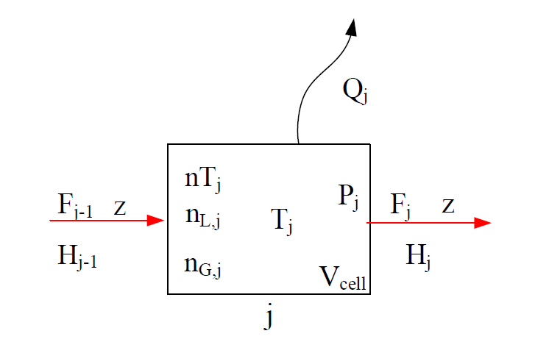
HEX Model - Equations
Nr | Equation | Formula | State attributed
1. | Overall mass balance |  | nT
2. | Component mass balance |  | n
3. | Energy balance |  | U
4. | Internal energy |  | T
5. | Component holdup |  | x
6. | VLE |  | y
7. | Holdup |  | VL
8. | Vapour compressibility |  | Zg
9. | Liquid compressibility |  | ZL
10. | VLE last component |  | P

Slide 9
Model Analysis
Differential Index
  constant pressure Index >1 (Matlab)
  introduce pressure as a state OK
Incidence Matrix analyze relation eq.-variables

Slide 10
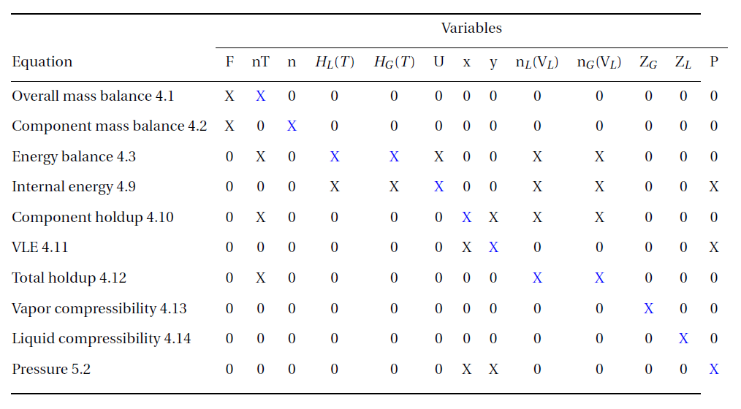
Incidence Matrix

Slide 11
Simulation – 1 Phase
eq. changed (no VLE)
const P
Cells number sensitivity

Slide 12
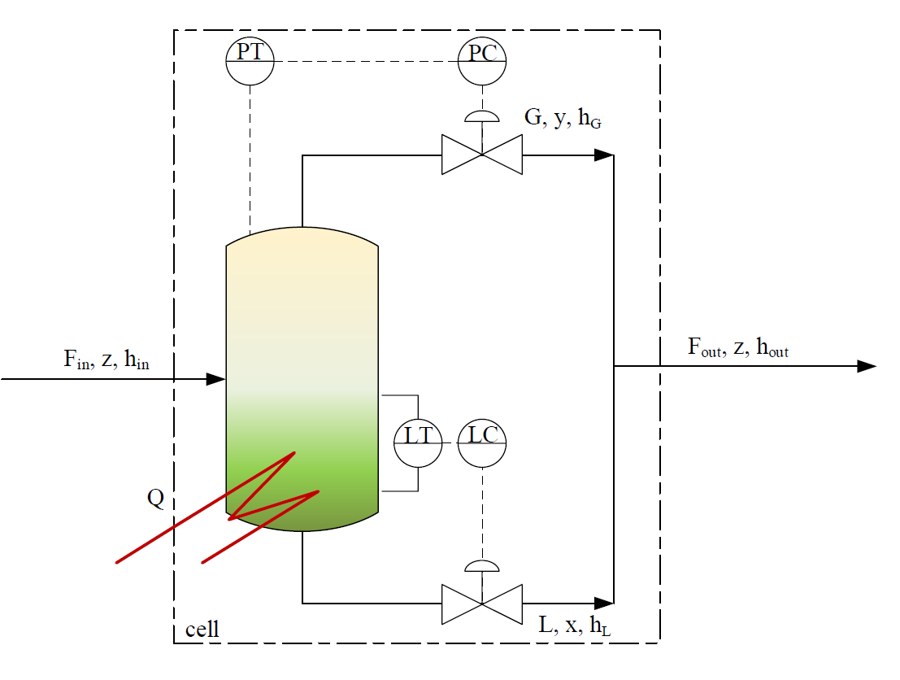
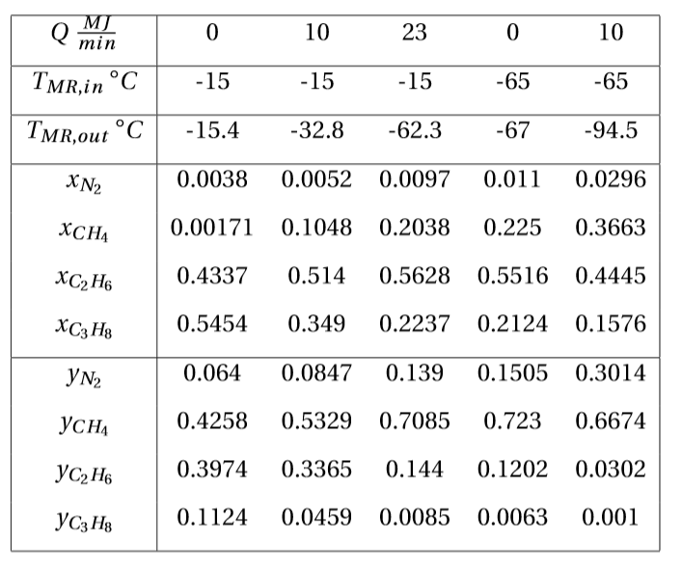
Simulation – 2 Phase
Flash Calculation
V= 0,66 m
V =1 m
3
1
3
2

Slide 13
Simulation – 2 Phase
transition with given heat source of 23 MJ/min (-15 to -65 ⁰C)
3

Slide 14
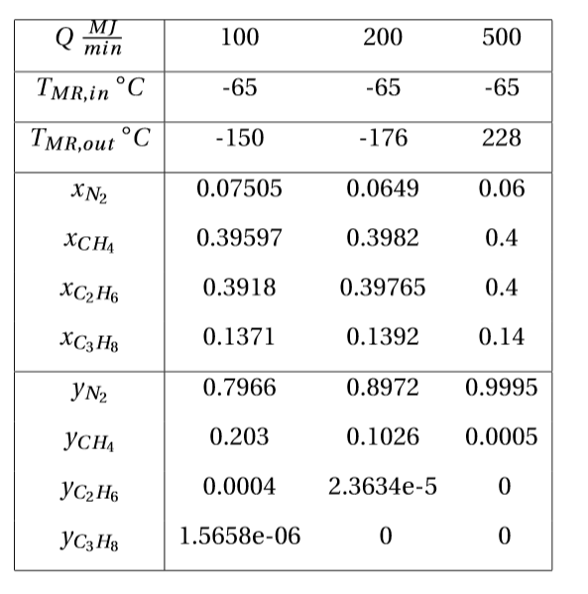
Simulation – 2 Phase
the most challenging transition
Single flash calculation

Slide 15
Future work
reconsider assumptions
model both streams as a series of lumps
transition across different phase regions
change the solver (?)

Slide 16

Notes:
write the model in term of extensive variables

