Slide 1
Dynamic modeling of compressor system in nitric acid plant
Specialization project fall 2015
Ingvild Marie Sørlie

Slide 2
My project
Summer internship 2015 with Yara
Dynamic modeling in Hysys
Industrial project

Slide 3
Outline of the problem
Backflow during shut down
Damages platina gauze
Compressor
Closing time valves

Slide 4
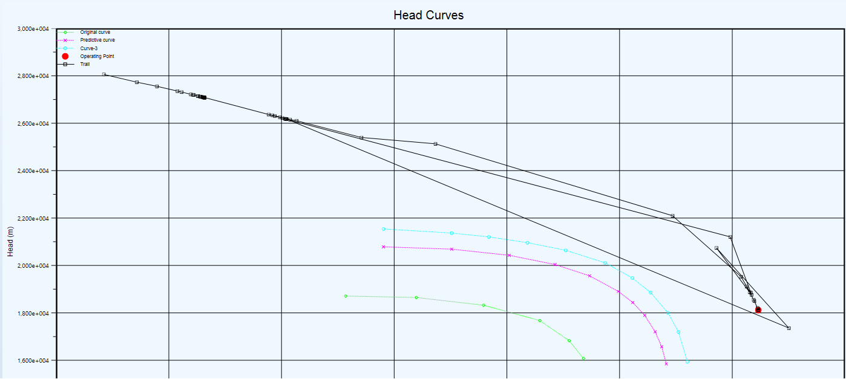
Important modeling aspects
Dynamic simulation - valves
Volumes – pipe segments
Compressor curves
Ammonia burner

Slide 5
The model

Slide 6
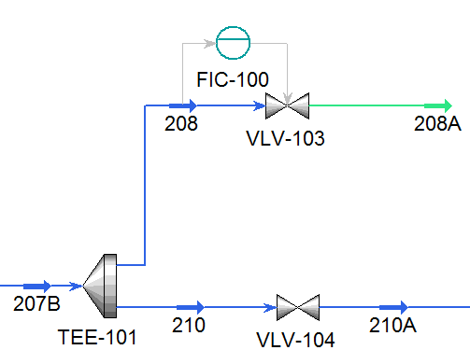
The valves – closing time
Three valves closing during shut down
Different closing time

Slide 7
Simulation
Different valve closing times
Use valve controllers – ramp controller
Simulate from steady state
Simulate from collected data

Slide 8
Simulation - Results

Slide 9
Simulation – Results Low Pressure

Slide 10
Conclusion
Tuned model consistent with steady state
Simulation failed to show backflow
Model improvements
Accuracy in simulation

