Slide 1
Development of an appetite model for fish
Siri Kildal Hansen

Slide 2
Outline
Motivation
My work
Questions

Slide 3
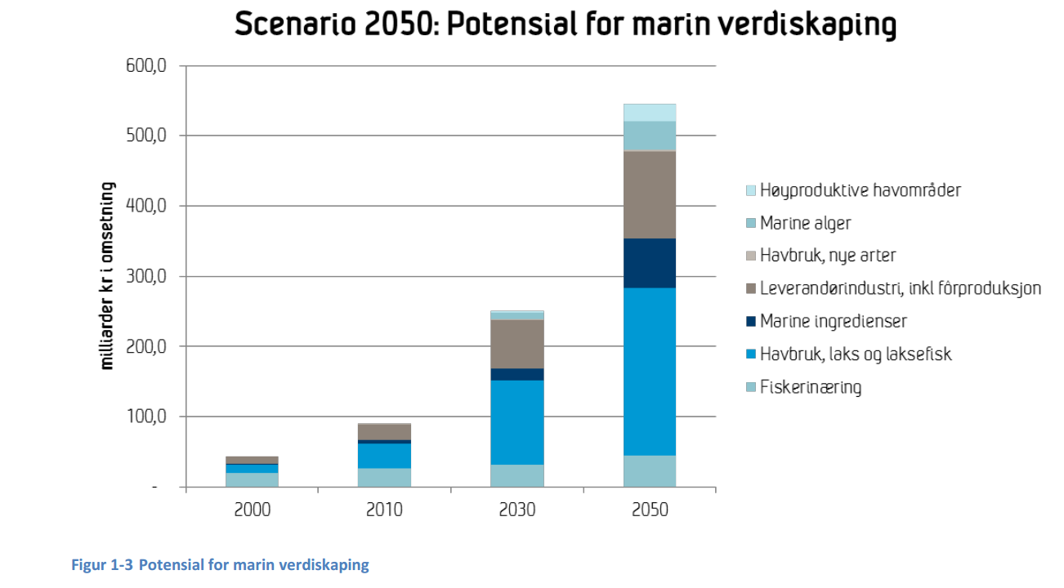
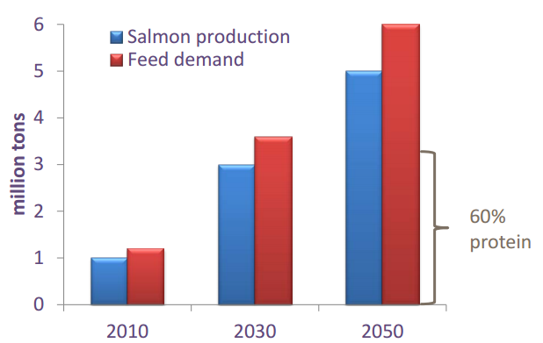
Motivation
Appetite → Feed intake → Growth → Annual production
DKNVS/NTVA (Olafsen et al., 2012)

Slide 4
My work
Part 1: Literature study
Part 2: Mapping and modelling
Part 3: Estimation of parameters
Part 4: Simulation

Slide 5
Part 1: Literature study
What are the factors affecting appetite?
Endocrine appetite regulation

Slide 6
Part 1: Literature study
External factors
Photoperiod
Temperature
Water flow
Salinity
Oxygen levels
pH
Turbidity
Stock density

Slide 7
Part 1: Literature study
Internal factors
Anorexigenic
  Amylin
  Calcitonin gene-related peptide (CGRP)
  Cholecystokinin (CCK)
  Cocaine- and amphetamine-regulated transcript (CART)
  Corticotropin-releasing factor (CRF)
  Cortisol
  Gastrin-releasing peptite (GRP)
  Glucagon-like peptide-1 (GLP-1)
  Gonadotropin-releasing hormone (GnRH)
  Intermedin (IM)
  Leptin
  Melanin-concentrating hormone (MCH)
  Melatonin
  Neuromedin U (NMU)
  Pituitary adenylate cyclase-activating polypeptide (PACAP)
  Prolactin-releasing peptide (PrRP)
  Urotensin I (UI)
Orexigenic
  Apelin
  Galanin
  Ghrelin
  Growth hormone (GH)
  Neuropeptide Y (NPY)
  Orexins (OX)
  Insulin

Slide 8
Part 1: Literature study
Internal factors:
Anorexigenic
  Amylin
  Calcitonin gene-related peptide (CGRP)
  Cholecystokinin (CCK)
  Cocaine- and amphetamine-regulated transcript (CART)
  Corticotropin-releasing factor (CRF)
  Cortisol
  Gastrin-releasing peptite (GRP)
  Glucagon-like peptide-1 (GLP-1)
  Gonadotropin-releasing hormone (GnRH)
  Intermedin (IM)
  Leptin
  Melanin-concentrating hormone (MCH)
  Melatonin
  Neuromedin U (NMU)
  Pituitary adenylate cyclase-activating polypeptide (PACAP)
  Prolactin-releasing peptide (PrRP)
  Urotensin I (UI)
Orexigenic
  Apelin
  Galanin
  Ghrelin
  Growth hormone (GH)
  Neuropeptide Y (NPY)
  Orexins (OX)
  Insulin

Slide 9
Part 2: Mapping and modelling

Slide 10
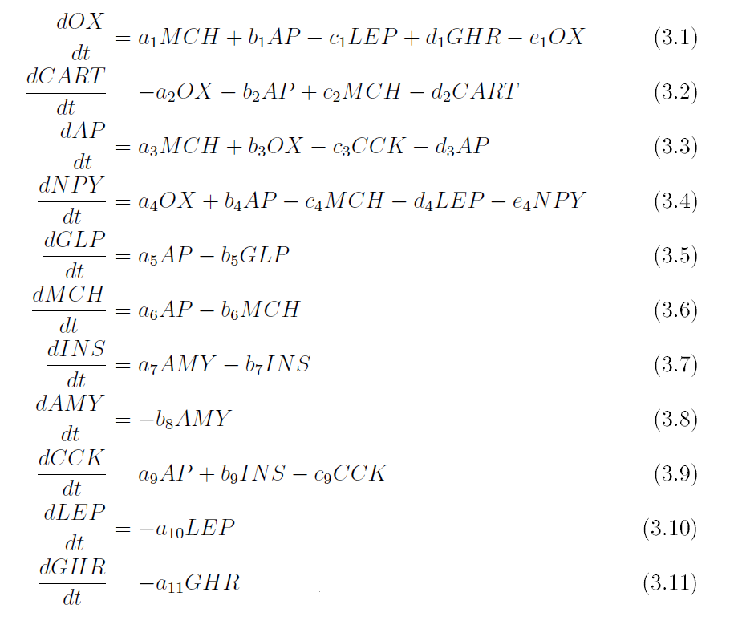
Part 2: Mapping and modelling

Slide 11
Part 3: Estimation of parameters
Cftool in MATLAB

Slide 12
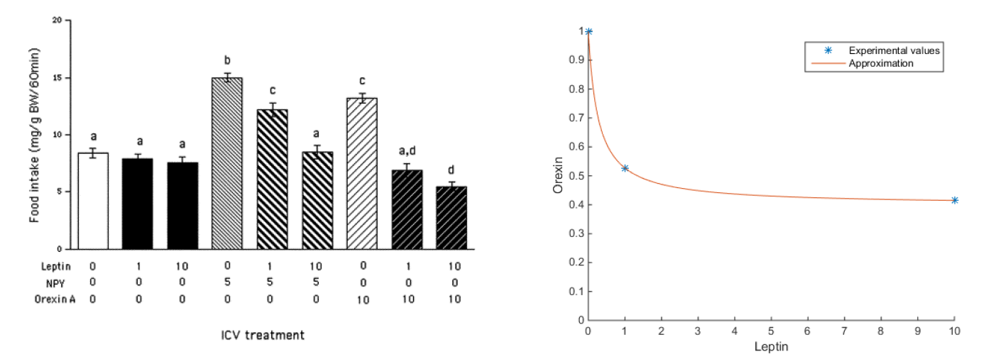
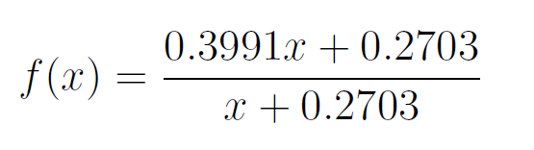
Part 3: Estimation of parameters

Slide 13
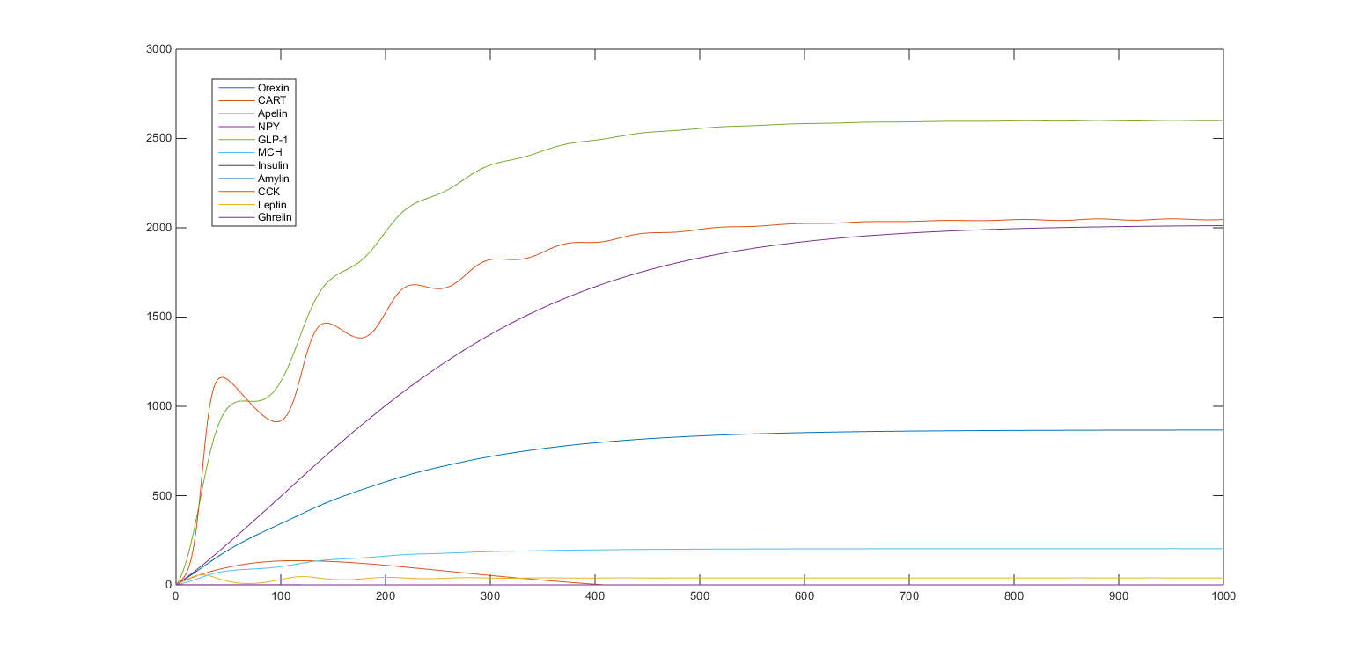
Part 4: Simulation
Ode45 in MATLAB

Slide 14
Further work
Statistical analysis
Expand model: add more factors
More research is needed

Slide 15
Questions?

