Slide 1
Modelling and Optimization of Compact subsea separators
By: Fahad Matovu
Supervisors: Prof. Sigurd Skogestad
Johannes Jäschke
NTNU
OCTOBER 15, 2014.

Slide 2
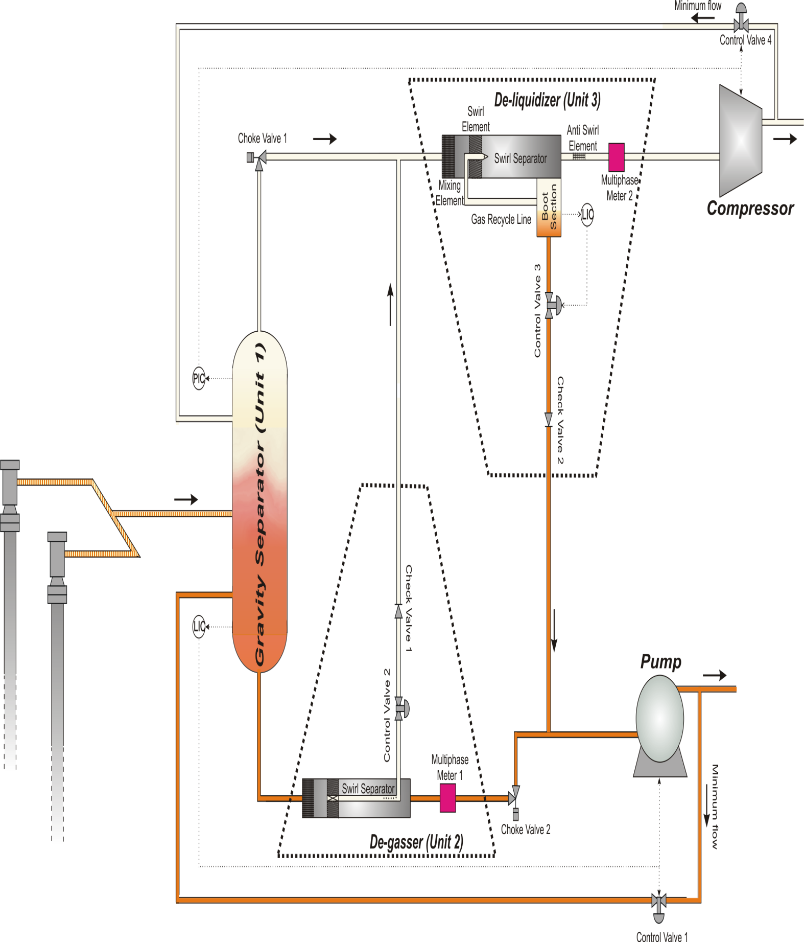
Compact subsea separation unit
Source: Compact Sub Sea Separation report by Christian Ellingsen, 2007

Slide 3
Work done so far
Aim: Model the deliquidizer in which there is separation of the entrained liquid from the gas. Predict the quality of the gas (volume fraction) as a function of inlet volumetric flow rate.
Models obtained so far have been based on the idea of the radial settling velocity, replacing the gravity term with the centripetal acceleration. Then integration over an area of a slice of the pipe to obtain the volumetric flow rate of liquid separated.
(Not a success yet). Doesn’t take into account the distribution of droplets. Assumes the radial velocity to be the average velocity of the droplets.

Slide 4
Next plan
Come up with some distribution of droplets over an area /volume and incorporate it into the models.
Alternative. Use the limiting case $t_{radial}= t_{axial}$ to predict the minimum inlet radius required for droplet separation. Use this to predict the separation based on particle distribution.
Separated liquid enters the boot section.
Another task is to predict the quality of the liquid as a function of the liquid holdup time in the boot section.
(Task not yet started)
Thank you!!!!

