Slide 1
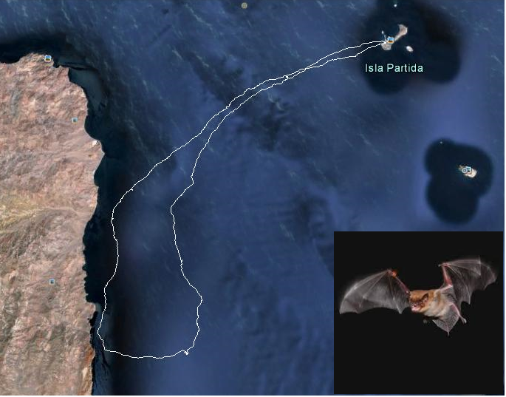
Title: Long distance guidance control and navigation of bats.
Student: Sigmund Andenes
Supervisor: Nadav Skjøndal Bar

Slide 2
Motivation for project
Propose a hypothesis that can explain navigation in bats, using control theory.
The results may have potential industrial applications→ Guidance control under difficult conditions or in absence of GPS.

Slide 3
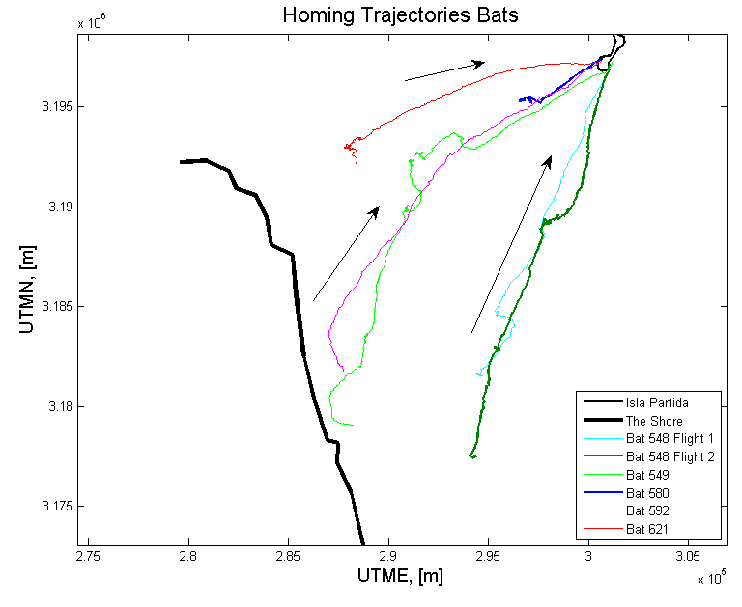
What have I done? → Results?
Read articles about animal navigation & previous research.
Studied mechanisms of navigation in animals.
Analyzed GPS-data from bats in Mexico. Matlab and Google Earth.
→ Do not have same turning point.
→Seems to know exact homeward direction.

Slide 4
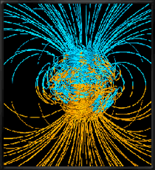
Planned Work
Hypothesis: Bats use the earth’s magnetic field to navigate. Geomagnetic bi-coordinate map?
Develop a model of navigation in geomagnetic field. → The World Magnetic Model.
Apply P, PI or PID controller that fit the bats behavior best.
Continue reading relevant articles.

