Slide 1
Modelling and Optimization of Compact Subsea Separators
Name: Preben F. Tyvold
Supervisors: Sigurd Skogestad & Johannes Jäschke
Recycled water
Swirl separator
Oil outlet
Feed
Gravity separator
Water outlet
Swirl separator
Recycled oil

Slide 2
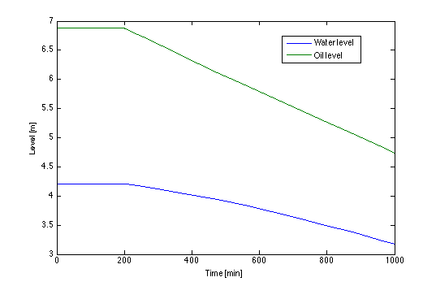
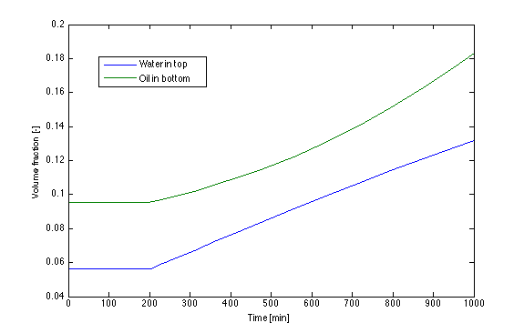
My Model this Far
Gravity Separator
Two components: Water and Oil
Response for: -10 % feed rate at t=200

Slide 3
Planned Work
Add a third component:
Asphaltenes (surfactant)
How are the distributed?
Consider accumulation of asphaltenes
Recycle
Drain

