Slide 1
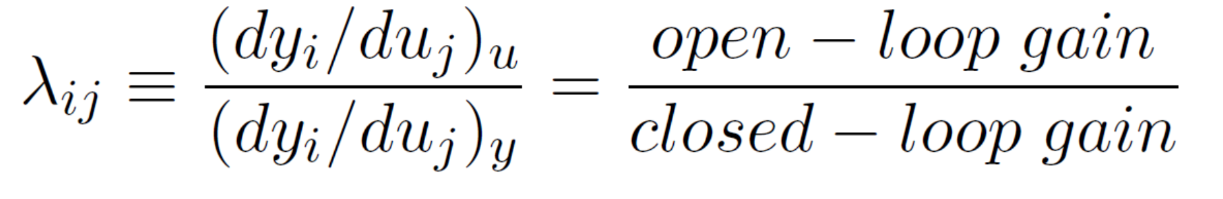
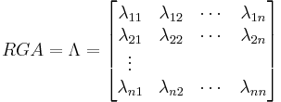
Paring on negative rga Elements
Martin J. Bland
Supervisor Sigurd Skogestad
Notes:
SISO-control of coupled processes. Recommended practice is to couple the selection of variables that give positive elements close to one.
But what happens if one pairs on negative elements? Most literature discourages this
-Sequential loop closing, for right gain
-Stability issues

Slide 2
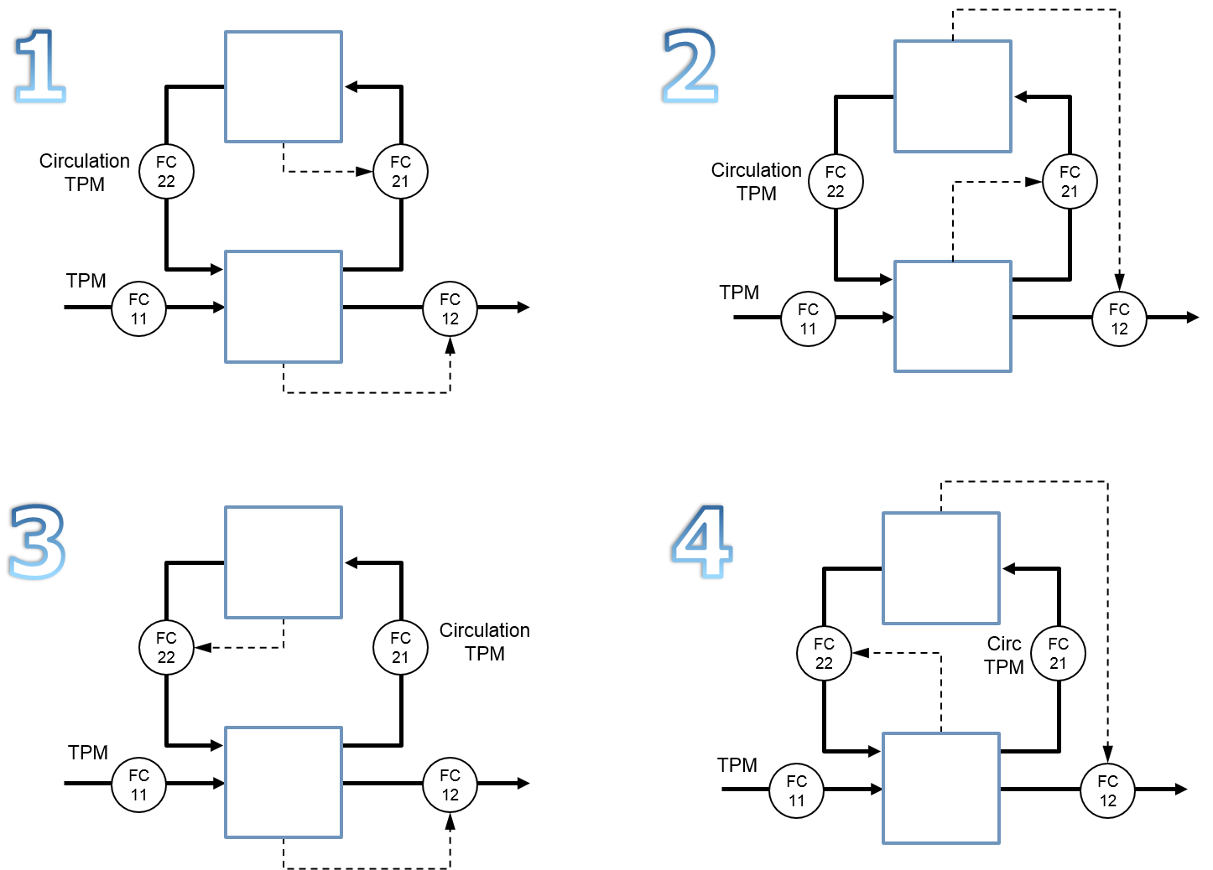
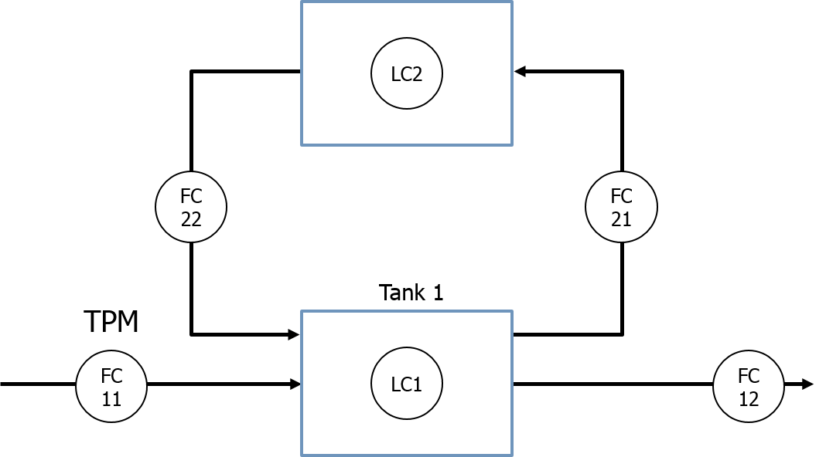
Two tank example (Zero coupling) from Krister Forsman
Notes:
Toy example from Krister Forsman. Level control of two tanks with TPM at inlet
Gives four possible control configurations.
1 and 3 are obvious with direct control, but how about two and four with indirect coupling? How do they compare
This is essentially coupling on a zero element in RGA matrix, have to close inner loop (control of lvl 1) before one can tune for lvl2 outer loop.

Slide 3
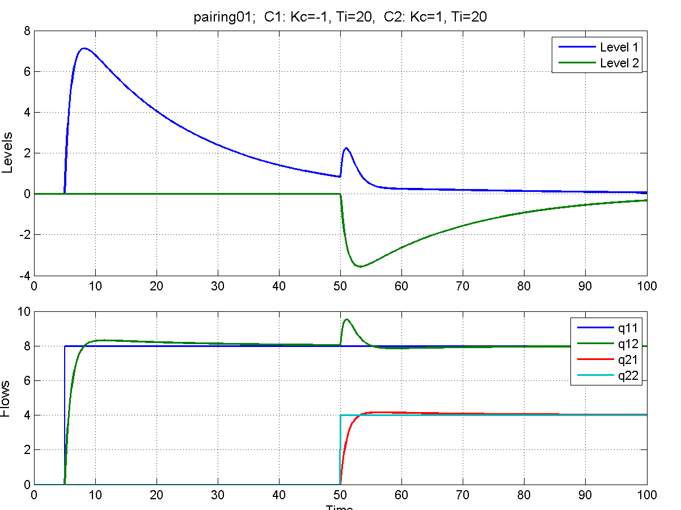
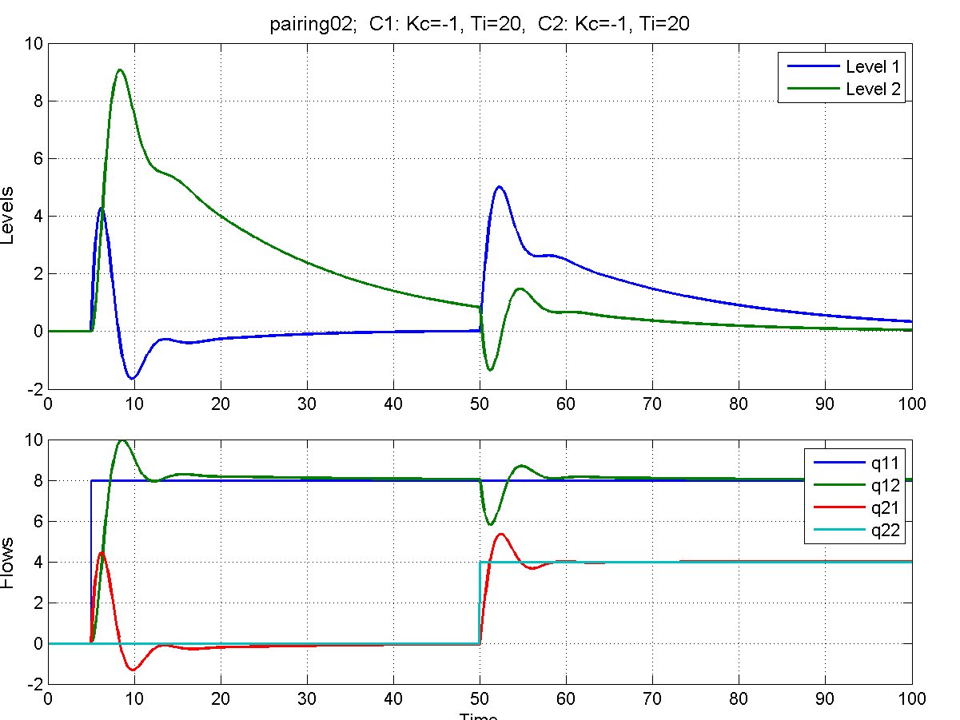
No Delay → Little Penalty For zero coupling
Notes:
With no delay, can have identical controller settings!
Not very large difference between the direct and indirect coupling

Slide 4
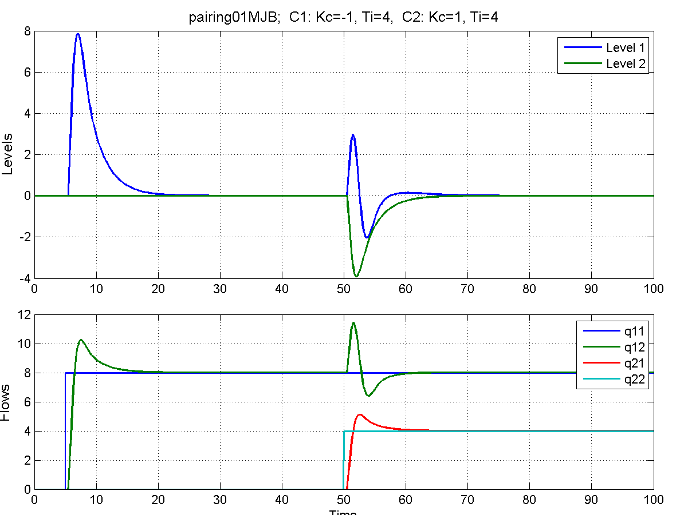
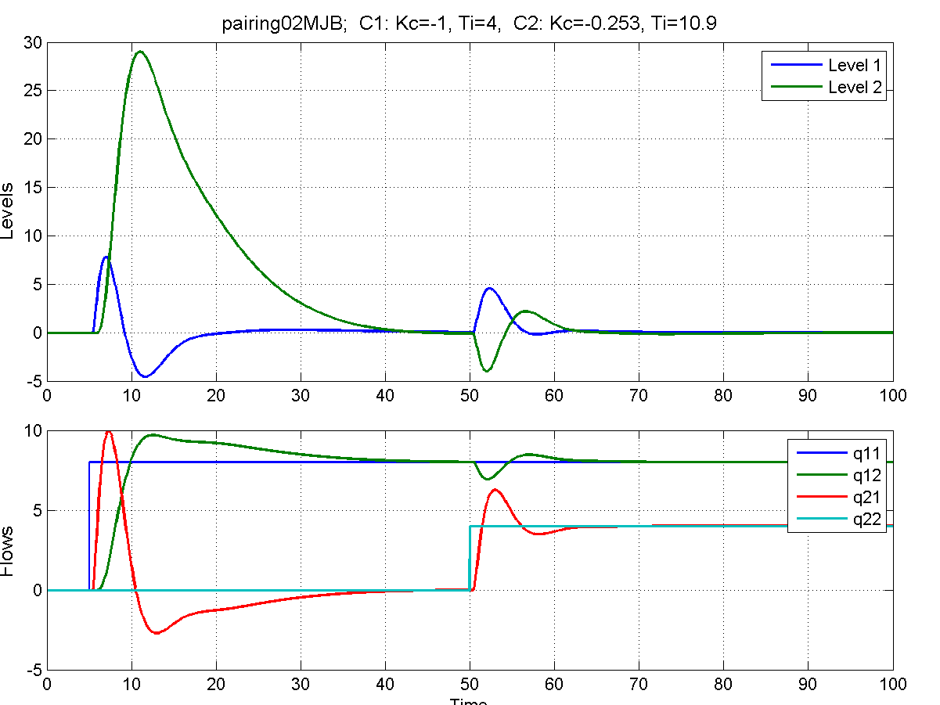
With delay and simc-tuning
Notes:
Delay of 0.5 (relative to gain). Hold up of 50% of controller gain

Slide 5
Further work
Look at negative gain elements
Find one or two more case studies
Further study of RGA properties
Suggestions for cases?

