Slide 1

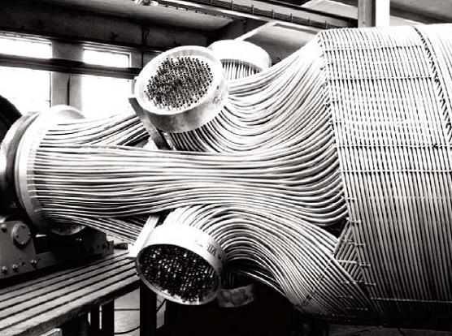
FLNG
Cooling cycles
Anders Leirpoll
Specialization Project for NTNU/Kongsberg Oil & Gas Technologies
Supervisor (NTNU): Magne Hillestad
Advisor (Kongsberg): Torgeir Løvmo

Slide 2
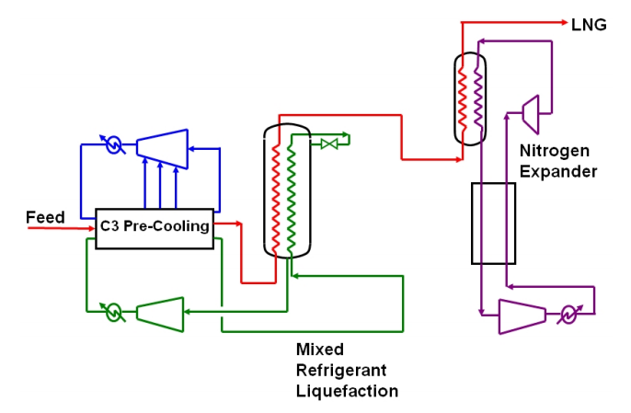
Land based plants – AP X

Slide 3
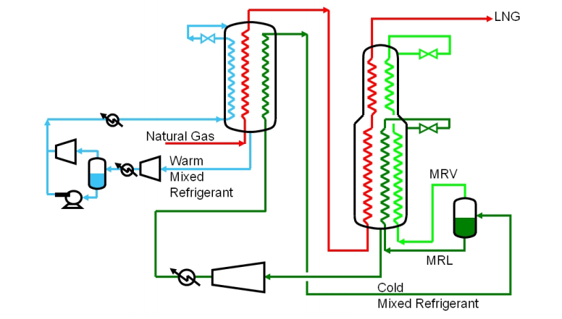
Shell Prelude - DMR

Slide 4
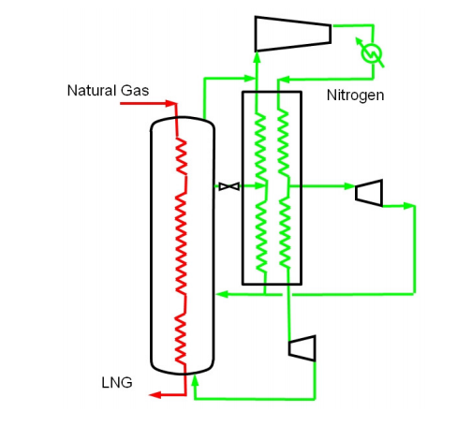
Petronas FLNG 1 & 2

Slide 5
Comparison
Vessel motion
Refrigerant phase
Flammability of refrigerants
Efficiency
Refrigerant volume
Train capacity
Arrangement
Compactness
Complexity

