Slide 1
Modeling and simulation of path-finding ants
Adrian Finvold
Supervisor: Nadav Bar

Slide 2
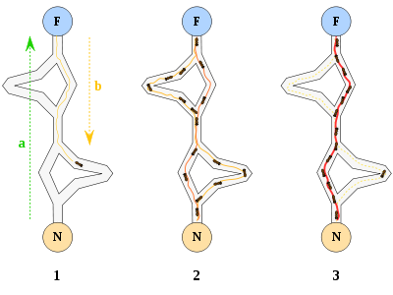
Pheromones in food finding
Optimization
Evaporation
Path integration
Notes:
What you see here is a food source and a ants nest. The way of getting to the food source and back is a set of different combinations. The ants walking home from the food source are laying pheremones in order to recruit other ants to join the exploitation of the food source. The ant are able to optimize their trail route by the pheromones evaporation rate. By this it means that some ants will go the short way, and will return to nest before the ant on the long route. This implies that the pheremones concentration on the short route will be higher, and therefor preferable route for the next ant. The ants have in addition the ability to path integrate their way too food source, and thereby calculate their most effective distance home.
Some ant species are also modifying their intensity and frequency of pheromones according to the food source quality. This prevents extensive use of workers on a small and poor food source.

Slide 3
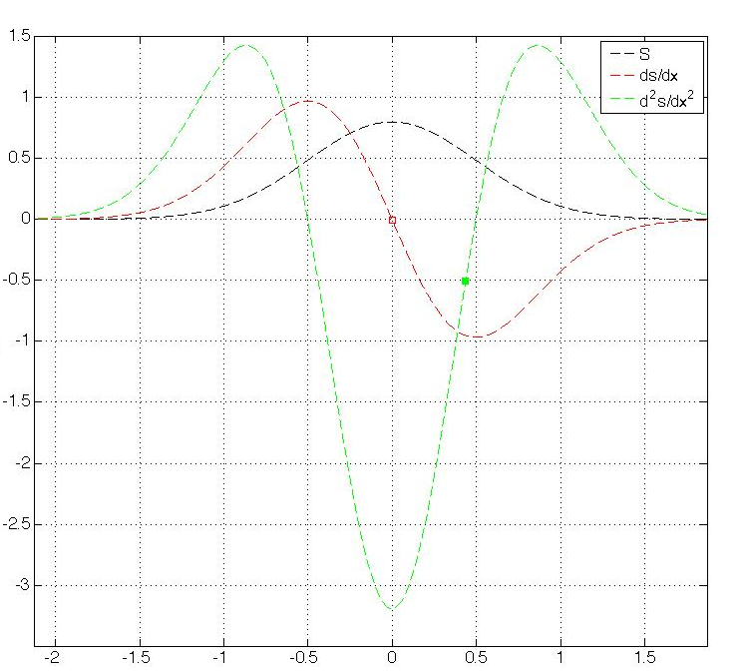
Project motivation:
Signal differentiation
Signal / Concentration
Distance from center of pheromones (cm)
Notes:
This Is the background for the project, and this is a illustration of the normal distributed Pheromone level, marked in black. **** forklare akser ***
The first derivative of the normal distributed curve is presented in red. The hypothesis of the ants path following behavior is that the ants uses its two antennas to differentiate over a given distance in order to visualize the outer points of the trail route. With use of the differentiated pathway, the second derivative is used to determine the direction of the ant by use of convex and concave observation.

Slide 4
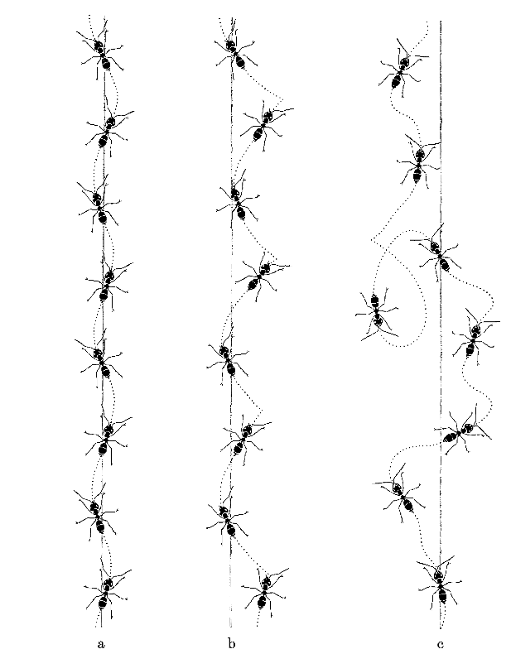
Real observation of ants
a) Both antennas intact
b) Left antenna clipped
c) Antennas crossed over
a) b) c)
Notes:
The observation of experiments shows that ants do not have a stable regulator and thereby causing sustained oscillations. In figure a) we have ants with their both antennas intact. In b) we have ants with their left antenna clipped, and c) we have ants with their antennas crossed over.
What is remarkable is that the ant is able to get to the target even with their antennas crossed over. This implies that the ant must use a maybe a visual cue in addition to the pheromone detection system.

Slide 5
Project goal:
Simulate Real behavior of ants
PID-regulator
Alternative trail formations
Compare to real situations

