Slide 1
Economic Plantwide Control using Commercial Process Simulation Software Project Status
Adriana Reyes Lúa
Supervisor: Sigurd Skogestad
Co-Supervisor: Vladimiros Minasidis
October 10th, 2013

Slide 2
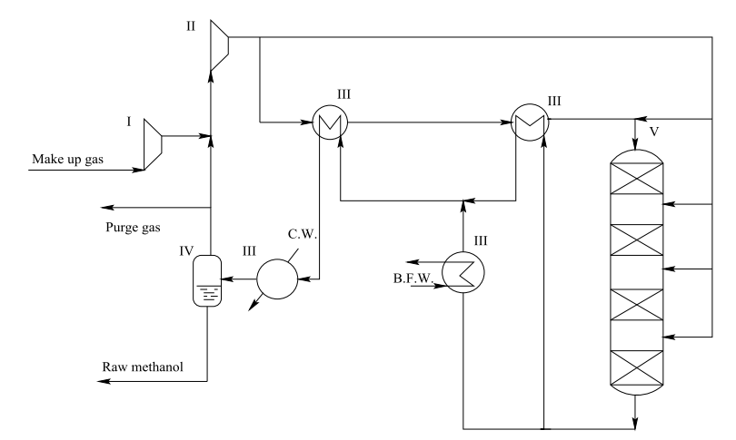
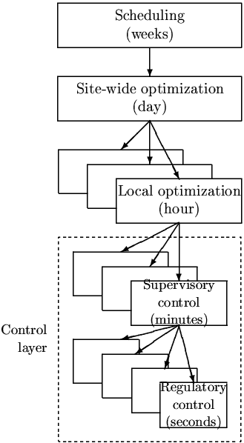
Process
Methanol Production
y₁ = c ? (economics)
y₂ = ? (stabilization)

Slide 3
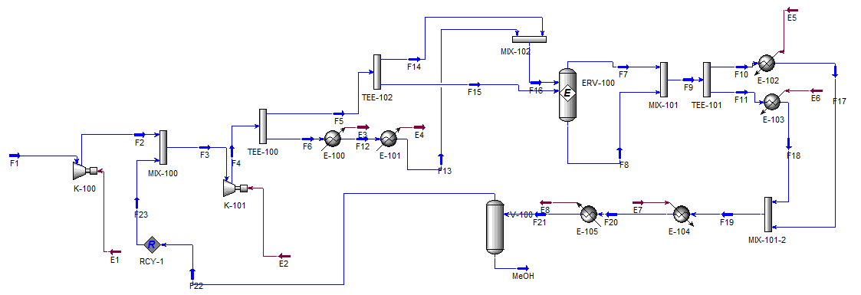
So Far
Next Step
Optimize process model using external NLP solver.
Design a self-optimizing control structure.

