Slide 1
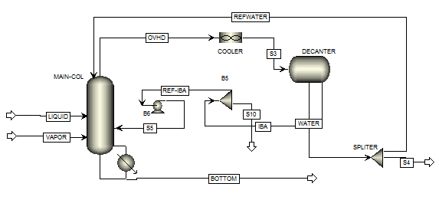
Semester project :
Azeotropic distillation
Supervisor: Krister Forsman
Student : LE Quang Khoa
Acetic Acid (heavy component)
Water ( light component)
Isobutyl Acetate(IBA) : entrainer

Slide 2
Mole fraction :
Bottom :
Acetic Acid : 0.92
Water : 0.06
Other : 0.02
Overhead :
Acetic Acid :
Water : 0.92
Other : 0.08

Slide 3

Sensitivity : change of bottom composition by varying bottom rate, reflux ratio or heat duty.
Heat integration
Thank you for your attention

