Slide 1
Bacteria stress responce to high pressure processing
Tine Bergitte Heggernes
Supervisor: Nadav Skjøndal-Bar
Project with Nofima – Måltidets Hus, Stavanger
Notes:
Department for food researching

Slide 2
Motivation and objectives
HPP - relatively new food processing technique.
Avoid quality degradation - both killing bacteria and gentle to food
More knowledge about how microorganisms react to stresses → Easier to prevent their growth
Listeria monocytogenes
The bacteria response - change of gene expressions and mechanisms in the cell when stressed.
Determine up to 5 potential marker genes involved in resistance
Find good models which predicts bacteria inhibition from high pressure processing

Slide 3
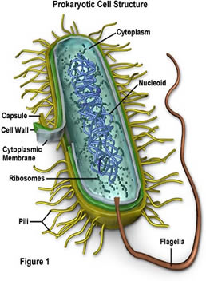
Results and future work
Genes involved in the bacteria cell membrane and cold shock genes
Choose the most important genes from these mechanisms
Preferably genes which are easily targeted and/or hub genes

