Slide 1
Depressurization of vessels under fire attack.
Validations of thermodynamic state calculations in Brilliant
Sigve Karolius
Supervisors: Associate professor Tore Haug Warberg
Petrell AS
Notes:
About yorself…..
Work with Tore due to the opportunity to do something a bit different
Petrell: Plant safety and fire integrety using CFD (Brilliant) and VessFire analysis.
Process safety considerations
Comercial software VessFire

Slide 2
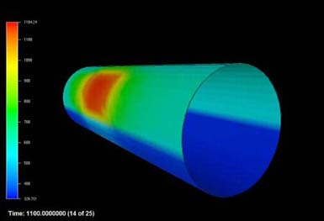
Challenges
Pressure profiles
Temperature gradients
Mechanical stress
Spatiotemporal
Notes:
Seems simple, (only assume isentropic or isentalpic expansion)
Complicated problem due to competing processes large gradients
Accurate model accounts for; multiphase considerations, spatial temperature distribution, structural interity
Temperature falls below ductile brittle point

Slide 3
Progress
Simplified model to understand the fundamentals.
Literature review
Q
W
Q
V
m
Notes:
Lumped model of vessel wall and content ”valve equation” accounts for the outflow.
VessFire uses time-step method, however pressure steps is also possible (Petrell did not think this was done in practice)

Slide 4
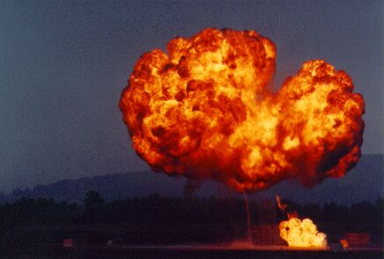
Plans
Compare simulations with experimental data
Explore depressurization techniques
(Try to implement a simple “homemade” algorithm)
Notes:
Repeat validation simulations, find data on more recent experiments
More in depth look at the pressure step technique
Wish to implement a simple version myself

