Slide 1
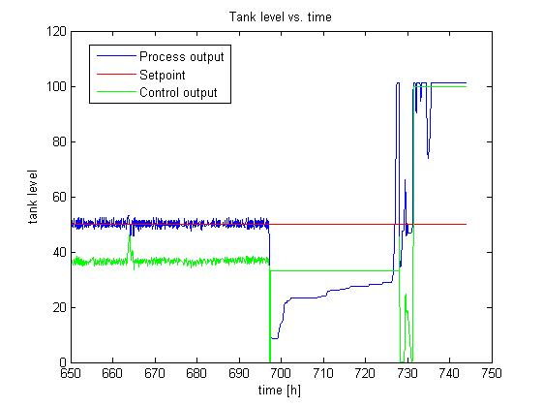
Typical PID settings
Ingrid Didriksen
Supervisor: Krister Forsman
Level control at a Perstorp plant

Slide 2
Method: SIMC tuning rules
So far
- Read about tuning methods
- Looked at operational data
Planned work
- System idenification
- New tuning parameters

