Slide 1
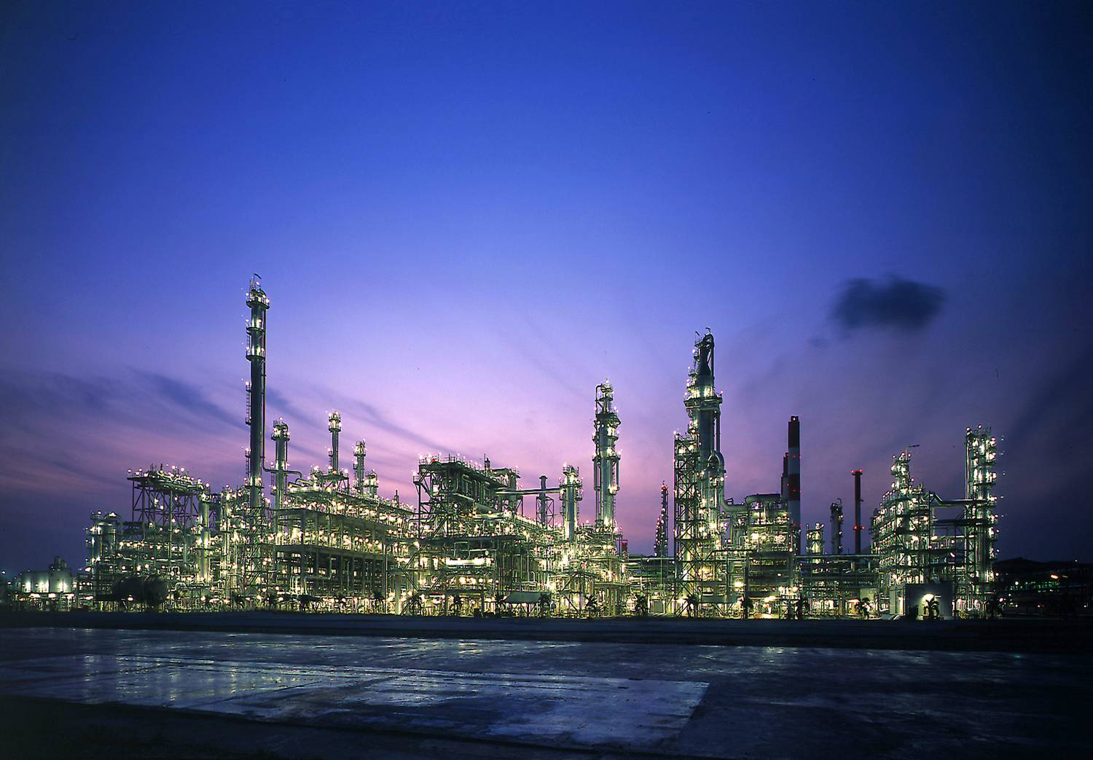
NTNU - NORWEGIAN UNIVERSITY OF SCIENCE AND TECHNOLOGY
SPECIALIZATION PROJECT 2013-2014
TKP 4550
Azetropic distillation process: Acetic acid dehydration
Supervisor: Krister FORSMAN
Co-supervisor: Siguird SKOGESTAD
Student: Quang Khoa LE

Slide 2
Contents
Introduction
Thermodynamic model analysis
Process simulation
Results
Analysis on multiple steady states

Slide 3
I. Introduction
Acetic acid dehydration: an important step in the production of purified isophthalic acid.
Acetic acid(HAC) – Water system

Slide 4
I. Introduction
Entrainer: Isobutyl Acetate (IBA)
Changes the relative volatility of the azeotropic constituent
Form a minimum boiling azeotrope water-IBA (88,6°C)
Heterogeneous azeotropic distillation
Difficult to operate : Distillation boundaries, phase split,
multicomponent presenting in the column
and the possible existence of multiple steady states.

Slide 5
II. Thermodynamique model analysis
Aspen simulator provides some models that may be used for highly non-ideal chemical system : UNIQUAC, UNIFAC, NRTL (nonrandom two liquids).
=> NRTL

Slide 6
II. Thermodynamique model analysis
Vapor phase non ideality caused by the dimerization of Acetic Acid => Hayden-O’connell (HOC)
=> NRTL-HOC

Slide 7
III. Process simulation
Feed composition
Liquid feed stream composition (%):
HAC 73 – 78
Water 20 – 25
MA 1.2 – 1.6
MX 0.02
IBA 0.1 – 0.2
MeOH 0.01
Vapor feed stream composition (%):
HAC 90 – 92
Water 7 – 8.5
MA 0.5 – 0.8
MX negligible
IBA negligible
MeOH negligible
Legend:
HAC: Acetic Acid MX: Metaxylene IBOH: Isobutanol
MA: Methyl Acetate IBA: Isobutyl Acetate MeOH: Methanol

Slide 8
Flow sheet and product specification
Product Specification:
Top: Bottom:
HAC < 0.1% Water 6 – 7%
IBA < 0.4 %

Slide 9
IV. Results
Three steady state solutions were obtained.
Only one can satisfy the product specifications with a reasonable energy requirement

Slide 10
1. Steady state SS1
L_IBA (IBA ref) (kg/h) | 20000 | 24000
B (bottom kg/h) | 25500 | 25500
Xwater | 0.108995 | 0.09803
X IBA | 3.7E-06 | 2.3E-06
XHAC | 0.891001 | 0.901968
D (top product kg/h) | 5776.977 | 5865.878
Xwater | 0.726584 | 0.767234
XHAC | 0.214185 | 0.180826
Product Specifications:
Bottom: Water 6 – 7%
Top : HAC < 0.1%
=> Undesired

Slide 11
2. Steady state SS2
LIBA(IBA ref) | 20000 | 18000
B (bottom kg/h) | 25500 | 25500
Xwater | 0.0155268 | 0.0274451
X IBA | 0.028294502 | 0.016377263
XHAC | 0.9559729 | 0.9559729
D (top product kg/h) | 6884.22 | 6557.035
Xwater | 0.9688071 | 0.9701339
XHAC | 2.16E-09 | 2.25E-08
Product Specifications:
Bottom: IBA < 0.4 %
=> Undesired

Slide 12
3. Steady state SS3
LIBA(IBA ref) | 22000 | 19000
B (bottom kg/h) | 25500 | 25500
Xwater (%) | 0.04296 | 0.041327
X IBA (%) | 0.001192 | 0.002708
XHAC (%) | 0.955843 | 0.955936
D (top product kg/h) | 6137.241 | 6179.337
Xwater (%) | 0.971139 | 0.971354
XHAC (%) | 0.000457 | 0.000131
Product Specifications:
Bottom: Water 6 – 7%
IBA < 0.4 %
Top : HAC < 0.1%
=> Desired

Slide 13
V. Analysis on multiple steady states
Figure a: manipulated variable: IBA reflux flow rate
Figure b: manipulated variable: water reflux ratio

Slide 14

Thank you for your attention

Slide 15
How to jump from SS1 to SS2 and SS3
The simulation is start up with:
IBA reflux flow rate: 20000 kg/h
Bottom flow rate : 26500 kg/h
Water reflux ratio : 0.17
The low steady state SS1 is achieved first, then we increase IBA reflux up to 32000 kg/h, we are still at SS1 solution branch.
Increase IBA reflux up to 37000 kg/h, and here we jump to the high steady state SS2. Then IBA reflux is decreased gradually with a step of 2000 kg/h until reach SS3 at about 19000 kg/h.

