Slide 1


- smart engineering since 1842
Engineering Recearch Center;
a company in the HALVORSEN GROUP
Gas Turbine Inlet Cooling Concept

Slide 2
ERC specialize in:
Gas turbine auxiliaries
Hydraulic and process systems
Air oil separation
Water treatment

Slide 3
Gas Turbine Inlet Cooling
Decreased shaft power with increasing temperatures
Inlet cooling technologies are used around the world
Common technologies
  Evaporative cooling and Inlet fogging
  Chillers
  Wet compression (SPRINT)

Slide 4
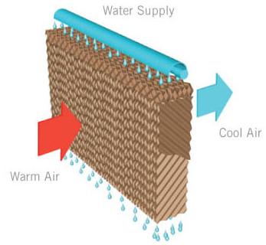
Evaporative Cooling
Requires very pure water
Desalination plant is expensive (reverse osmosis)
Large footprint
Wet compression is only available for some GTs (Requires very pure water)

Slide 5
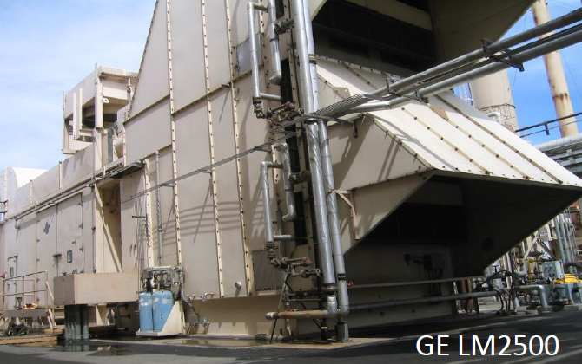
Chiller
Requires large changes to the air intake
Down time during installation

Slide 6
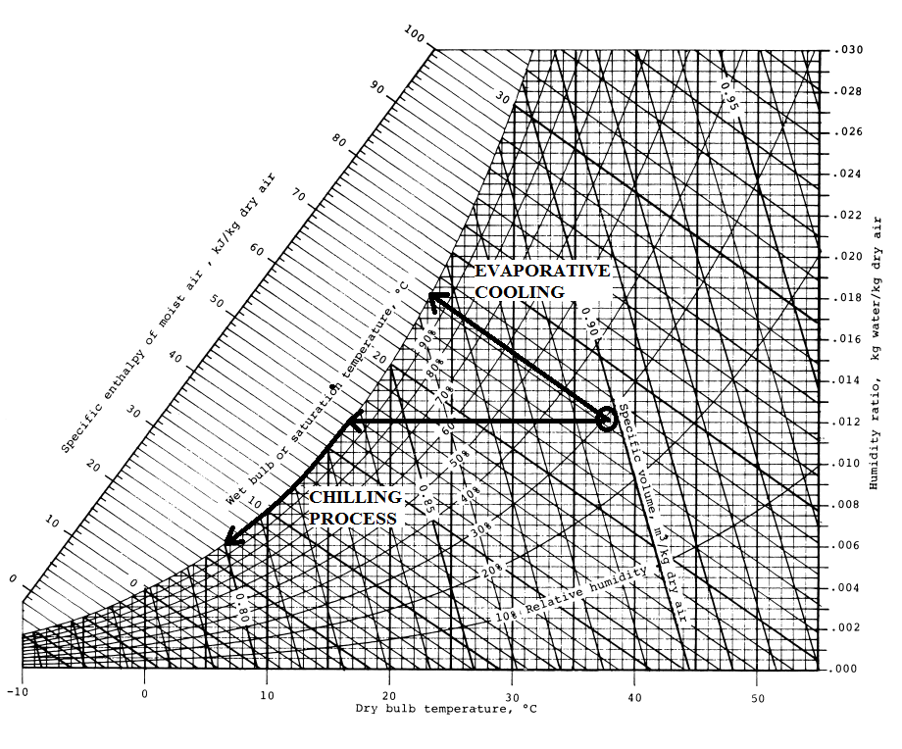
Psychrometric Chart

Slide 7
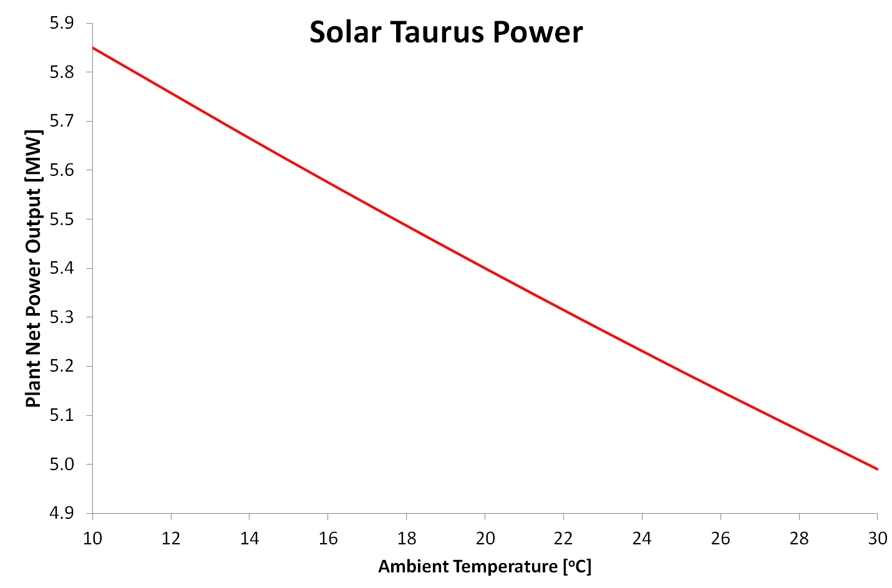
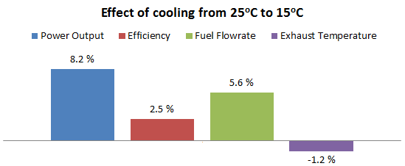
Solar Taurus GT Performance

Slide 8
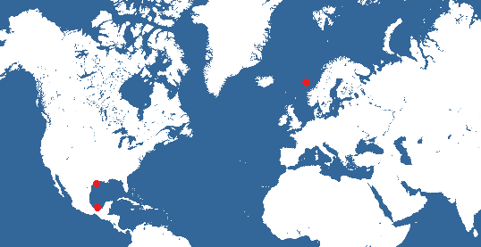
3 Cases
Pilot plant Tabasco, Mexico (onshore)
  Air cooling
  Solar Taurus (6 MW)
Gulf of Mexico (offshore)
  Cooling water 15ºC
  GE LM2500 (25 MW)
North sea (offshore)
  Cooling water 5ºC
  GE LM2500 (25 MW)

Slide 9
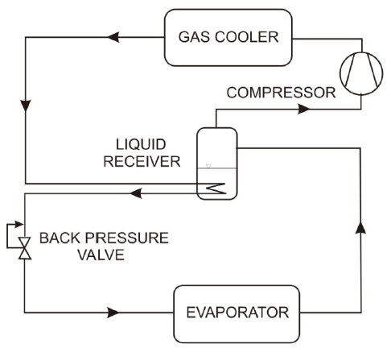
CO₂ as working fluid
Supercritical
COP = 2
Compressors will be single speed
Several refrigerator units to adjust load
1 x 25 ton (30’’ container)

Slide 10
Performance, Pilot Plant
NOAA Climate Data |  |  | Max Available Power |  |  |  | Halvorsen AIC Improvement
Ambient Temperature | Relative Humidity | Frequency | Refrigeration Load | No Inlet Cooling | Halvorsen Air Inlet Cooling | Evaporative Cooling | Total Power Increase | Power Increase
[ºC] | [%] | [h/yr] | [kW] | [HP] | [HP] | [HP] | [HP] | [%]
40/43 | 31.6 | 4 | 450 | 6110 | 6730 | 6820 | 620 | 10.15 %
38/40 | 38.5 | 60 | 450 | 6240 | 6820 | 6830 | 580 | 9.29 %
35/37 | 49.7 | 145 | 450 | 6380 | 6920 | 6830 | 540 | 8.46 %
32/34 | 59.3 | 1100 | 450 | 6540 | 7050 | 6870 | 510 | 7.80 %
29/31 | 68.4 | 2274 | 450 | 6690 | 7200 | 6930 | 510 | 7.62 %
26/29 | 74.1 | 3026 | 450 | 6820 | 7350 | 7010 | 530 | 7.77 %
24/26 | 75.1 | 1215 | 350 | 6960 | 7380 | 7130 | 420 | 6.03 %
21/23 | 76.5 | 806 | 334 | 7130 | 7600 | 7280 | 470 | 6.59 %
18/20 | 77.9 | 107 | 273 | 7300 | 7680 | 7430 | 380 | 5.21 %
15/18 | 77.2 | 16 | 222 | 7440 | 7780 | 7580 | 340 | 4.57 %
13/15 | 71.0 | 5 | 166 | 7590 | 7880 | 7760 | 290 | 3.82 %
10/12 | 74.2 | 2 | 126 | 7770 | 8010 | 7910 | 240 | 3.09 %

Slide 11
Further Work (Master thesis)
Dynamic model
Detailed design
Implementation Pilot Plant

Slide 12
Thank you

