Slide 1
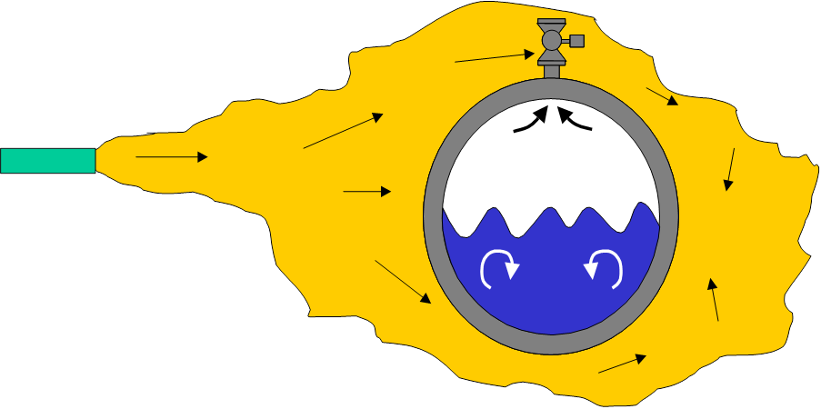
Literature Review and Simulation Study of Depressurization of Pressure Vessels
By: Sigve Karolius
Supervisors: Tore Haug Warberg &
Geir Berge

Slide 2
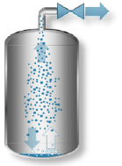
Depressurization Trajectory
Pressure Profile
Temperature Profile
Mass Efflux
Thermodynamic Processes

Slide 3
Physical Mechanisms
Heat Transport
  From surroundings to surface
  Through Wall
  Into and Between Phases
Mass Transport
  Between Phases
  Out of Vessel
Mechanical Stress
  Three Dimensions

Slide 4
Software Development
Fire Engulfment
Mechanical Stress
Thermodynamic Calculations
Numerical Increments

Slide 5
Time or Pressure Increments
Pressure saves one flash calculation
Time can deal with positive and negative pressure variations

Slide 6
Experiment Data
Few experiments
  Expensive
  Dangerous
Experimental data lacks vital parameters
  Valve Properties
  Fluid Composition
Difficult to measure, especially under fire conditions

Slide 7
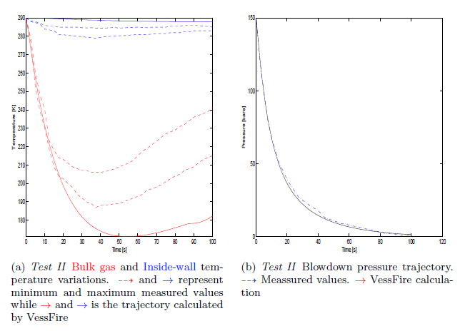
Cold Blowdown of Nitrogen

Slide 8
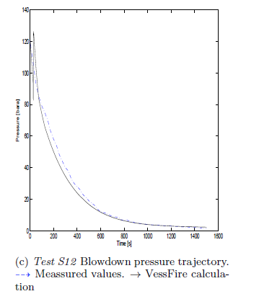
Cold Blowdown of LPG

Slide 9
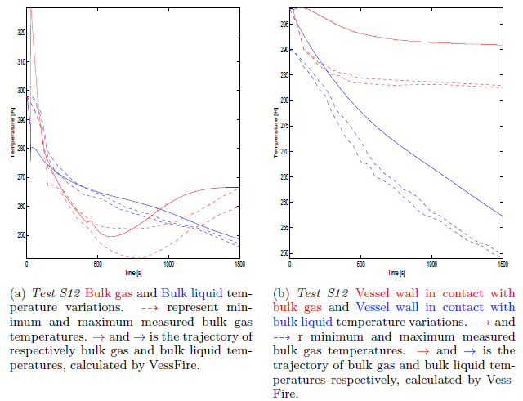
Cold Blowdown of LPG

Slide 10
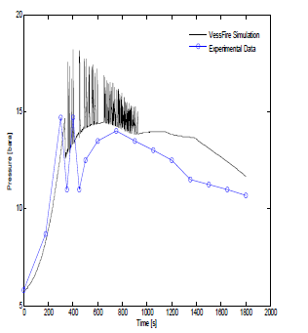
Fire Engulfed LPG

Slide 11
Conclusion
Complex process to model
  Interacting and competing mechanisms
  Thermodynamic
Purchase and Safety benefits
  Determine nessecity for expencive alloys
  Dimension

