Slide 1

Bacteria stress response to high pressure processing
Tine Bergitte Heggernes
Supervisor: Nadav Skjøndal-Bar
Project with Nofima – Måltidets Hus, Stavanger
Notes:
Department for food researching

Slide 2
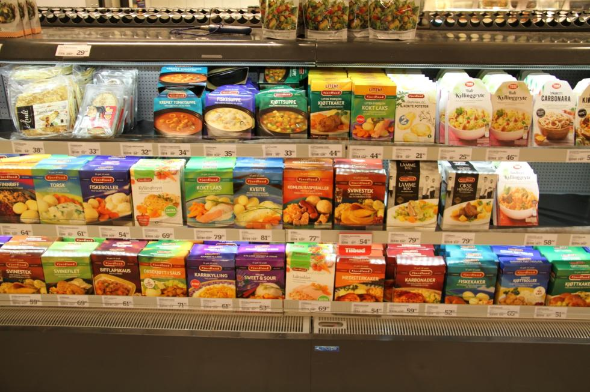
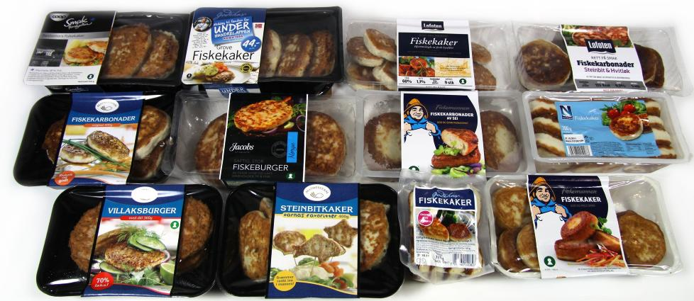
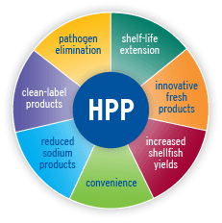
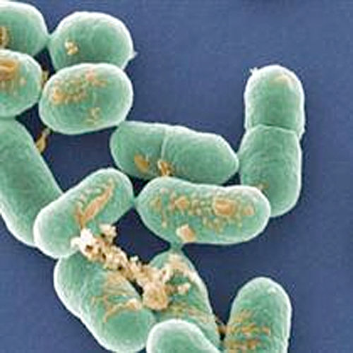

Motivation
Listeria monocytogenes

Slide 3
Objective and methodology
Objective
Doing a literature study on bacteria stress response to high pressure processing (HPP).
The bacteria response - change of gene expressions and mechanisms in the cell when stressed.
Methodology
Using experimental data done with HPP at 400 Mpa and 600 Mpa with Listeria contaminated food
Find vital HPP affected mechanisms → Genes activating these mechanisms → Determination of most significant genes → Comparing genes with regulation from other environmental stresses → Proposing the most pressure specific genes

Slide 4
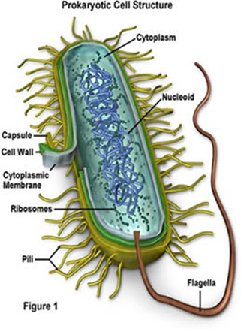
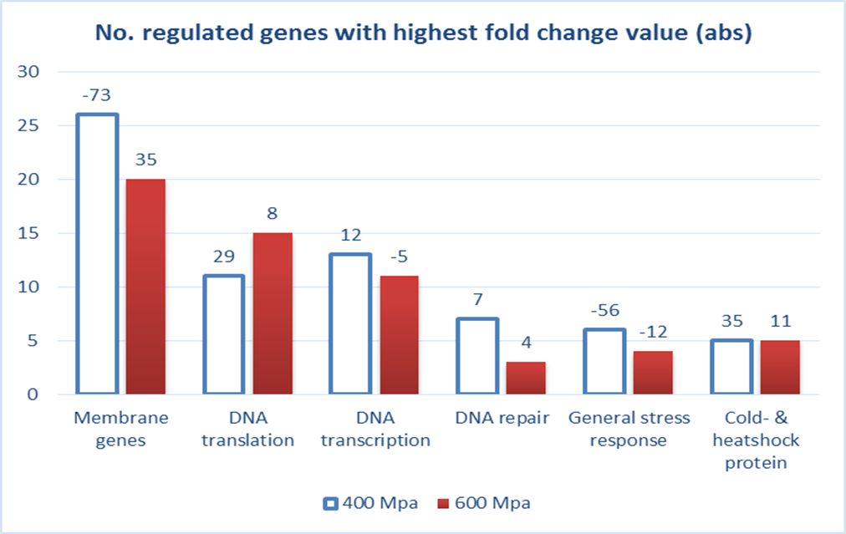
Results and conclusion
HPP induced changes
Many genes expressed as a response to HPP
Expression change higher at 400MPa than 600 Mpa → less developed response systems for higher pressures.

Slide 5
The 7 most pressure specific genes

Slide 6
Futute work – Master thesis
Conduct HPP experiments
Develop models which predicts bacteria inhibition from high pressure processing

