Slide 1
Models for on-line control of batch polymerization processes
State and parameter estimation for a semi-batch free-radical emulsion copolymerization process
Student: Fredrik Gjertsen
Supervisor, NTNU: Prof. Sigurd Skogestad
Supervisor, external: Peter Singstad, Cybernetica AS
Trondheim, 13. desember 2013

Slide 2
Agenda
Motivation and overview: MPC
Model description
The need for estimation
Results from off-line parameter estimation
Conclusions from the work
Looking forward: A proposal for an extension to the work

Slide 3
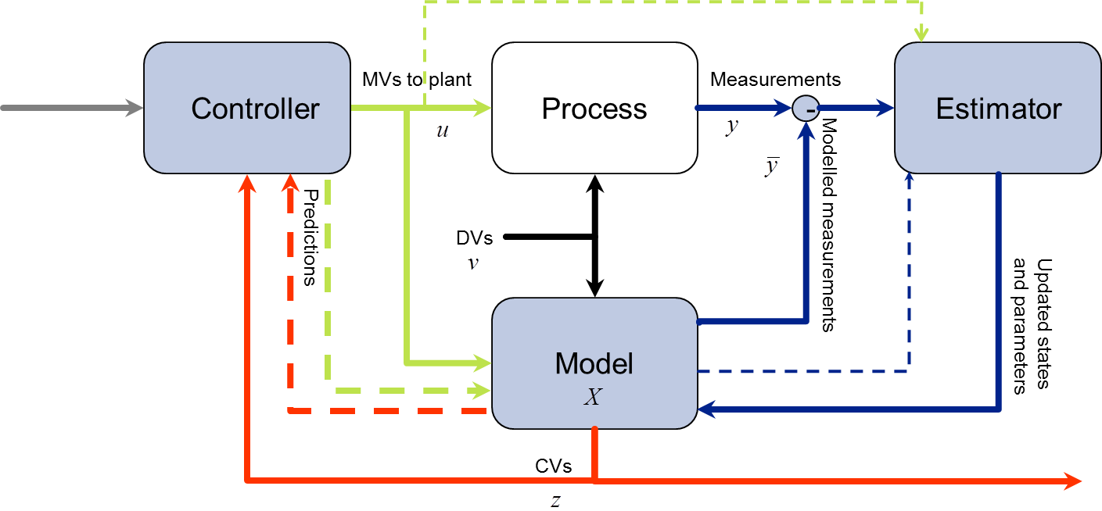
Components of an MPC implementation

Slide 4
Typical development process
(In my case: Approximately one year)

Slide 5
Components of an MPC implementation
Initially: A process of interest – Free-radical emulsion copolymerization
Step 1: Acquire a process model
Step 2: Verify and improve the process model through parameter fitting
Ultimate goal: A complete package including all the necessary components

Slide 6
Model description
Free-radical emulsion copolymerization
  Monomers: Styrene, Butyl acrylate
  Multi-component, multi-phase, reactive chemical system
Semi-batch reactor setup
  The model is formulated in lab-scale
The model was formulated using the Modelica programming language and implemented using the Dymola software.
Parameter fitting was performed using the Cybernetica ModelFit software.

Slide 7
Estimator algorithms
States and parameters of the model is only known with a certain accuracy
  Off-line parameter fitting prior to on-line implementation
  On-line state and parameter estimation (filtering)
The estimator is a key component in the model-based controller implementation
H∞-methods, Moving Horizon Estimator, etc.
Kalman Filter estimator has been chosen
  Extended to apply for nonlinear systems

Slide 8
Components of an MPC implementation

Slide 9
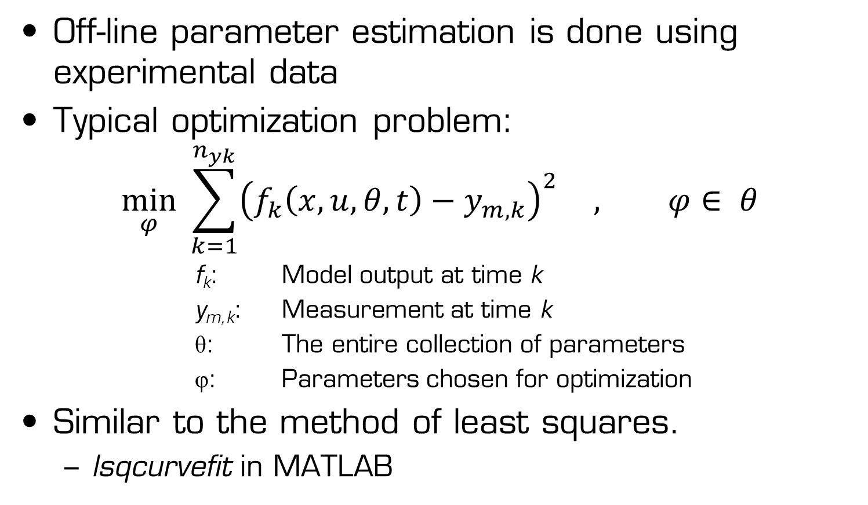
Strategy for parameter fitting
Off-line parameter estimation is done using experimental data
Typical optimization problem:
$$\min_{φ}{ \sum_{k=1}^{n_{yk}}{{\left(f_{k}\left(x,u,θ,t\right)−y_{m,k}\right)}^{2}} , φ∈ θ}$$
f_{k}: Model output at time k
y_{m,k}: Measurement at time k
θ: The entire collection of parameters
φ: Parameters chosen for optimization
Similar to the method of least squares.
  lsqcurvefit in MATLAB

Slide 10
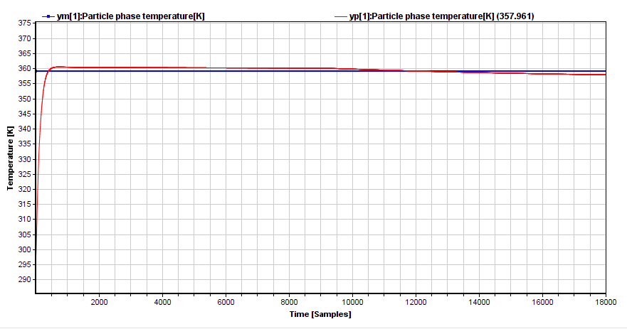
Results – Reactor temperature
(Initial behavior)

Slide 11
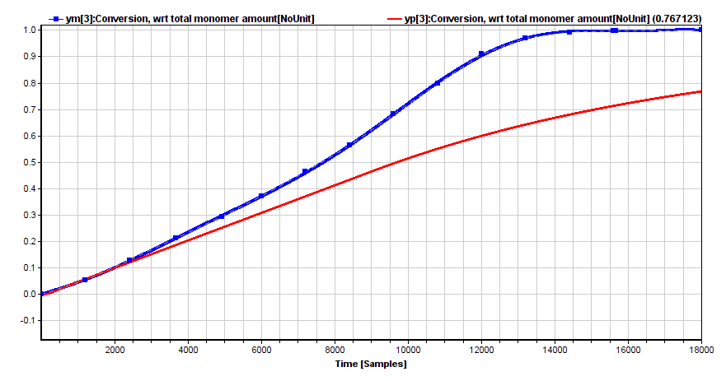
Results – Conversion of monomer
(Initial behavior)

Slide 12
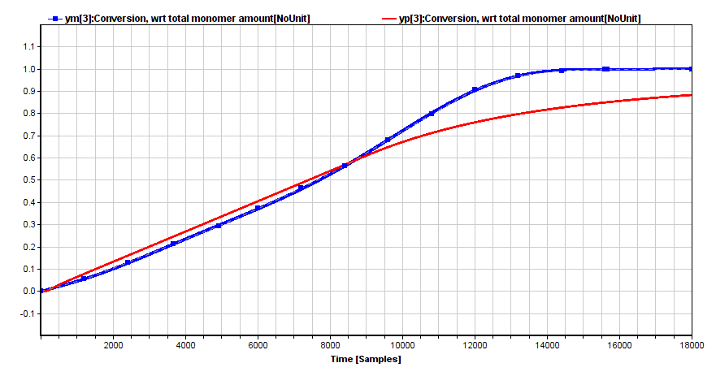
Results – Conversion of monomer
(With optimally fitted parameters)

Slide 13
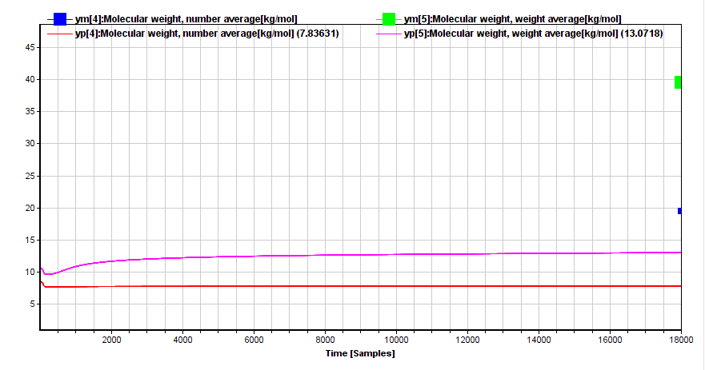

Results – Molecular weight distribution
(Initial behavior)

Slide 14
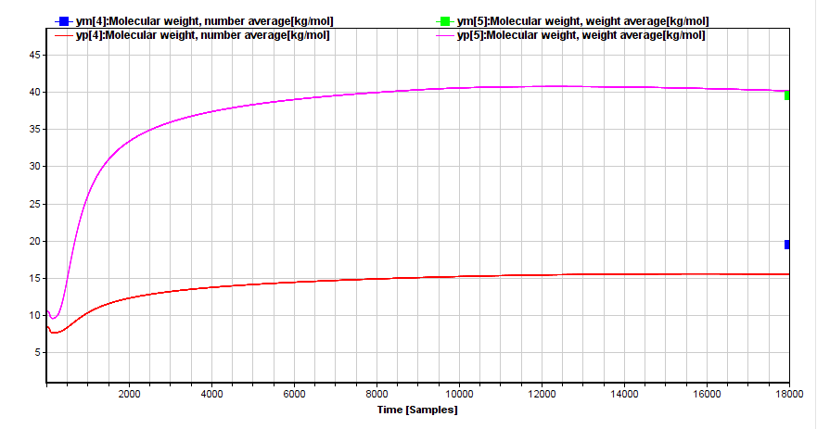
Results – Molecular weight distribution
(With optimally fitted parameters)

Slide 15
Conclusions
Some parameters have been adjusted to improve the model
  Factors governing the chemical reaction rates
  Factors governing termination of growing polymer chains
  Factors governing heat transfer remain untouched
Demand for computational power is high
  Maybe too high?
  Include simplifications for on-line implementation?
The established formulations for on-line estimation can be applied in the on-line controller implementation

Slide 16
Suggestions for further work
Complete the MPC setup for a semi-batch case
  Tune estimator based on project work
  Design and tune controller algorithm
Extend the established work to include continuous reactor cases
  «Smart-scale» tubular reactors
  This will require more modeling work, but most of the theory is reapplicable
  Design and tune both estimator and controller, using experimental data for tubular reactors

