Slide 1
Specialization project
Project title
“Practical modeling and PI-control of level processes”
Student
Ingrid Didriksen
Supervisor
Krister Forsman

Slide 2
Objective
Level controllers in a chemical plant
Obtain process models by use of historical data
Obtain better tuning for the PI-controllers
Apply theory in practice

Slide 3
The Problem
Poor tuning in level controllers
Kc and τI for all the level controllers

Slide 4
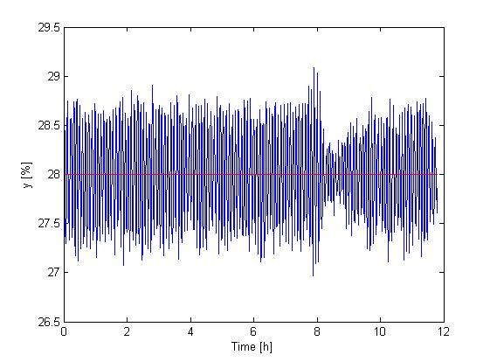
Why?
Problem with poor
tuning
Oscillations
Process output and set point

Slide 5
Desired
Smooth control
Buffer tanks

Slide 6
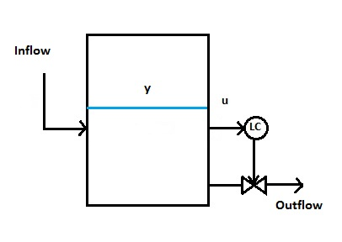
How?
Integrating process, $g\left(s\right)=\frac{k}{s}e^{−θs}$
Matlab System
Identification toolbox

Slide 7
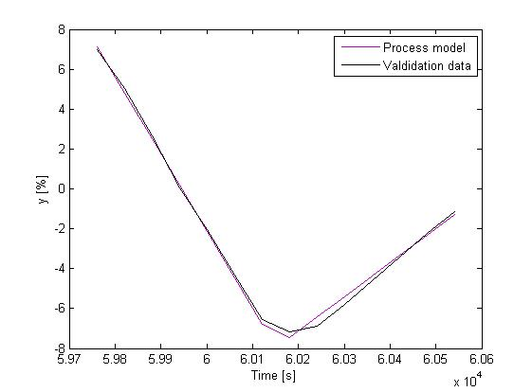
Process model

Slide 8
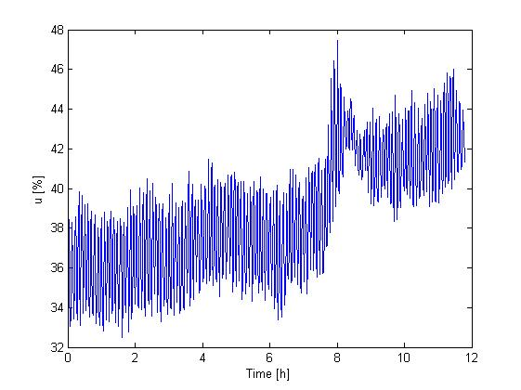
How?
Arrest time
Disturbance in inflow Deviation in process output

Slide 9
Tuning
Level controller | Kc0 | τI0 | Kc | τI | fmodel | fSkogestad
1 | 3.3 | 83.9 | 1.48 | 403 | 2.15 | 2.12
2 | 3.08 | 29.1 | 1.49 | 533 | 8.86 | 8.72

Slide 10
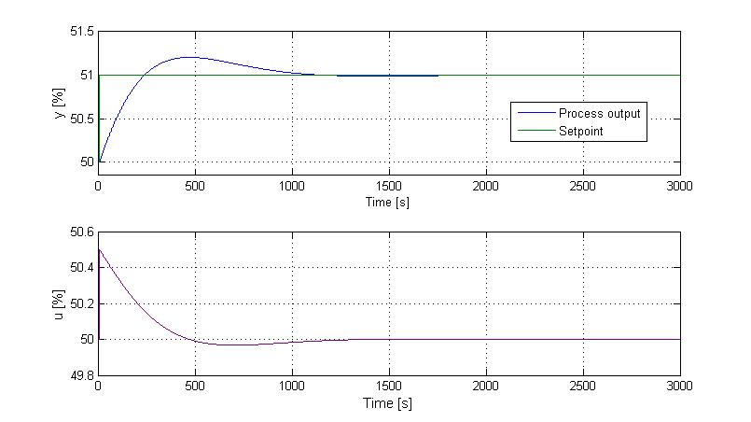
Simulation
No time delay
Process output and set point
Process input

Slide 11
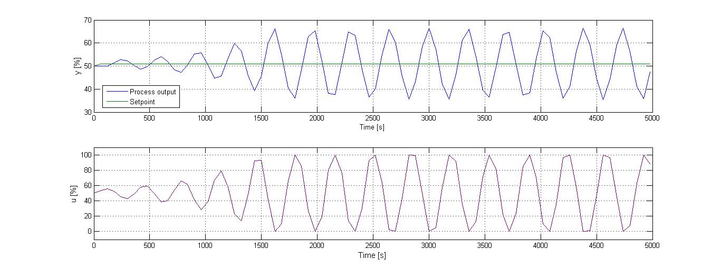
With “time delay”
Process output and set point
Process input

Slide 12
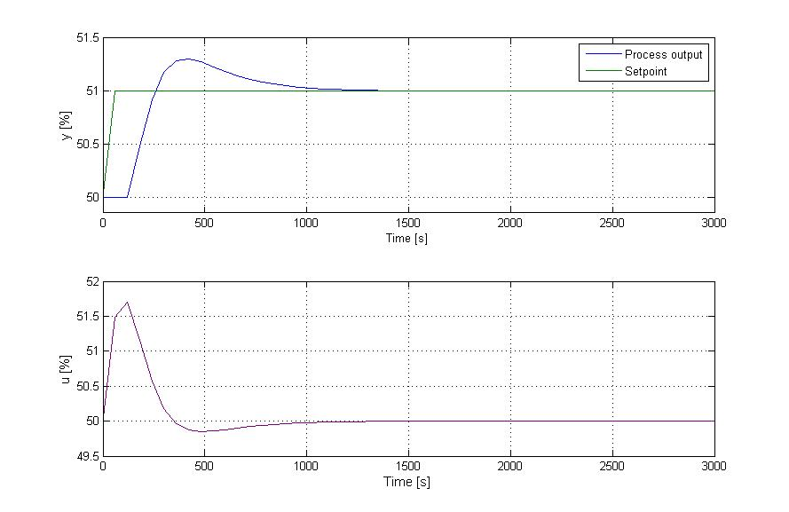
Retuning
Process output and set point
Process input

Slide 13
Furture work
Concider dynamics of the level controllers

Slide 14
Thank you for your attention!

