Slide 1
Optimal temperature control of rooms
Siri Hofstad Trapnes
Superviors:
Sigurd Skogestad and Chriss Grimholt

Slide 2
The model
Direct heating in floor and room
Keep the temperature in the room within optimal bounds in order to save energy costs

Slide 3
Steps
1) Creating the model
- Matlab, Simulink
2) Implementation of the control structure
- PI control
- SIMC

Slide 4
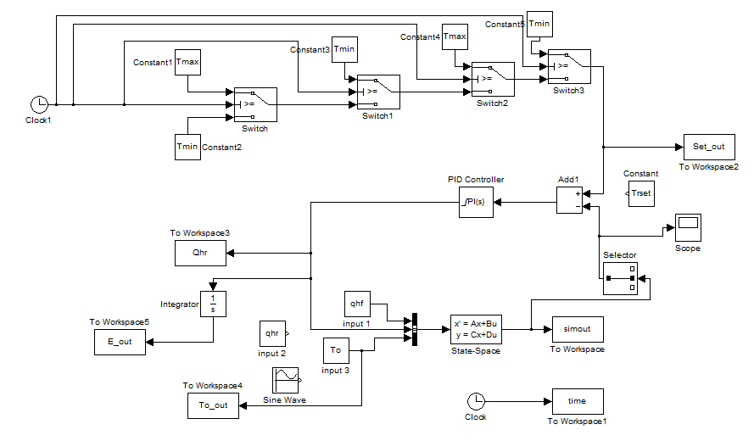
No heating in the floor
Constraints on the room temperature
Intervals with temperature equal to 10°C and 20°C
Constant energy price
Minimum energy consumption

Slide 5
3) Finding the optimal temperature
- Quadratic programming

Slide 6
4) Introducing disturbances
5) The null space method
Even if time of switch changes with disturbances the controlled variable should be constant

Slide 7
The null space method did not give acceptable results
Measurements:
Disturbances:
To
t switch
∆T = Tr-To
Distance
Qh/r
To
UAr/o

Slide 8
Results from different combinations of measurements
To minus 10°C
To plus 10°C

Slide 9
The best combination of measurements and disturbances
To minus 5°C
To plus 5°C
Notes:
d1 + d3: To + DeltaT + distance + tsq

Slide 10
Summary of obtained results
Works fine around the nominal value (0°C)
The further away from the nominal value the worse results
If good results above the nominal value then not below 0°C

Slide 11
Improvements
Find controlled variable for all the switching times
Adjustments to the null space method

