Slide 1
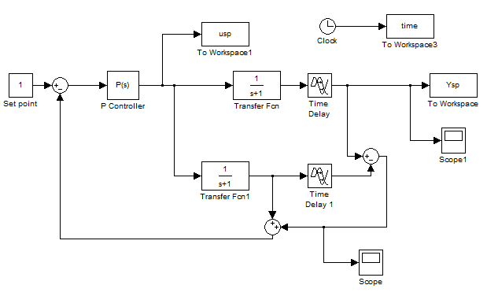
Performance and Robustness of the Smith Predictor Controller
Test for different time delays
Compare with PI
Tuning of SP and PI
By: Helene Paulsen
Supervisor: Sigurd Skogestad
Co-supervisor: Vinicius De Oliveira

Slide 2
Results:
Several stability regions for P control
Robust tuning rules of SP
Integral square error (ISE) used to compare performance
Further work:
Compare the SP and PI as fair as possible
Fix the robustness and find the best tuning

