Slide 1
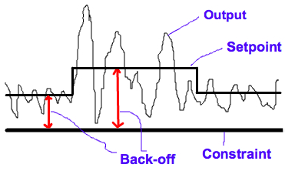
Dynamic back-off for control of active constraints
Student: Vilde Haarsaker
Supervisors: Johannes Jäschke, Chriss Grimholt and Sigurd Skogestad

Slide 2
What I have been doing:
Optimization of Column A
Adding controllers to existing
Simulink model
Now: creating a realistic disturbance
in the feed

Slide 3
What more needs to be done:
Implement dynamic back-off: A controller that adjusts the x_{B} setpoint when there are disturbances in the feed
If time: One more case study

