Slide 1
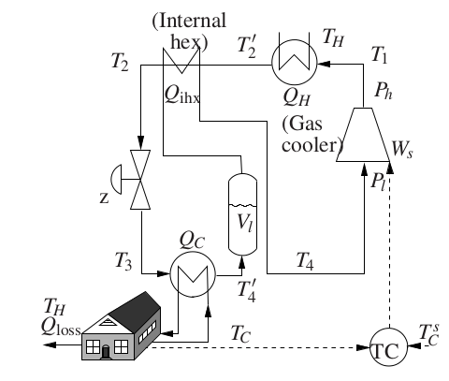
Refrigeration Cycle CO2
By Nils Arne
Supervisors: Sigurd, Vlad and Johannes

Slide 2
Planned work further on...
Results so far...
...none particularly except the model code
Achieve a fully working thermodynamic system
Optimize the model in JModelica

