Slide 1
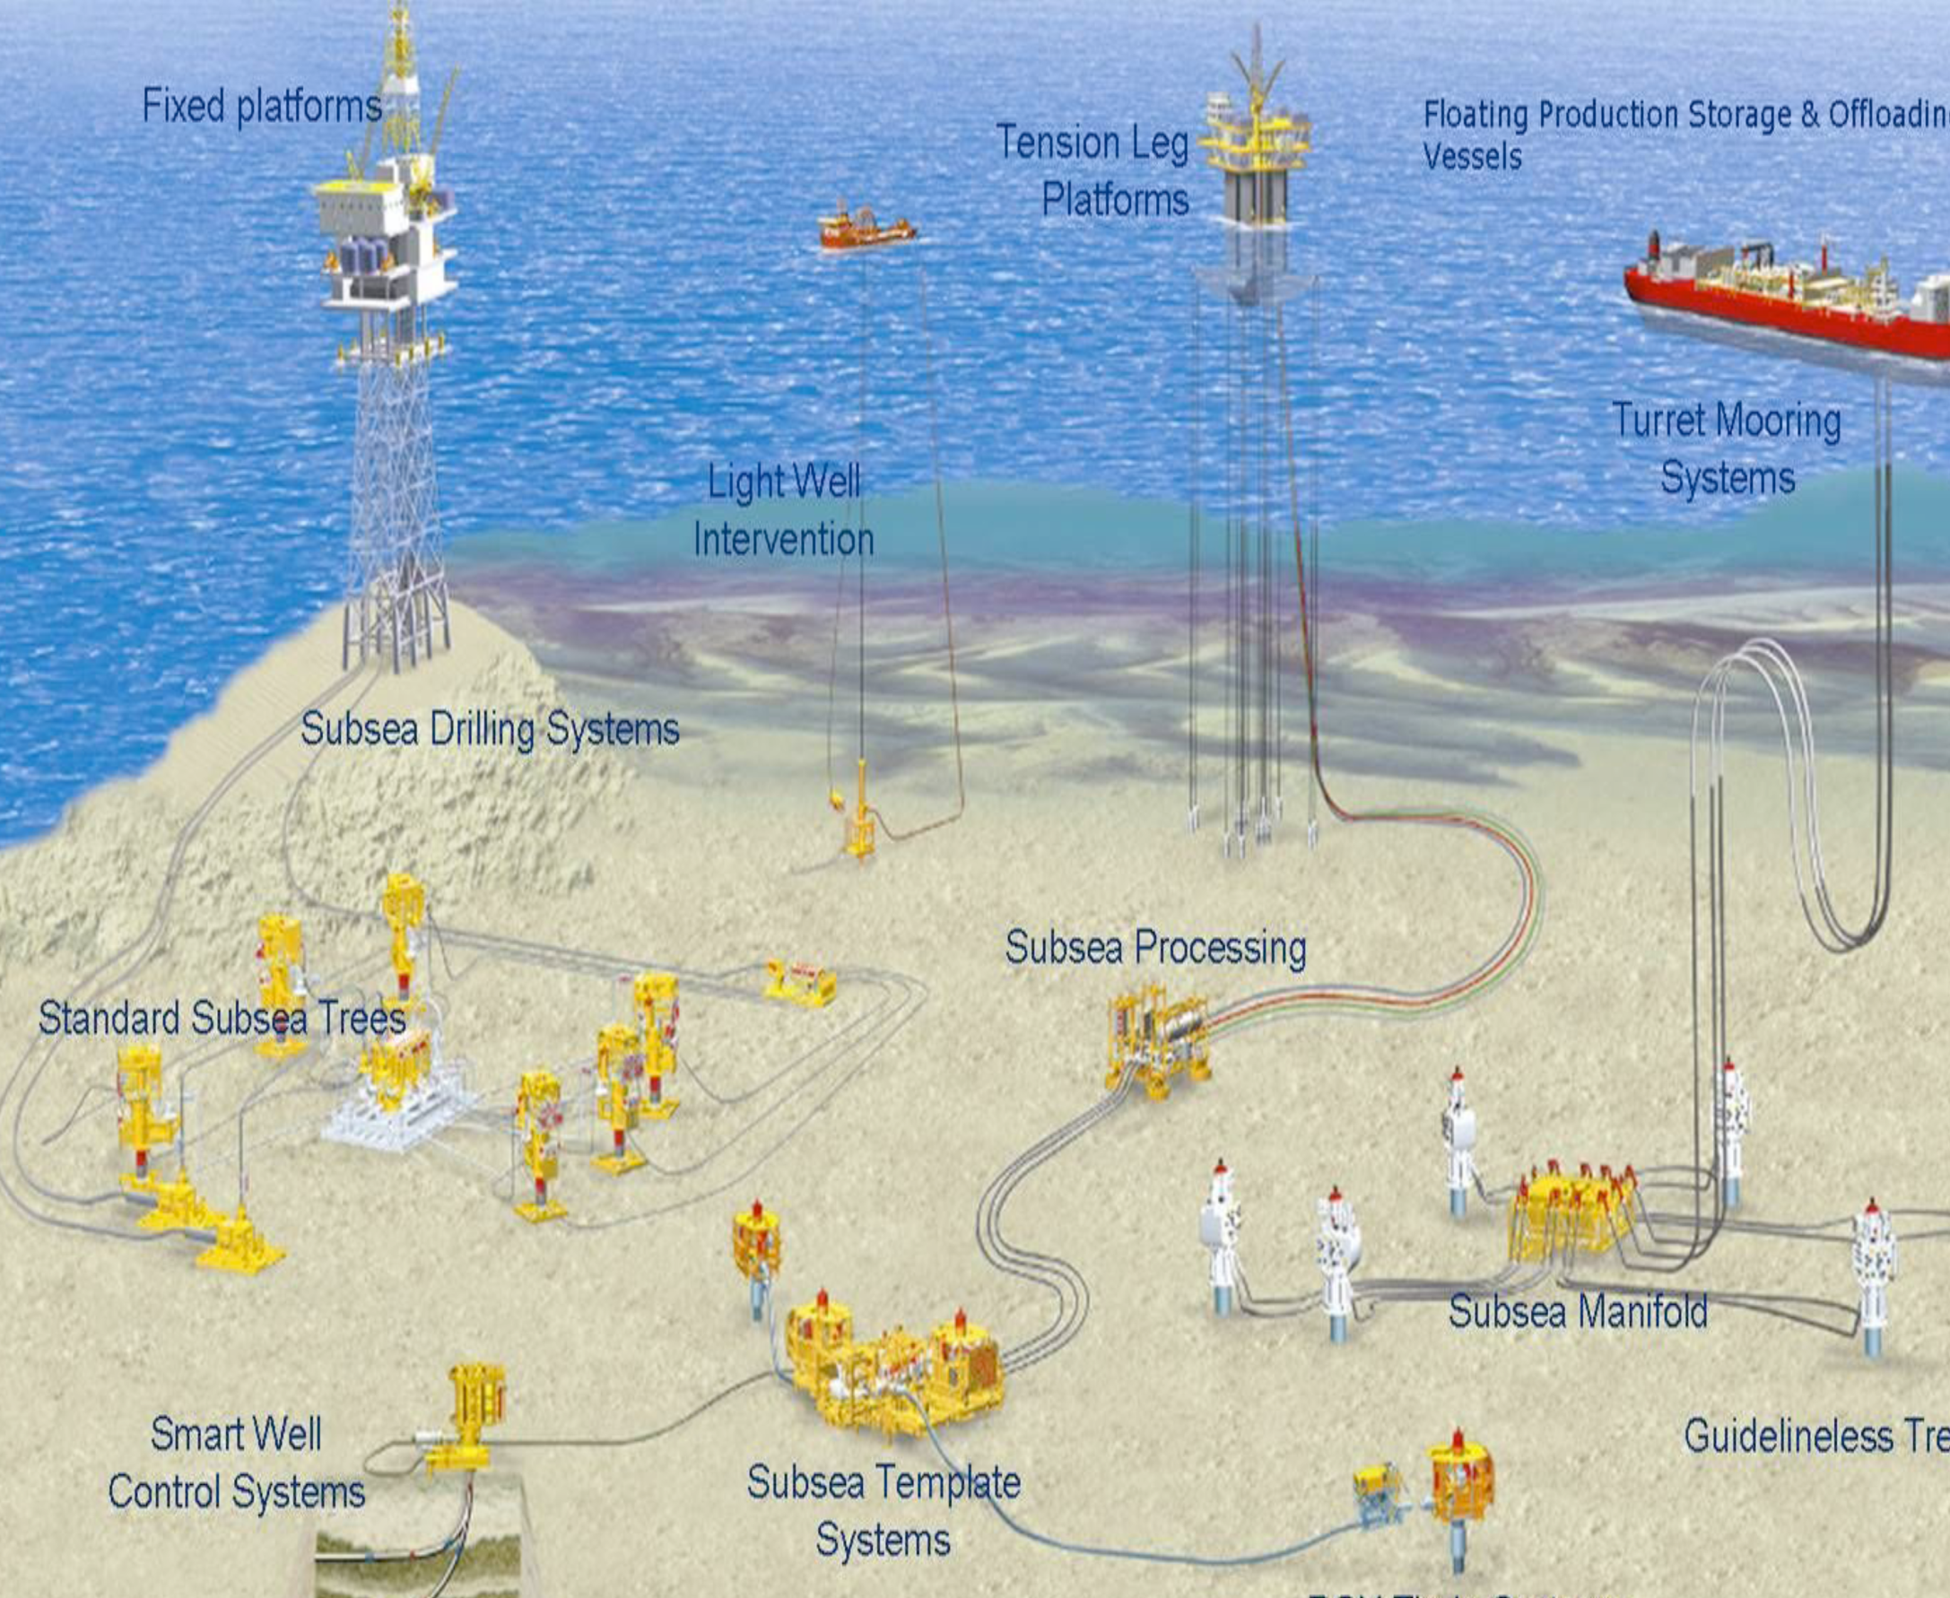
Slug flow in S-shaped risers
Simplified model for slug flow in S-Riser
Anne Sofie Nilsen
Supervisor: Sigurd Skogestad
Co-supervisor: Esmaeil Jahansahi

Slide 2
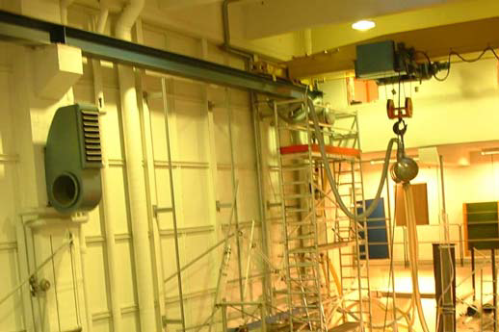
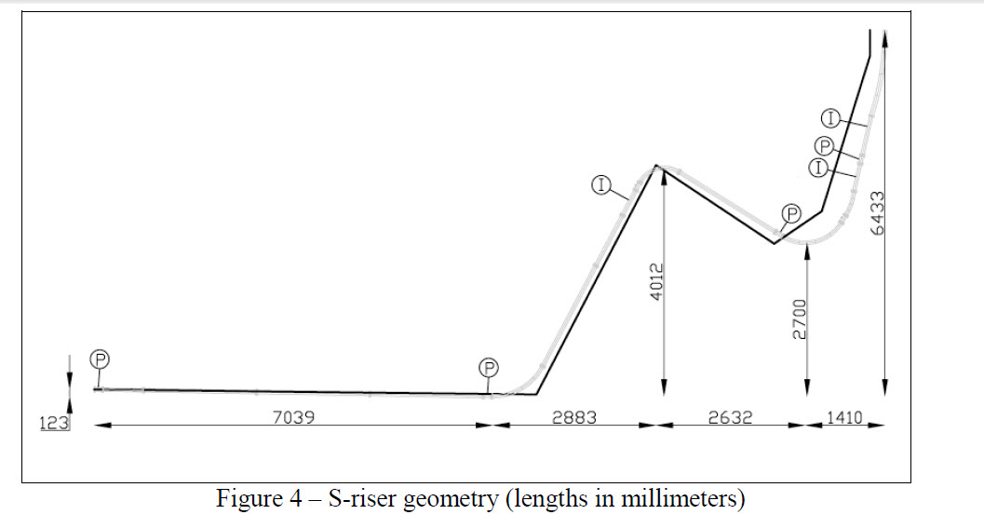
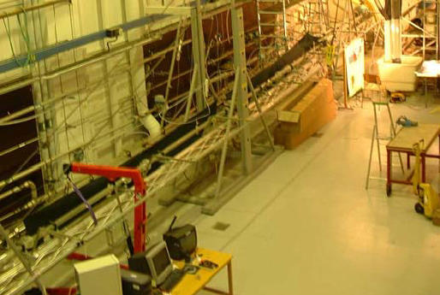
Experimental set-up
16 m long, 7 m high
Compare the following:
- Matlab model
- Olga simualation
-Experimental values

Slide 3
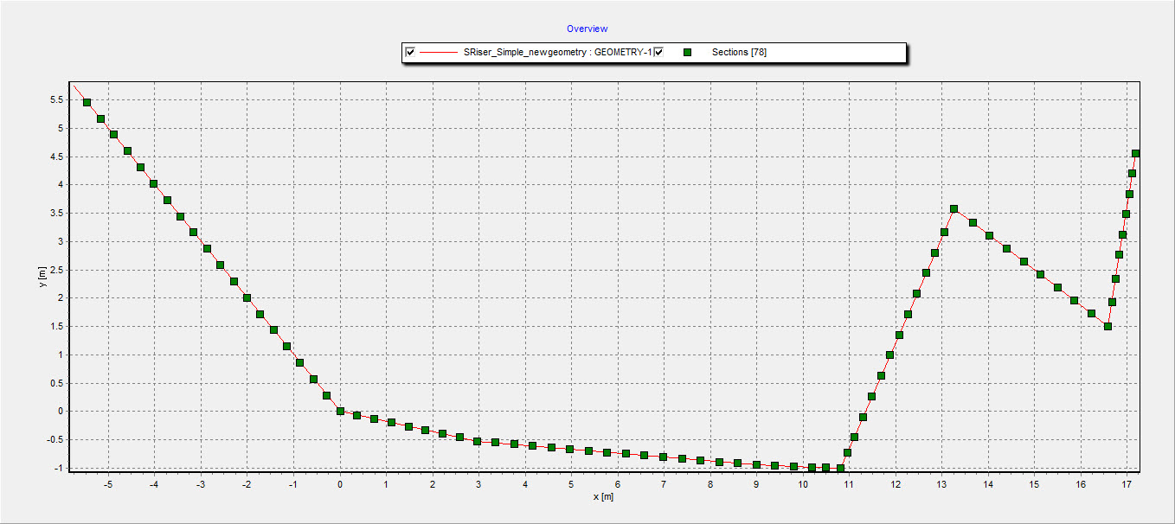
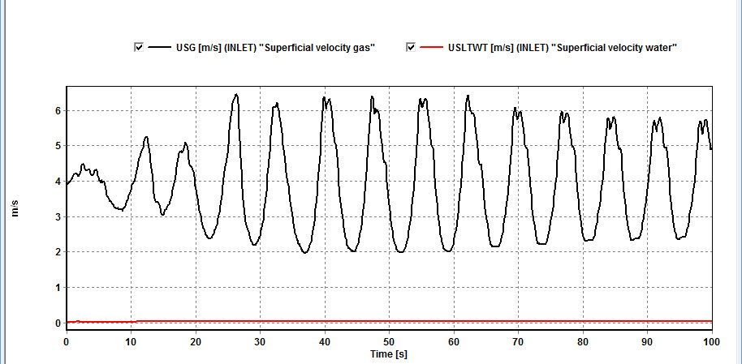
Slug flow in S-shaped riser, OLGA simulation
Stability map

Slide 4
Slug flow in S-shaped risers
Simulating S-riser in OLGA
Extending the simplified MATLAB model for L-riser to S-riser
Comparing the results from OLGA and MATLAB
Comparing results from the S-shaped riser to results from L-shaped riser model
Verifying the simplified model (MATLAB) by experiments on the S-riser in multi-phase flow lab

Slide 5
Slug 2- Simplified first principle model for severe-slugging flow in S-shaped risers
Simulating S-riser in OLGA
Extending the simplified MATLAB model for L-riser to S-riser
Comparing the results from OLGA and MATLAB
Comparing results from the S-shaped riser to results from L-shaped riser model
Verifying the simplified model (MATLAB) by experiments on the S-riser in multi-phase flow lab

