Slide 1
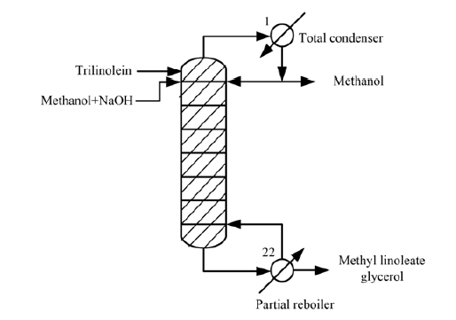
Production of Biodiesel from Reactive Distillation
My name: Emilie Øritsland Houge
Supervisor: Sigurd Skogestad
Co-supervisor: Chriss Grimholt
Main paper:
Simasatitkul, L., et al. (2011). "Reactive distillation for biodiesel production from soybean oil." Korean Journal of Chemical Engineering 28(3): 649-655.

Slide 2
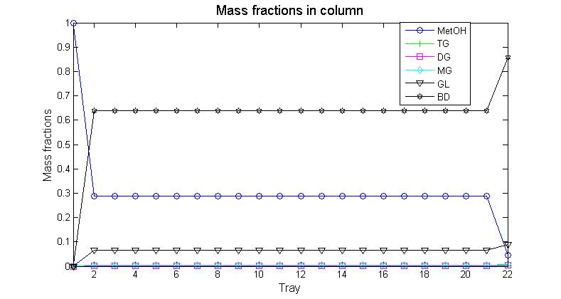
The Model
Molar balances
Kinetics
Liquid dynamics from Francis weir formula
Constant molar overflow
Estimation of vapour pressure equations for reaction intermediates using the Riedel method.
Estimation of vapour compositions using Raoult’s law.

