Slide 1
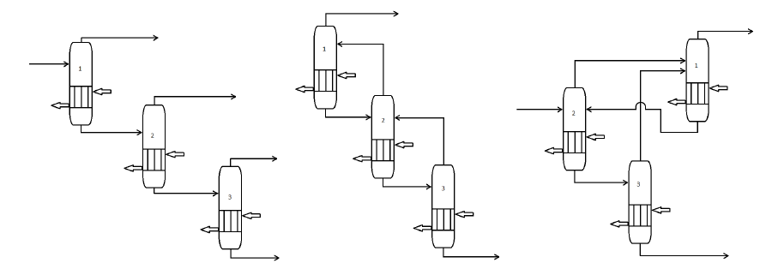
Optimization of evaporator system
By: Sigrun Dyvik Berstad
Supervisor: Sigurd Skogestad
Co-supervisors: Vladimiros Minasidis, Johannes Jäschke

Slide 2
Optimization of evaporator system
Result
Configuration | Cost
Existing | 0.337
"Distillation" | 0.218
Reflux | 0.060
- Litterature search
- Varification by UniSim-model
- Dynamic model
- If time: Control structure

