Slide 1
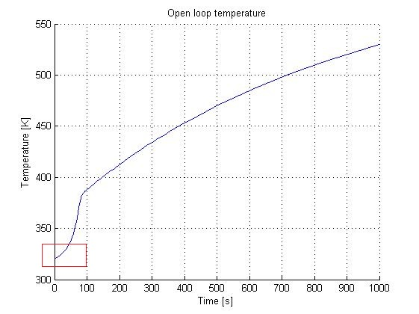

PID control of unstable chemical reactor
Make a simple Matlab model of an unstable CSTR
Simulate PI and PID control of the process
Propose a simple way to obtain tuning parameters
By Ola S. Hjetland
Supervisors: Sigurd Skogestad,
Krister Forsman and Vinicius de Oliveira

Slide 2
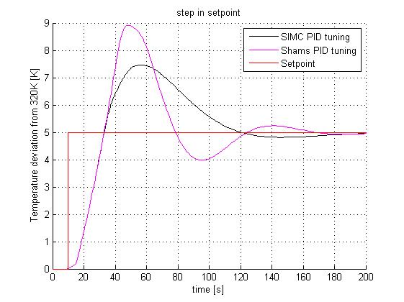
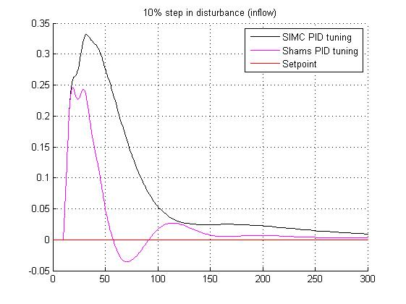
SIMC (open loop simulation)
Shams (closed loop simulation)
Method based on Nyquist stability and the sensitivity function (Vinicius)
Further work:
Implement the dynamics of the heat exchanger in the model
Further investigation of the controller performance
Make a recommendation for tuning parameters (or method to acquire these parameters)

