Slide 1
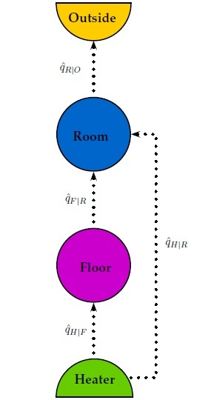
Control of floor heating process
Siri Hofstad Trapnes
Supervisors: Sigurd Skogestad and Chriss Grimholt
Direct heating in the floor and room
Keep the temperature in the room within optimal bounds in order to save energy costs
Simple and advanced model

Slide 2
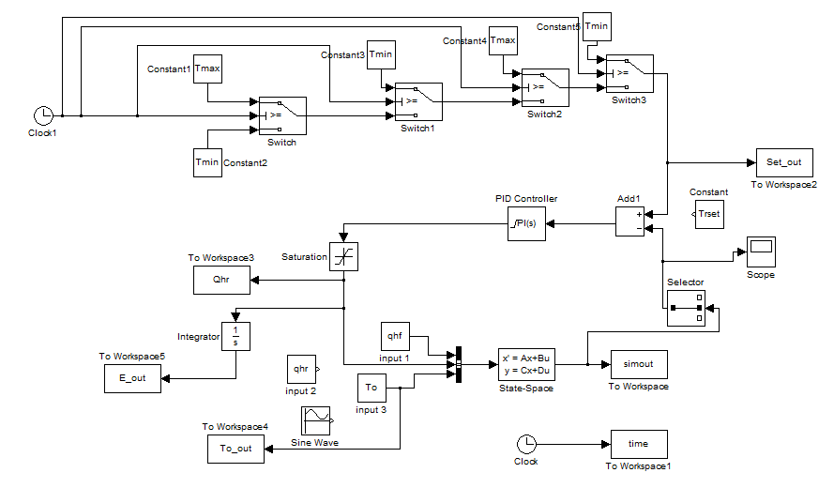
Steps:
1) Creating the model
- Matlab, Simulink
2) Implementation of the control structure
- PI control
- SIMC

Slide 3
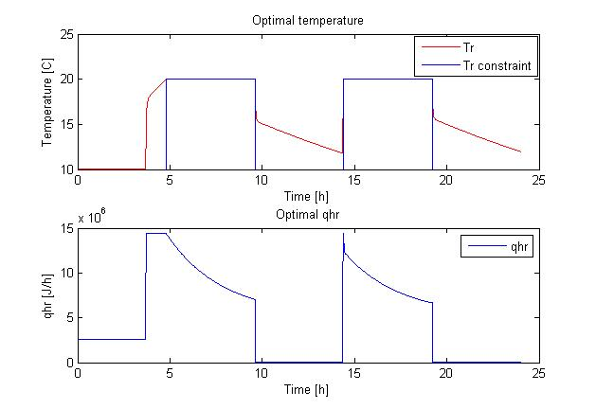
3) Finding the optimal temperature
- Quadratic programming
4) Finding a control variable that is independent of disturbances
- Nullspace method

