Slide 1
Performance and Robustness of the Smith Predictor Controller
By Helene Paulsen
Supervisor: Sigurd Skogestad
Co-supervisor: Vinicius De Oliveira

Slide 2
Motivation
Performance and robustness of processes with time delays
Time delay compensation
Compare SP with PI
Variation in the real time delay

Slide 3
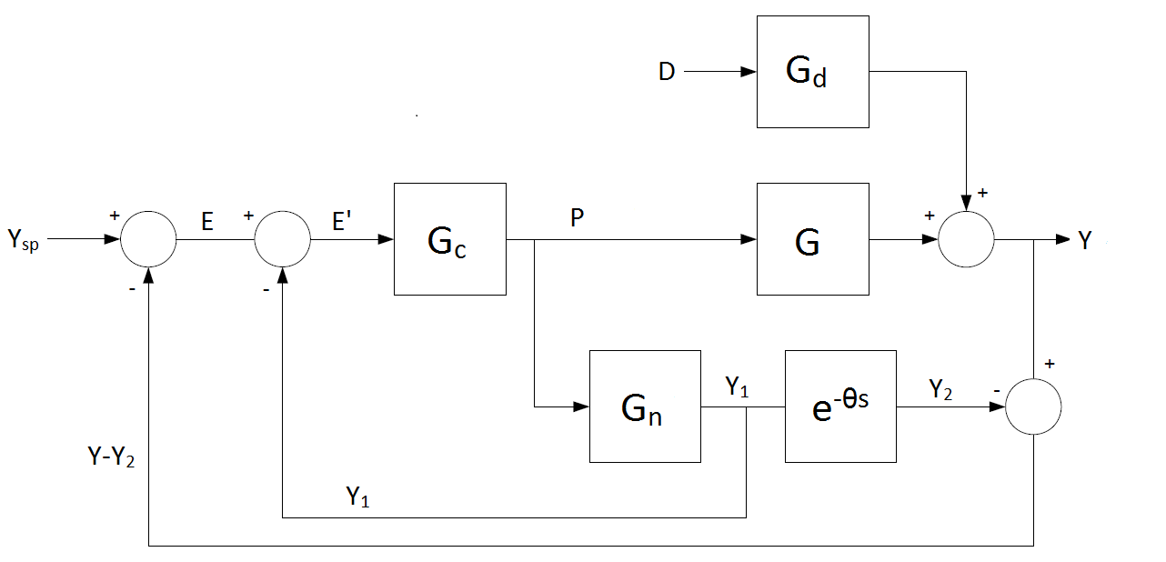
Process flow sheet

Slide 4
Verification of example from article
FOPTD process with θ₀ = 1
P-controller with τ=1 and K_{c}=4
→ discontinuous stability domain
Time Delay | Stable/Unstable
0 - 0.3462 | Stable
0.3462 – 0.5668 | Unstable
0.5668 – 1.4425 | Stable
1.4425 – 1.8206 | Unstable
1.8206 – 2.5320 | Stable
2.5320 → | Unstable

Slide 5
PI as primary controller in SP
Same tunings as before
→ continuous stability domain
Time delay | Stable/unstable
0 – 2.68 | Stable
2.68 → | Unstable

Slide 6
Robust tuning of SP
Robust tuning rules
Set-point change and disturbance
Increasing controller gain
Integral squared error (ISE) was used to compare the performances

Slide 7
Robust tuning

Slide 8
Tight control of SP

Slide 10
Optimization
Trade-off between performance and robustness
Performance in terms of integral absolute error (IAE) values
Robustness in terms of the M_{s} value
Optimal tuning parameters
Optimization of two processes

Slide 13
Verification of optimization
Simulink was used to verify the optimization
Optimal tuning from optimization was used
IAE values were plotted against the time delay error

Slide 14
Case 1

Slide 15
Case 2

Slide 16
Thank you for your attention!

