Slide 1
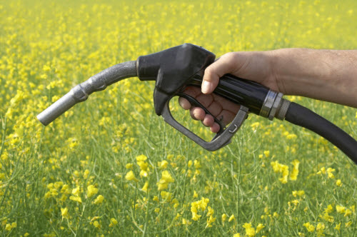
Modelling of the production of biodiesel by reactive distillation
Supervisor: Sigurd Skogestad
Co-supervisor: Chriss Grimholt

Slide 2

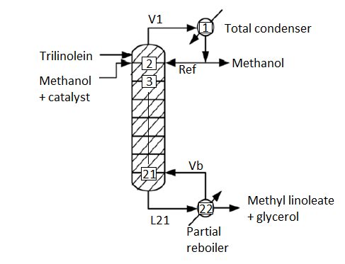
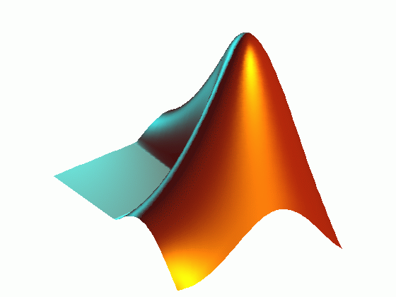
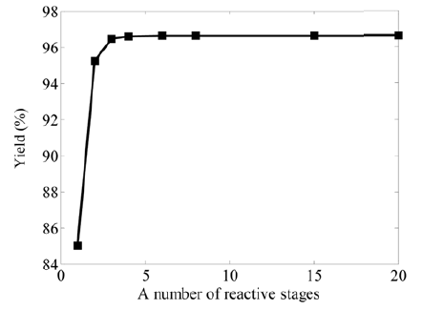


Outline

Slide 3
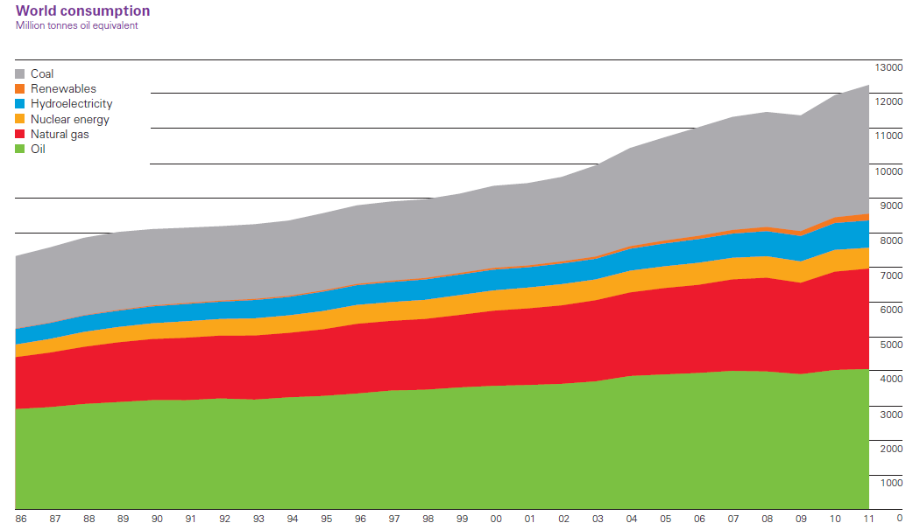
Energy Consumption
Notes:
This graph shows the world consumption of energy from the annual report by BP. Renewables constitutes a small amount of the total energy consumption, but it is also the fastest growing. The production of biodiesel is expected to double in size in 20 years. Biodiesel willIncrease lubrication, can be used on almost all engines. Less emissions, carbon neutral.

Slide 4
Biodiesel
Made from plant oils
No modification of engine
Lower emissions
Carbon neutral
Renewable energy source

Slide 5
Reactive Distillation
The merging of a reactor and a distillation column in one
Much interest in this technology
Can save a lot of money
Not always feasible

Slide 6
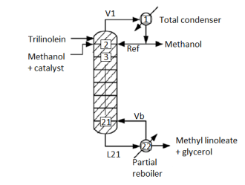
Process Conditions

Slide 7
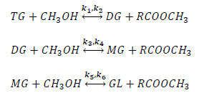
The Reactions
Rate equations from the rate law
Kinetic constants from the Arrhenius equation

Slide 8
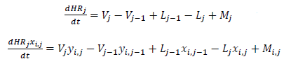

Distillation Column
Molar balances
Raoult’s Law

Slide 9
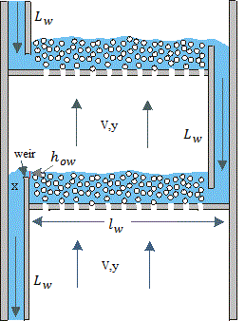
Dynamics

Slide 10

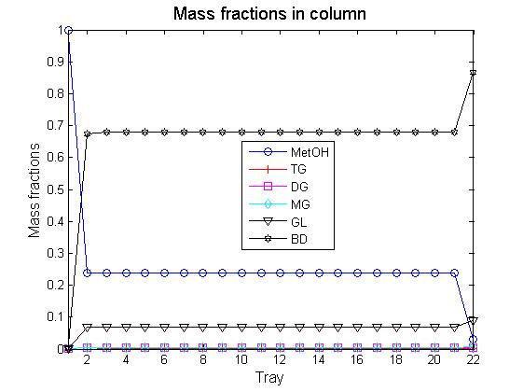
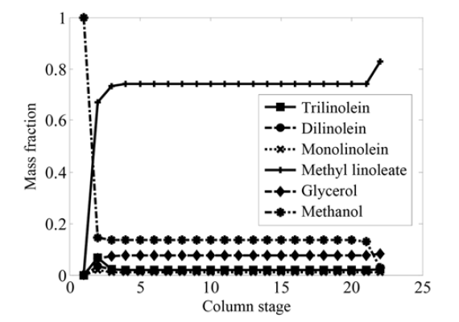
Composition

Slide 11
Temperature
Simple boiling point method
Modified boiling point method
Iterative Raoult’s law

Slide 12
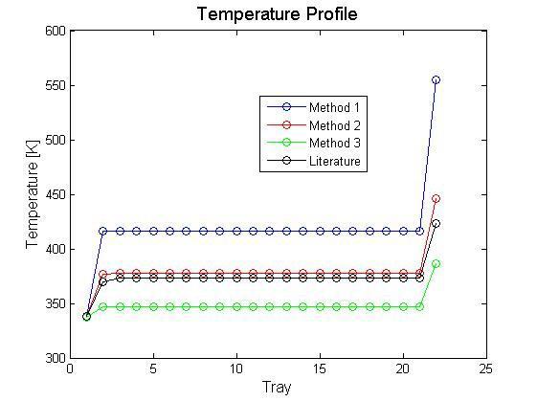
Temperature

Slide 13
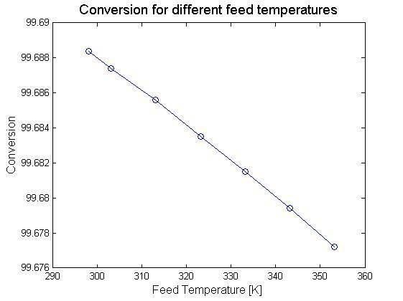
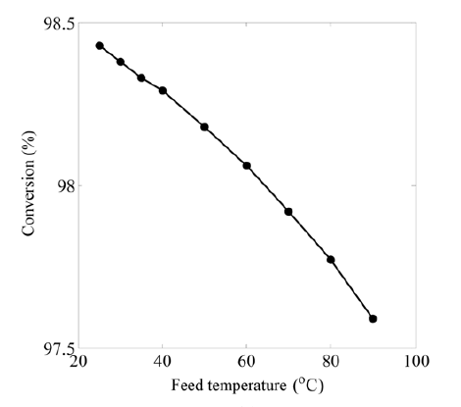
Performance

Slide 14
Summary
The model shows the same trends as in the literature.
The model is not ideal and some challenges still exists.
The chemical equilibrium needs to be modelled a different way to get more accurate results.

Slide 15


Slide 16
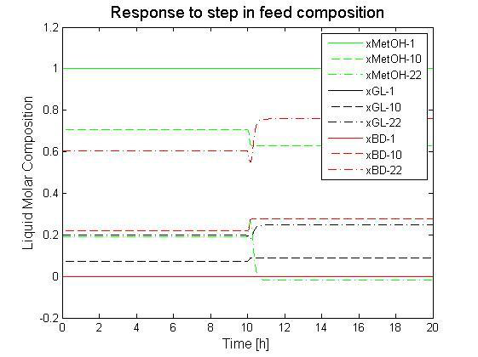

Slide 17


Francis weir

