Slide 1
Specialization project 2012
Temperature control of an unstable chemical reactor
By
Ola Sæterli Hjetland
Supervisors: Sigurd Skogestad, Krister Forsman
and Vinicius de Oliveira

Slide 2
Project description
Create a simple, generic Matlab model of an unstable CSTR
Simulate PI and PID control of the process
Propose a simple way to obtain tuning parameters

Slide 3
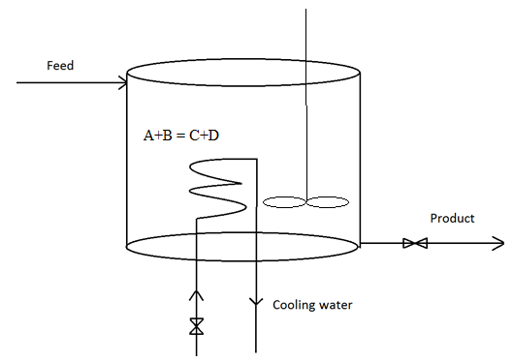
Process Description

Slide 4
Control Structures
Power control
Cooling input is linear
CW flowrate control
Cooling input is highly non-linear

Slide 5
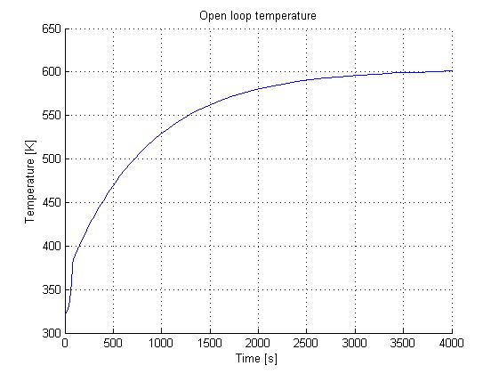
Open Loop Behaviour

Slide 6
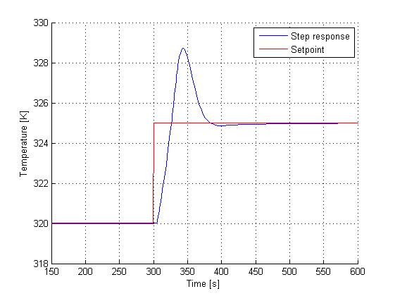
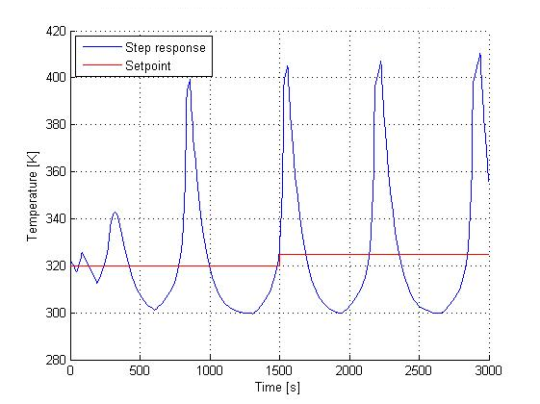
SIMC Tuning
Step in input at the open loop steady state
Power control CW flow control

Slide 7
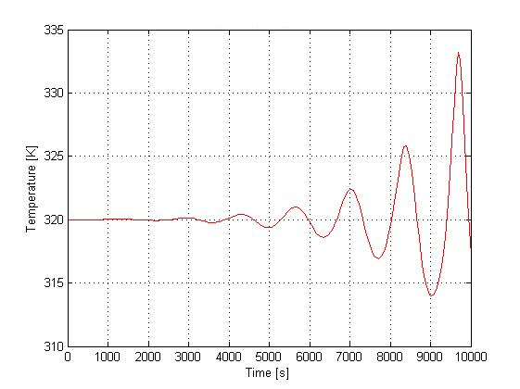
Linearization and Transfer Functions
Identify the operating point (x₀, u₀)
TF linking T and u (cooling power or CW flow rate)
Power control
CW flow control

Slide 8
Tuning Procedures
SIMC (non-linearized, open loop)
Shams* (Linearized, closed loop)
min(L_{d}) (Linearized, open loop Nyquist plot)
*Shamsuzzoha, M., Skogestad, S. A simple approach for on-line PI controller tuning using closed-loop setpoint responses, ESCAPE20, 2010

Slide 9
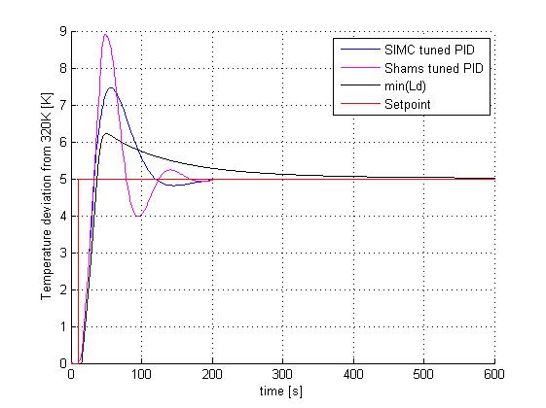
Setpoint Response
5 K increase in temperature setpoint

Slide 10
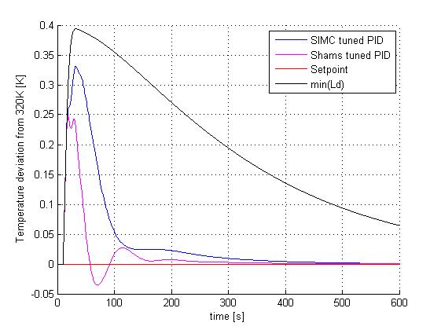
Disturbance Rejection
+10% increased feed

Slide 11
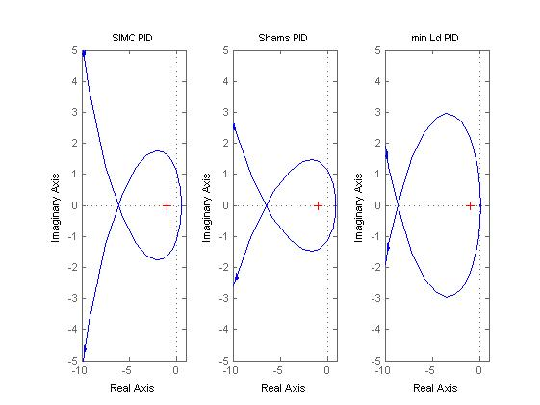
Stability

Slide 12
Conclusion and Further Work
Shams tuning procedure seems like the most promising
Dynamics for valves, sensors etc.
CW flow control
Tuning

